Slide 1
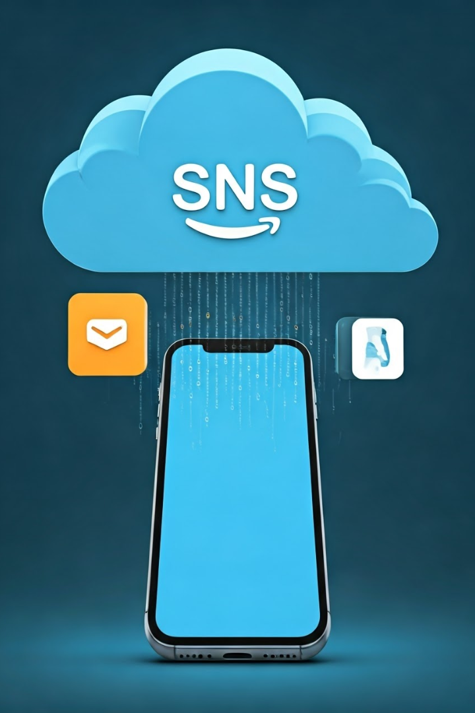

AWS SNS + SMS Subscription
AWS SNS (Simple Notification Service) is a cloud service that sends messages (notifications) to users through different channels like SMS (text messages), emails, and push notifications.
by Ram N Java

Slide 2




What is AWS SNS + SMS?
AWS SNS allows you to send SMS messages to mobile phones worldwide.
You can send messages to one phone number or multiple users using a Topic Subscription.
Example: A company can use SNS to send alerts, OTPs, or promotional messages to customers.

Slide 3
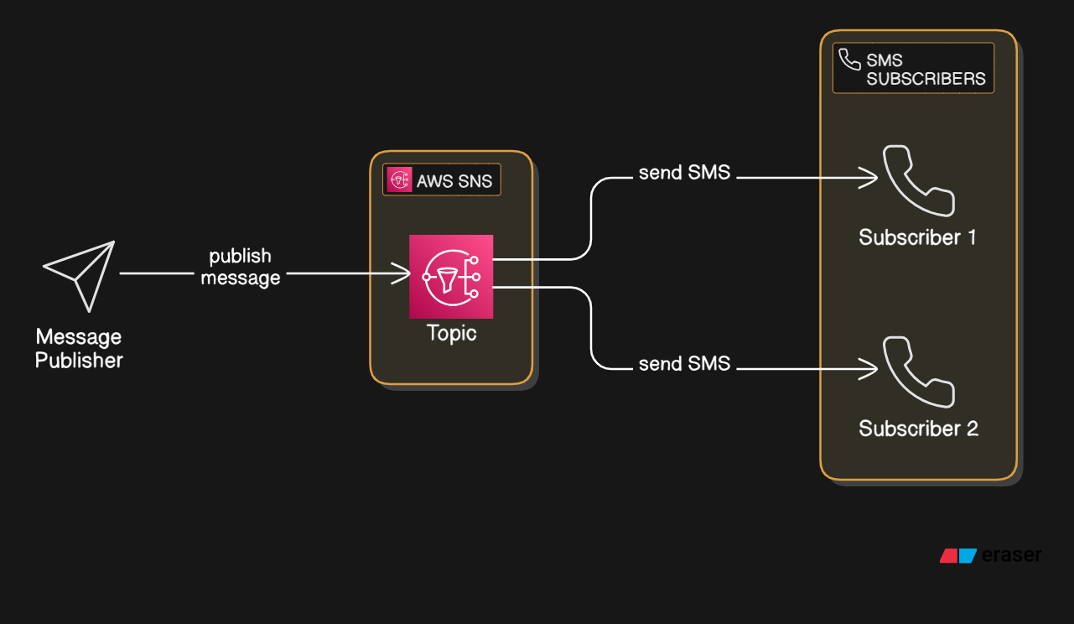


Slide 4
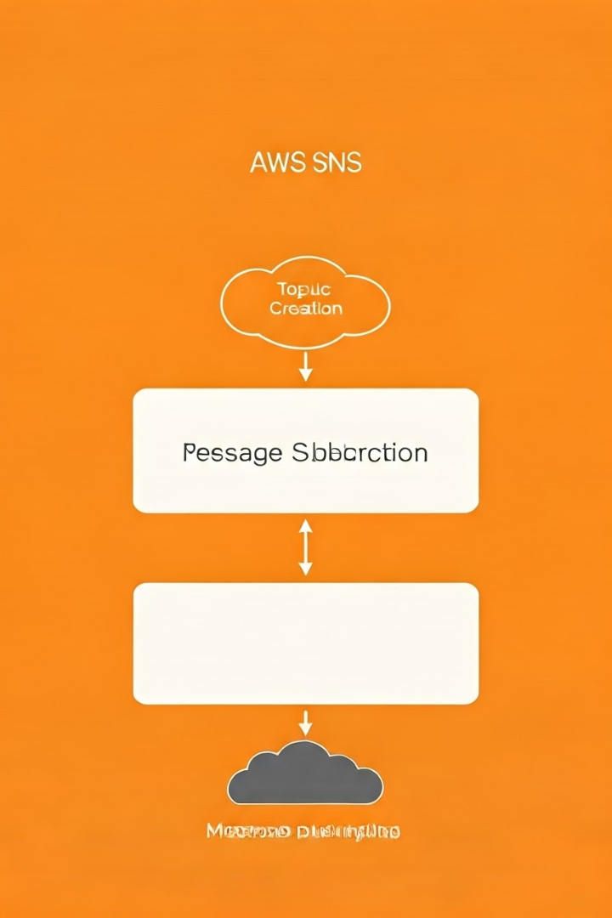



How Does
SMS Subscription Work?
Step 1: Create an SNS Topic
(A topic is like a channel for sending messages)
Step 2: Subscribe phone numbers to the topic
(Users agree to receive SMS)
Step 3: Publish a message to the topic
(SNS sends it to all subscribers)

Slide 5
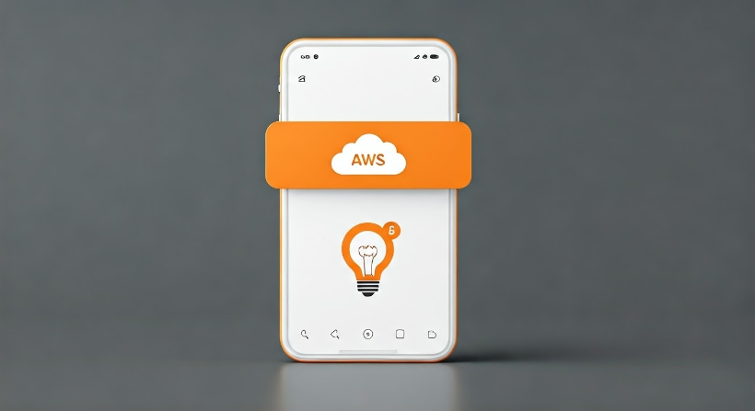
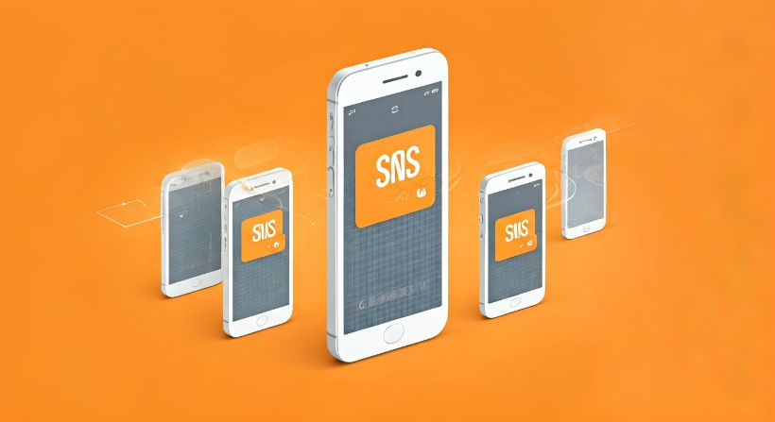
Ways to Send SMS Using AWS SNS
1. Direct SMS (No Topic Needed)
2. Topic-Based SMS Subscription
Send a message directly to a phone number.
Create an SNS topic and add multiple phone numbers.
Best for one-time notifications like OTPs or alerts.
Best for bulk messaging like promotions or service updates.

Slide 6

Key Features
Global SMS Support
Send messages worldwide.
Scalable
Can handle thousands of messages at once.
Cost-Effective
Pay only for what you use.
Easy Integration
Works with applications, websites, and AWS services.

Slide 7





Example Use Cases
OTP Verification
Order Updates
Emergency Alerts
Marketing Messages
Notify customers about orders or deliveries.
Send security codes to users.
Send urgent messages to people.
Send promotions and discounts to customers.

Slide 8
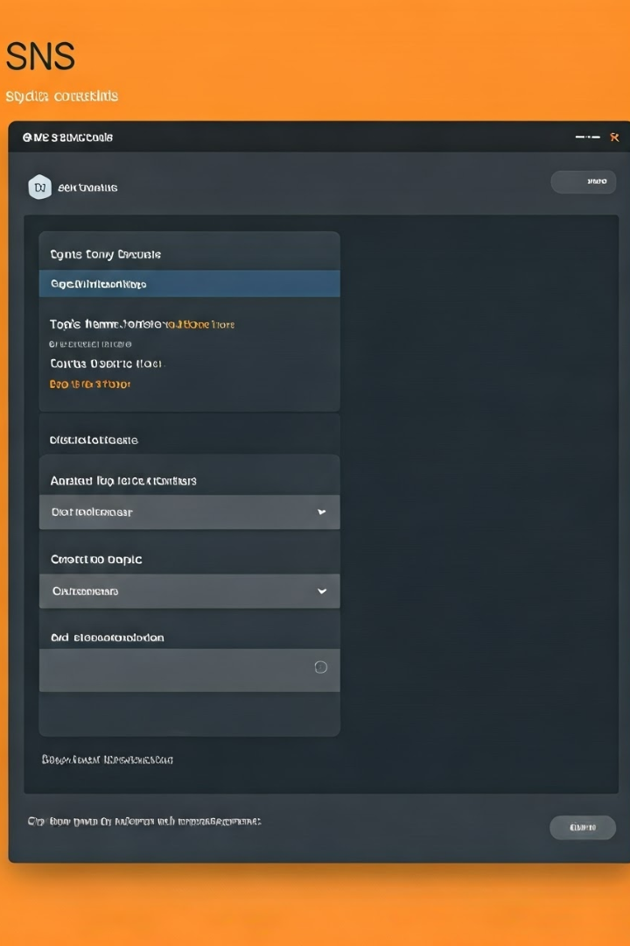
How to Set Up AWS SNS for SMS?
Step 1: Sign in to AWS Console.
Step 2: Go to SNS and create a Topic (optional).
Step 3: Add phone numbers as subscribers.
Step 4: Publish a message and test SMS delivery.

