Slide 1


Wi-Fi vs Ethernet
What is Wi-Fi?
Wi-Fi lets you connect to the Internet without wires. Your device uses radio signals to talk to the Wi-Fi router.
You can move around your home or office and still stay connected.
by Ram N Java

Slide 2
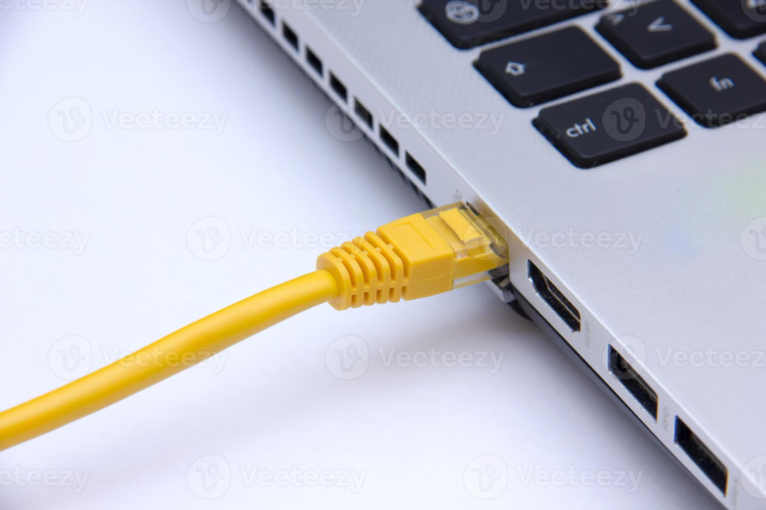
What is Ethernet?
Ethernet uses a physical cable to connect your device to the Internet. One end of the cable goes into your computer or laptop, and the other end goes into the router.
It is a wired connection.

Slide 3
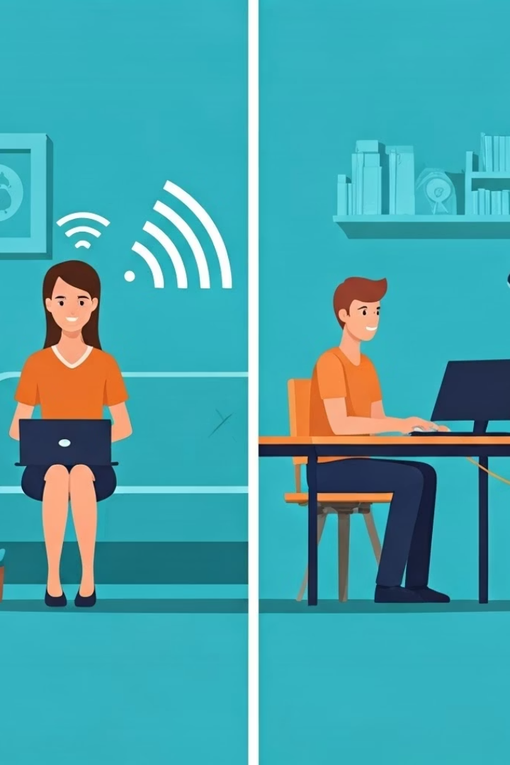
Main Differences Between
Wi-Fi and Ethernet
Speed
Stability
Ethernet is usually faster than Wi-Fi.
Ethernet is more stable because it uses a cable.
Wi-Fi is fast enough for normal tasks like browsing, streaming, or video calls, but Ethernet gives more stable and higher speed.
Wi-Fi can lose signal if you are far from the router or if there are walls or other devices in the way.
Convenience
Wi-Fi is more convenient because there are no wires.
With Wi-Fi, you can move around freely with your phone or laptop.
Ethernet is less flexible because your device must stay near the cable.

Slide 4



Security and Setup Differences
Security
Setup
Ethernet is more secure because it's harder for others to access a wired network.
Wi-Fi is easy to set up, no cables needed.
Ethernet requires a cable, and your device must have an Ethernet port.
Wi-Fi can be less secure unless you use a strong password and encryption.

Slide 5




Which One is Better for You?
Choose Wi-Fi if you want:
Mobility
Easy setup
No cables
Choose Ethernet if you want:
Faster speed
Better stability
Stronger security
Simple Tip
If you're watching videos, browsing, or using your phone — Wi-Fi is enough.
If you're gaming, working from home, or uploading large files — Ethernet is better.

