Slide 1
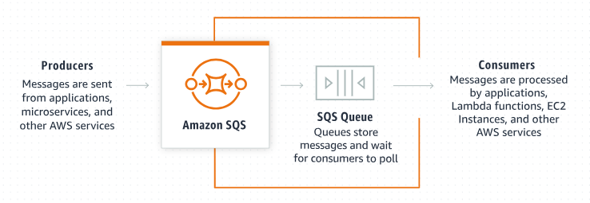
Amazon SQS Message Retention Period: A Beginner's Guide
What is Amazon SQS?
Amazon Simple Queue Service (Amazon SQS) is a fully managed message queuing service provided by AWS (Amazon Web Services).
Amazon SQS allows you to send, store, and receive messages between software components, helping to decouple and scale microservices, distributed systems, and serverless applications.

Slide 2
Amazon SQS Message Retention Period: A Beginner's Guide
What is a Message Retention Period?
The message retention period in Amazon SQS refers to the length of time that a message will be kept in the queue after it has been sent.
If a message is not processed and deleted within this time frame, it will be automatically deleted by the SQS service.
This ensures that your messages are not kept indefinitely, which could lead to unnecessary storage costs and clutter.

Slide 3
Amazon SQS Message Retention Period: A Beginner's Guide
Key Points:
Default Retention Period: By default, Amazon SQS retains messages for 4 days.
Configurable Retention Period: You can configure the retention period from a minimum of 60 seconds (1 minute) to a maximum of 1,209,600 seconds (14 days). This flexibility allows you to adjust the retention period based on your application's requirements.
Why Retention Period Matters:
Ensures Timely Processing: It ensures that messages are processed within a certain period. If a message is not processed within the retention period, it might indicate an issue with the processing logic or application.
Manages Storage Costs: Longer retention periods mean more storage space and potentially higher costs, so setting an appropriate retention period helps manage costs.
Data Freshness: In some applications, old messages might become irrelevant or stale. Setting a suitable retention period ensures that only relevant data is processed.

Slide 4
Amazon SQS Message Retention Period: A Beginner's Guide
Example Scenario:
Imagine you have an e-commerce application that processes orders. You want to ensure that all orders are processed within a week. You can set the message retention period to 7 days.
If any order message is not processed within this period, it will be deleted automatically, signaling you to check for any issues in the order processing system.

Slide 5
Amazon SQS Message Retention Period: A Beginner's Guide
How to Set the Retention Period:
You can set the message retention period when you create a new queue or update the settings of an existing queue via the AWS Management Console, AWS CLI, or SDKs.
Using AWS Management Console:
Create a Queue:
Go to the Amazon SQS console.
Click "Create Queue".
In the "Configure Queue" section, set the "Message Retention Period" to your desired value.
Update an Existing Queue:
Go to the Amazon SQS console.
Select the queue you want to update.
Click on "Queue Actions" and select "Configure Queue".
Update the "Message Retention Period" and save changes.

Slide 6
Amazon SQS Message Retention Period: A Beginner's Guide
Dead Letter Queue Scenario:
The expiration of a message is always based on its original enqueue timestamp. When a message is moved to a dead-letter queue, the enqueue timestamp remains unchanged.
For example, if a message spends 1 day in the original queue before being moved to a dead-letter queue, and the retention period of the dead-letter queue is set to 4 days, the message is deleted from the dead-letter queue after 3 days. For this reason, we recommend that you always set the retention period of a dead-letter queue to be longer than the retention period of the original queue.

Slide 7
Amazon SQS Message Retention Period: A Beginner's Guide
Summary:
The message retention period in Amazon SQS is the time duration for which a message stays in the queue before being automatically deleted.
Configuring it correctly helps in ensuring timely message processing, managing storage costs, and maintaining data relevance. You can easily set or update this period using the AWS Management Console, AWS CLI, or SDKs.

