Slide 1


What is CORS?
CORS (Cross-Origin Resource Sharing) is a security feature implemented by browsers. It allows websites to request data from other websites, but only if the second website gives permission.
Normally, websites are restricted by the Same-Origin Policy, meaning a website can only request data from the same domain (or origin) that it was loaded from. CORS allows developers to bypass this restriction safely, but only when the server
(the second website) says it's okay.
by Ram N Java

Slide 2
CORS Example
Website A's Request
Browser's Action
Website B's Response
Let's say Website A wants to get some data (like an image or information) from Website B, which is on a different domain.
Without CORS, the browser would block that request.
However, if Website B allows it, it will send a special response (CORS header), telling Website A it can access the data.

Slide 3
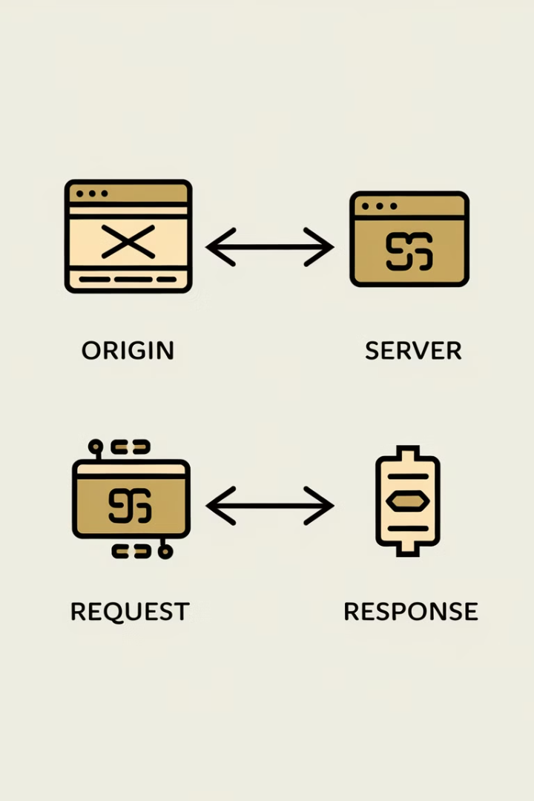
Simple Steps in CORS
1
Step 1
Website A asks Website B for data.
2
Step 2
Website B checks if it's allowed for Website A to access the data.
3
Step 3
If allowed, Website B sends permission to Website A.
4
Step 4
Website A gets the data and uses it.

Slide 4
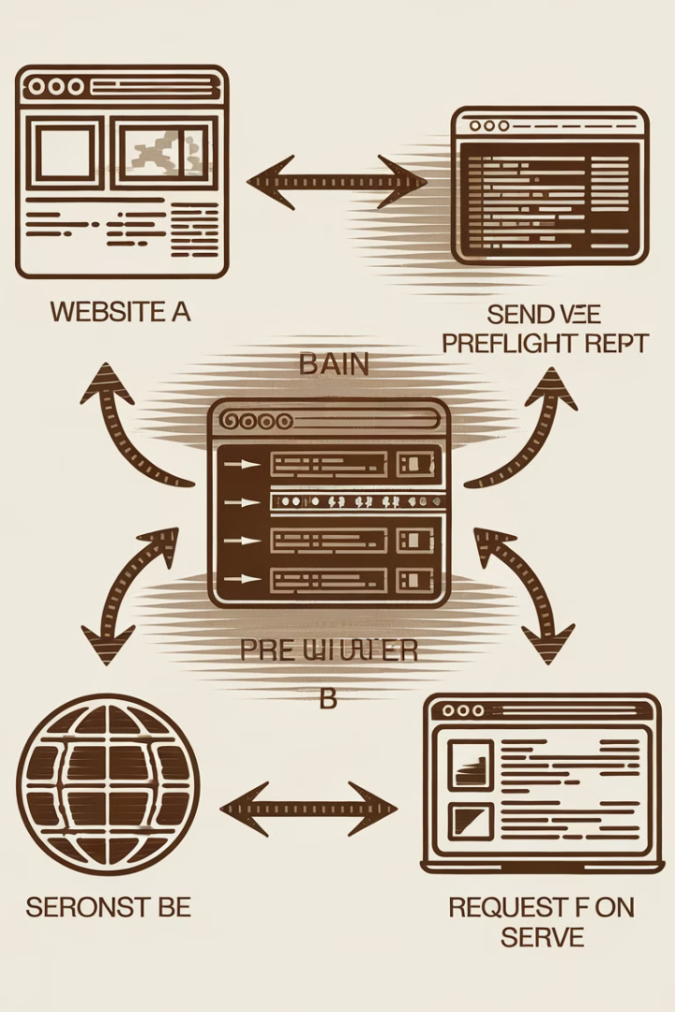
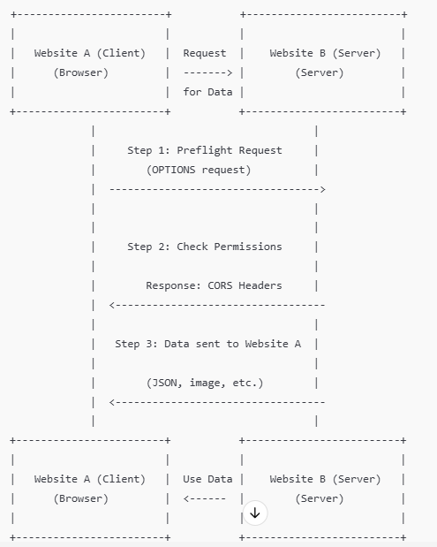
Sequence Diagram of CORS

Slide 5



Breakdown of the CORS Diagram
Website A (Client) sends a request for data to Website B (Server).
This could be an image, text, or other information.
Step 1
If Website A is making a request to a different website (domain), the browser first sends a preflight request (this is an OPTIONS request) to Website B. This checks if Website A is allowed to access the data.
Step 2
Website B checks its settings (CORS policy) and decides whether to allow Website A to access the data. It sends a response with CORS headers like Access-Control-Allow-Origin, saying whether or not the request is allowed.
Step 3
If Website B allows the request, it sends the actual data back to Website A (for example, an
image or some text).
Website A receives the data and uses it, like displaying the image or showing the information on
the page.

Slide 6
Simple Example in Action
News Website Request
1
Website A (like a news website) wants to show weather data from Website B (an API).
2
Data Request
Website A asks Website B for the data.
Preflight Check
3
The browser sends a preflight request to check if Website B allows this request.
4
Permission and Data
Website B sends back permission and the weather data.
Display Weather
5
Website A receives the data and shows the weather info on its page.

Slide 7




Key Points to Remember
Permission
CORS is like asking for permission to access data from another website.
Security
Without CORS, browsers block requests between different websites for security.
Headers
CORS headers are the server's way of saying, "Yes, you're allowed to access this data."
By using CORS, websites can safely share data between different domains.

Slide 8

Conclusion: Understanding CORS
Security Feature
Controlled Access
CORS is a crucial security feature implemented by browsers to allow controlled data sharing between different domains.
It provides a way for websites to request data from other domains, but only with explicit permission from the server.
Safe Data Sharing
CORS enables developers to bypass the Same-Origin Policy restriction safely, promoting secure and efficient data exchange on the web.

