Slide 1
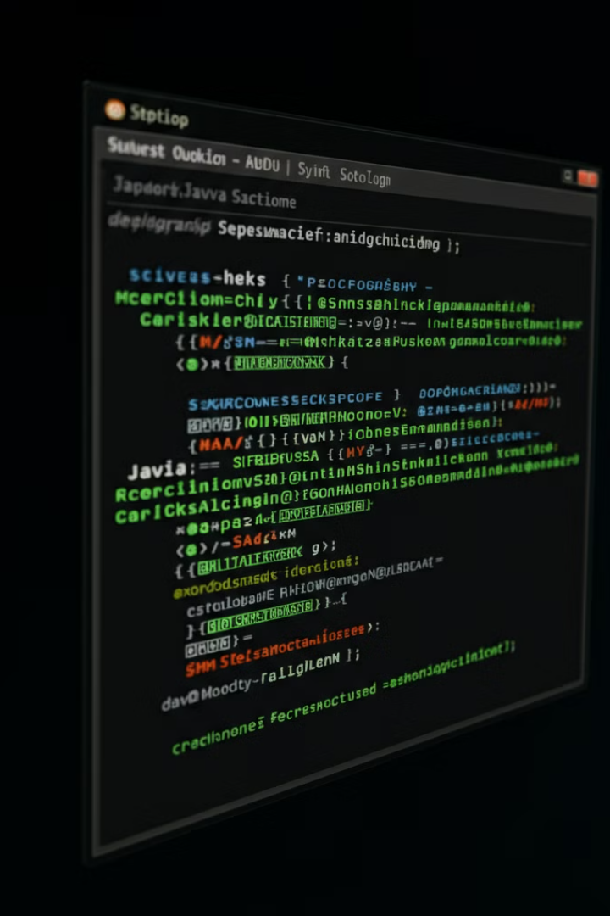

Uninstalling
JDK 21 on Linux
Uninstalling JDK 21 from a Linux system requires careful steps to ensure complete removal. This guide will walk you through the process of identifying the installation path, removing JDK 21, updating environment variables, and verifying the uninstallation.
by Ram N Java

Slide 2

Step 1: Identify the Installation Path
1
Check Java Installation Paths
Before uninstalling JDK 21, you need to confirm where it is installed. If you installed it manually, it's usually located in /opt/ or a custom directory.
2
Run Command
Check for Java installation paths:
sudo update-alternatives --config java This will list the different Java versions installed and their paths.
3
Identify JDK 21 Path
Identify the path for JDK 21, which is something like /opt/jdk-21/.

Slide 3



Step 2: Remove JDK 21
Navigate to Installation Directory
If JDK 21 was installed manually using a .tar.gz file, you can simply delete the folder. Navigate to the directory where JDK 21 is installed:
cd /opt/
Remove JDK 21 Directory
Remove the JDK 21 directory: sudo rm -rf jdk-21 This will completely remove the JDK 21 installation.

Slide 4
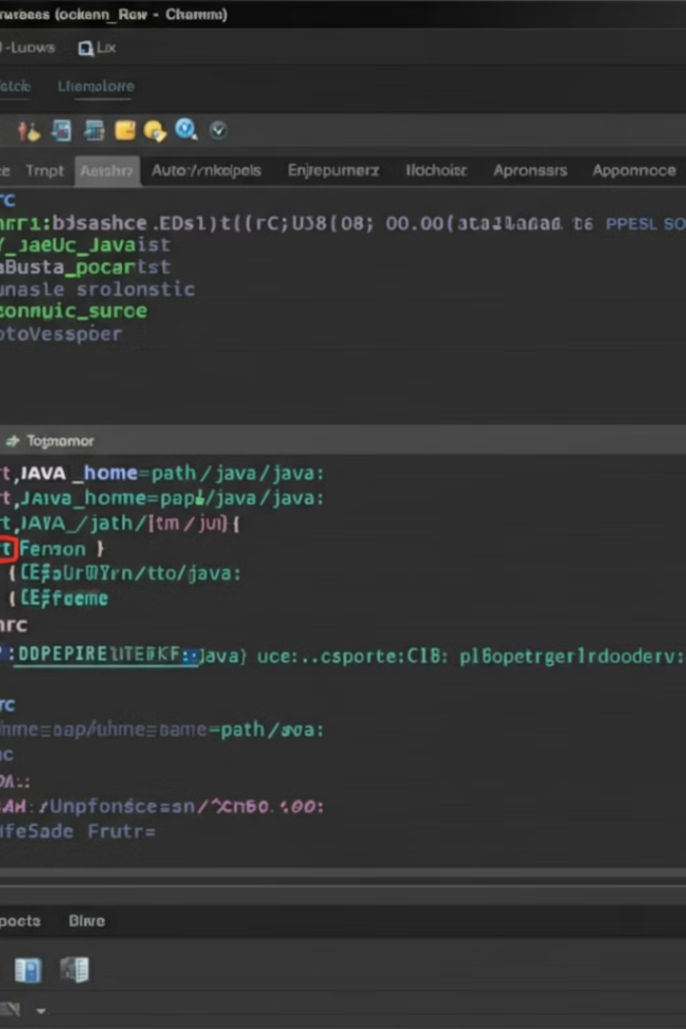
Step 3: Remove Environment Variables (Part 1)
1
Open Environment Variables File
If you had set environment variables such as JAVA_HOME for JDK 21, you should remove or update them. Open the environment variables file (usually /etc/profile or ~/.bashrc, depending on where you set them): sudo nano /etc/profile
2
Locate JDK 21 Related Lines
Look for any lines related to JDK 21, like:
export JAVA_HOME=/opt/jdk-21
export PATH=$PATH:$JAVA_HOME/bin
3
Remove or Comment Out Lines
Remove or comment out those lines by adding # at the beginning of the line, or delete them.

Slide 5

Step 3: Remove Environment Variables (Part 2)
1
Save and Exit
Save and exit by pressing CTRL + X, then Y to confirm changes, and hit Enter.
2
Reload Environment Variables
Reload the environment variables:
source /etc/profile

Slide 6
Step 4: Update Alternatives
Remove Java Alternative
Remove Javac Alternative
If JDK 21 was added to the alternatives system, remove it using the following commands:
Remove the JDK 21 alternative for javac:
sudo update-alternatives --remove javac /opt/jdk-21/bin/javac
Remove the JDK 21 alternative for java:
sudo update-alternatives --remove java /opt/jdk-21/bin/java

Slide 7
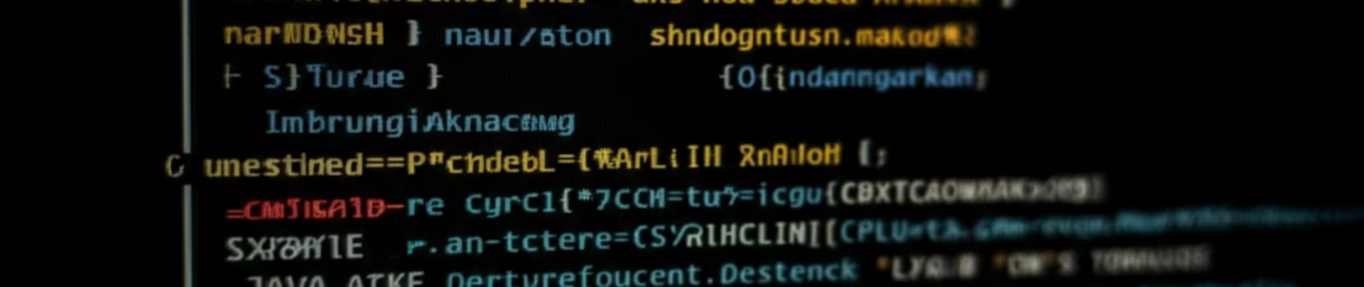
Step 5: Verify Uninstallation
Run Java Version Check
Interpret Results
Finally, check to make sure JDK 21 has been removed: Run: java -version
If JDK 21 was the only Java version installed, this should return an error message or point to a different Java version if installed.

Slide 8




Conclusion
Successful Uninstallation
By following these steps, you should have successfully uninstalled JDK 21 from your Linux system.
Switch to Another JDK
If you need to switch to another JDK version, you can install it and update your JAVA_HOME and alternatives accordingly.
Linux System Maintenance
Regularly maintaining your Linux system by removing unused software helps keep it clean and efficient.

