Slide 1
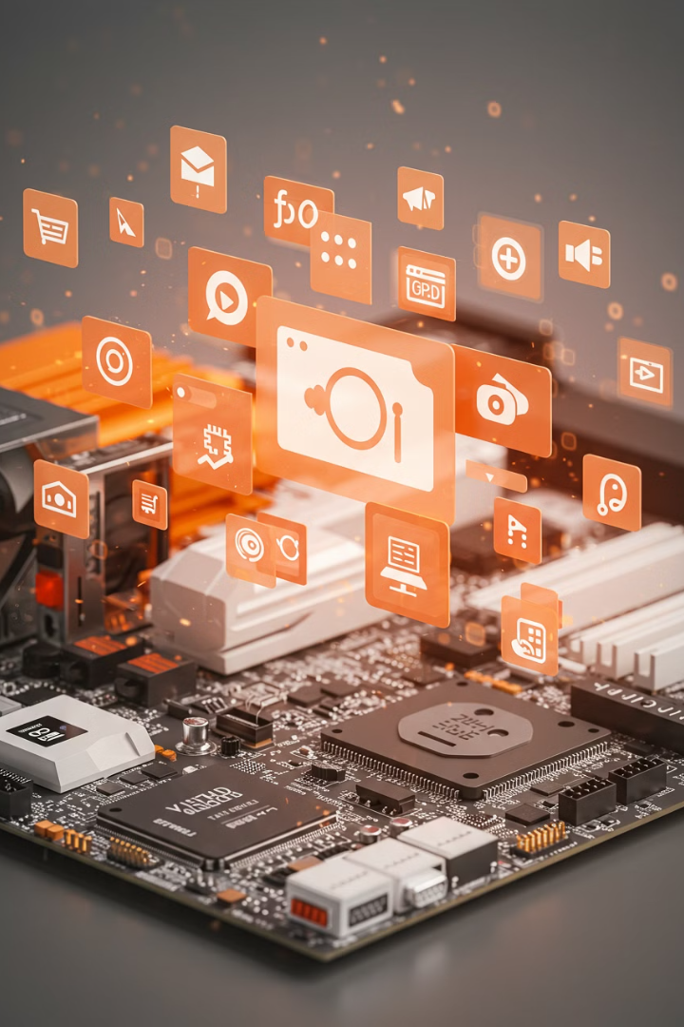

Computer
Hardware vs Software – What's the Difference?
A computer has two main parts: Hardware and Software. Both work together to make a computer function.
by Ram N Java

Slide 2







Hardware
Monitor
Keyboard
Mouse
Displays images and text.
Used for typing.
Helps to click and move things.
CPU (Central Processing Unit)
RAM (Random Access Memory)
Hard Drive or SSD
Stores files and programs permanently.
The brain of the computer, which processes data.
Helps the computer run fast by temporarily storing data.
Printer, Speakers, Webcam
Additional devices for output.
Example: If a computer is like a human, hardware is like the body (hands, eyes, brain, etc.).

Slide 3
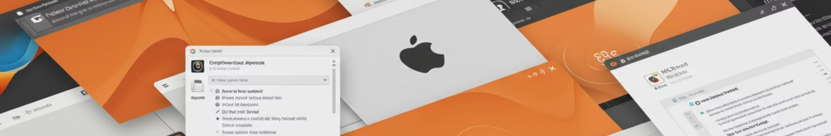
What is Software?
Operating System (OS)
Applications (Apps)
Manages the computer (e.g., Windows, macOS, Linux, Android).
Programs used for tasks (e.g., MS Word, Google Chrome, WhatsApp).
System Software
Games & Multimedia Software
Helps the hardware run smoothly.
For entertainment and creativity.
Software is the set of instructions that tell the computer what to do. It is not physical and cannot be touched.
Example: If a computer is like a human, software is like the mind (thoughts, ideas, and instructions).

Slide 4
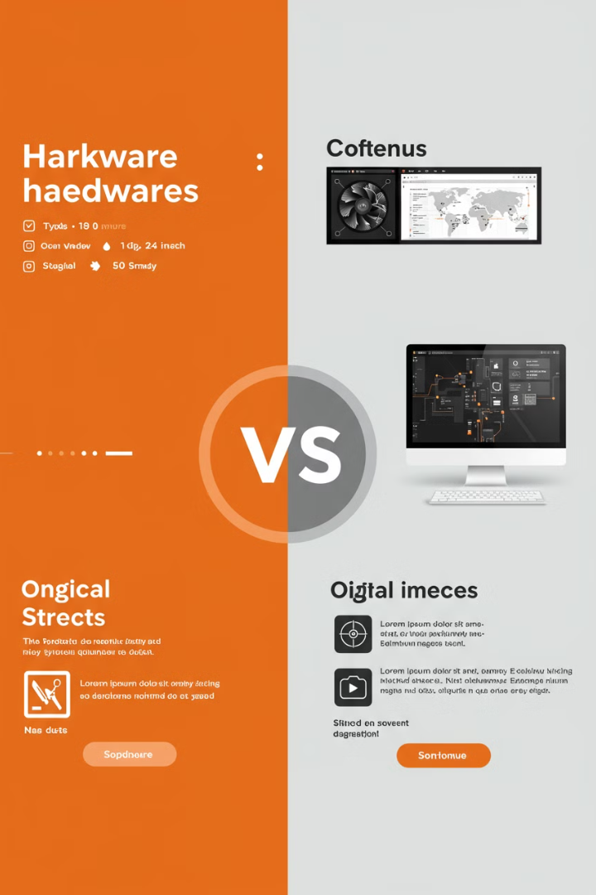
Key Differences Between Hardware and Software
Feature
Hardware
Software
What is it?
Physical parts of a computer
Programs and instructions
Can you touch it?
Yes
No
Examples
CPU, RAM, Monitor, Keyboard
Windows OS,
MS Word, Google Chrome
Function
Helps in running and processing data
Tells hardware what to do
Failure Effect
Can be repaired or replaced
Can be reinstalled or updated

Slide 5
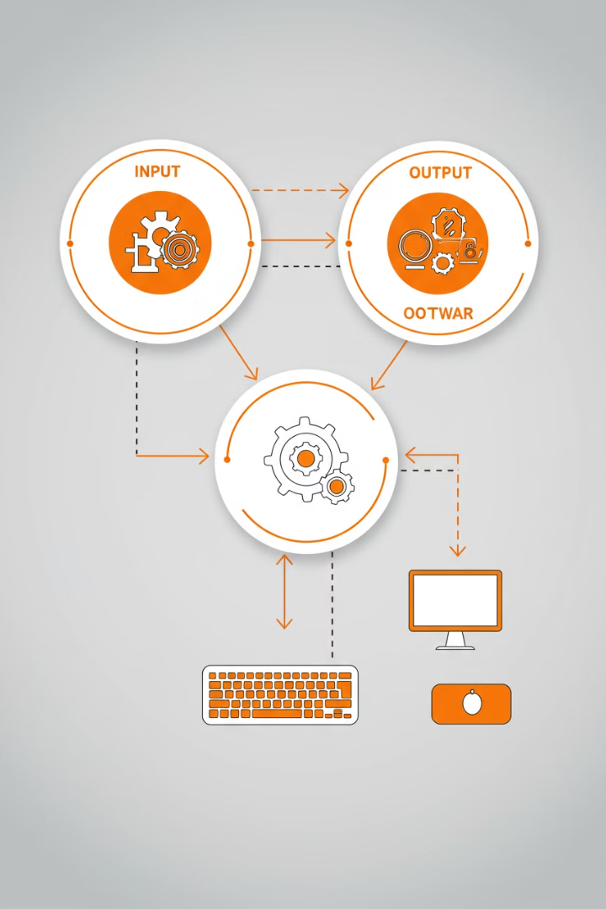



How Hardware and Software Work Together
You Give Input
You use hardware (like a keyboard or mouse) to give instructions to the computer.
Example: You type a letter using the keyboard.
Software Processes It
The software (like a word processor) takes the input and processes it.
Example: The word processor saves the letter you typed.
Hardware Shows Output
The hardware (like the monitor or printer) shows or gives you the result.
Example: You see the letter on the screen or print it on paper.
Both hardware and software need each other. A computer cannot work without both.
✔ Hardware needs software to function.
✔ Software needs hardware to run.

Slide 6






Why is This Important?
They Need Each Other
Hardware and software must work together for the computer to function.
Software is the Mind
Without software, the hardware wouldn't know what to do.
Hardware is the Body
Without hardware, the computer wouldn't exist.
Example: A monitor (hardware) needs software to display images, and software needs a monitor to show results.

Slide 7






Conclusion
Software
The mind of the computer
Hardware
The body of the computer
Working Together
Makes a computer useful!

