Slide 1
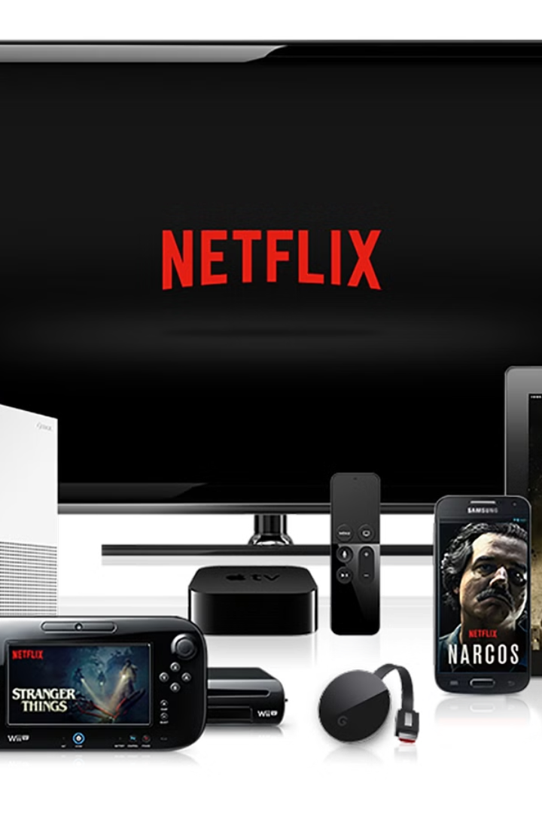

Designing a System Like Netflix: A Simple Guide
Designing a system like Netflix may sound complex, but let's break it down into simple steps so it's easy to understand. Netflix is an online platform that lets you watch movies and
TV shows on demand. To make this happen, Netflix uses a system design that ensures millions of users can stream smoothly at the same time. Here's how it works:
by Ram N Java

Slide 2
What Does Netflix Need to Do?
Store movies and TV shows (content)
Allow users to browse and search for content
Stream videos smoothly, even if millions of people are watching
Personalize recommendations for each user
Handle payments and user accounts

Slide 3
Key Parts of Netflix's System Design
Think of the system as a group of interconnected parts working together:
A. Content Storage
B. Content Delivery Network (CDN)
C. User Management
Netflix stores videos in data centers or the cloud (like AWS).
Users create accounts, log in, and manage their profiles.
When you watch a movie, the video comes from a CDN, not the central server.
Netflix keeps this information in a database.
These videos are saved in multiple locations worldwide so they are closer to the users.
A CDN is a network of servers spread across the globe. It helps stream videos faster by delivering them from the nearest server.

Slide 4

More Key Parts of Netflix's System Design
D. Recommendation System
E. Video Streaming
Videos are broken into small chunks and sent to your device one at a time. The system adapts the video quality based on your internet speed (this is called adaptive streaming).
Netflix uses AI and algorithms to suggest what you might like based on your viewing history. This happens by analyzing big data—like what you've watched, searched for, or rated.
F. Payment and Subscriptions
A secure system handles your payments and keeps track of your subscription.

Slide 5




How Does Netflix Handle Millions of Users?
Scalability
Load Balancing
Constant Monitoring
Netflix is scalable, meaning it can handle more users by adding more servers.
It uses load balancers to distribute user requests across multiple servers.
Netflix monitors its system constantly to fix issues before they affect users.

Slide 6
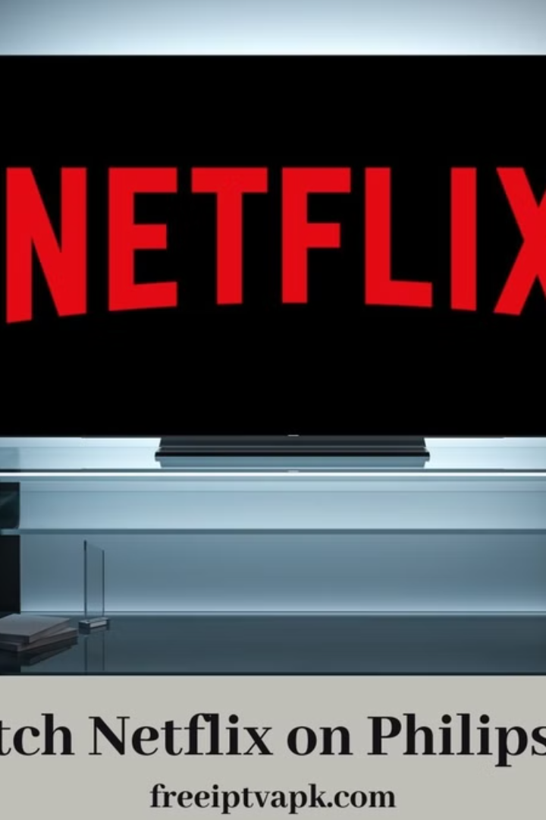
What Happens When You Watch a Movie?
Here's a simple step-by-step flow:
1
You open Netflix and log in
Netflix's database retrieves your account details
and profile.
2
You search for a movie
The recommendation system shows personalized
suggestions.
3
When you press play
Netflix checks the nearest CDN server with the movie.
The video streams to your device in chunks.
The adaptive streaming system adjusts the video quality based on your internet speed.

Slide 7





Why Does Netflix Work So Well?
CDN Servers
Scalability
AI Algorithms
Cloud Storage
Make streaming fast and reliable.
Allows Netflix to handle millions of users.
Personalize your experience.
Ensures there's enough space for all the movies and TV shows.

Slide 8

Netflix in Simple Words
Netflix is like a smart library where:
Movies and shows are stored on shelves (servers) worldwide
When you request a movie, it's fetched from the closest shelf
Netflix's system adapts to give you the best viewing experience based on your device and internet speed

