Slide 1
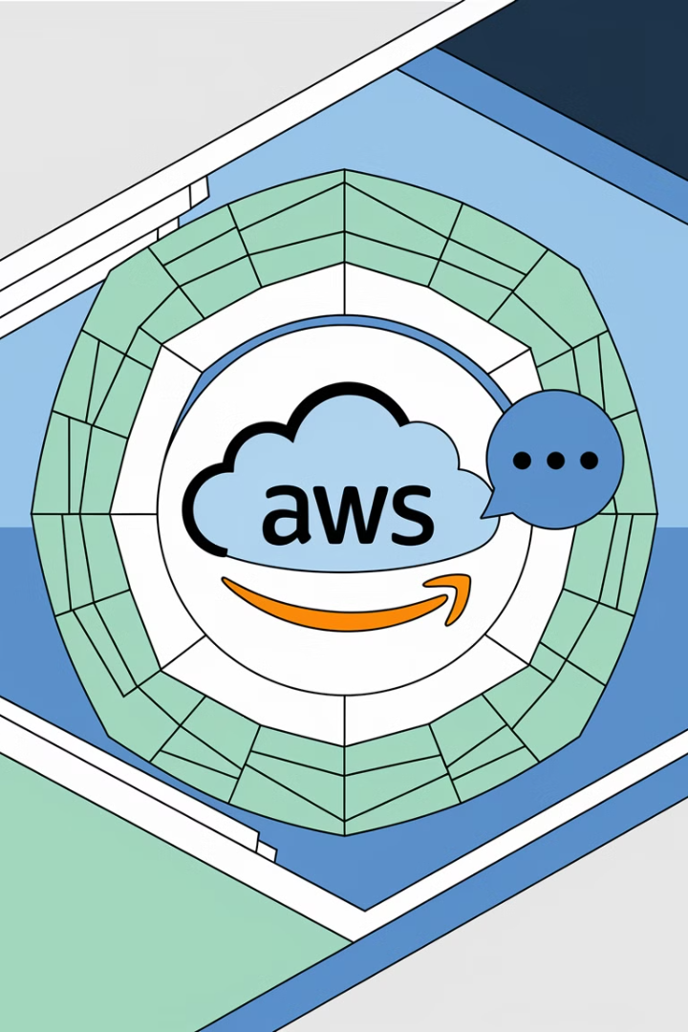

What is AWS SNS?
AWS SNS stands for Amazon Simple Notification Service. It is a messaging service provided by Amazon Web Services (AWS) that helps you send notifications or messages to multiple people or systems at once.
by Ram N Java

Slide 2
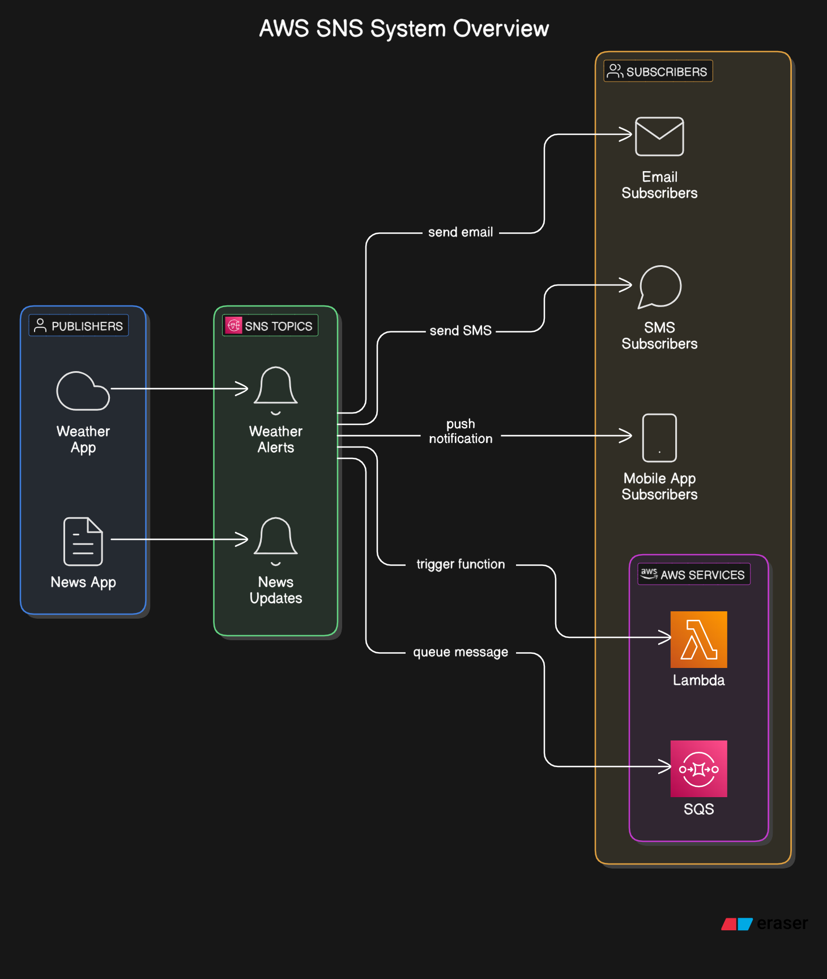

Slide 3

How Does AWS SNS Work?
1
Publishers and Subscribers:
2
Topics:
3
Delivery:
A topic is like a channel or a group where messages are sent.
SNS can send messages to multiple devices or services like:
Publishers are the ones who send messages. For example, a weather app sending weather alerts.
Publishers send messages to a topic, and all subscribers of that topic receive the message.
Email
SMS (text messages)
Subscribers are the ones who receive the messages. For example, you or a system that needs the weather alert.
Mobile apps (via push notifications)
Other AWS services (like Lambda or SQS)

Slide 4





Why Use AWS SNS?
Broadcast Messages:
Flexible Delivery:
Reliable:
Scalable:
You can send a single message to many people or systems at once. For example, sending a notification to all users of an app.
SNS can send messages to different platforms like email, SMS, mobile apps, or other AWS services.
SNS ensures that your messages are delivered quickly and reliably.
It can handle millions of messages at once, making it great for large applications.

Slide 5

Key Features of AWS SNS
Fan-Out Messaging:
Multiple Protocols:
Send one message to multiple subscribers at the same time.
Supports SMS, email, mobile push notifications,
and more.
Integration with AWS Services:
Message Filtering:
Works well with other AWS services like Lambda, SQS, and S3.
Subscribers can receive only the messages they are interested in.

Slide 6

Example Use Case
Weather App
SNS Topic
Subscribers
The weather app (publisher) sends a storm alert to an SNS topic.
Receives the storm alert from the weather app.
Subscribers like users' phones (via SMS), email addresses, and other apps (via push notifications) all receive the alert at the same time.

Slide 7
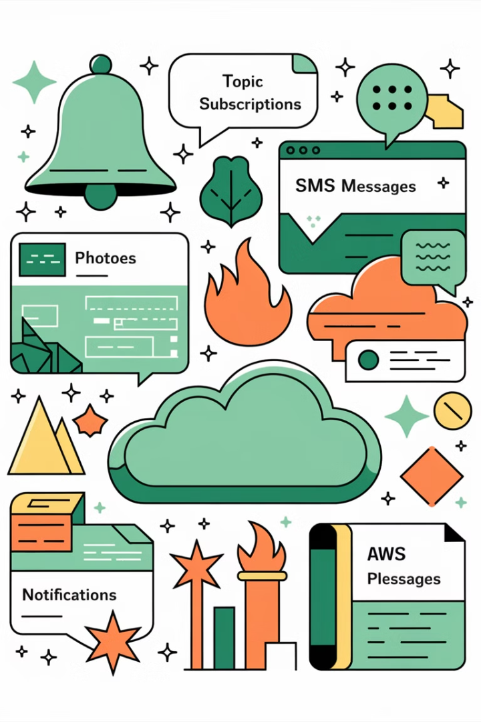
Key Points to Remember
1
AWS SNS is a messaging service for sending notifications.
2
It uses topics to group messages and send them to subscribers.
3
It can send messages to email, SMS, mobile apps, and other AWS services.
4
It is scalable, flexible, and reliable.

