Slide 1
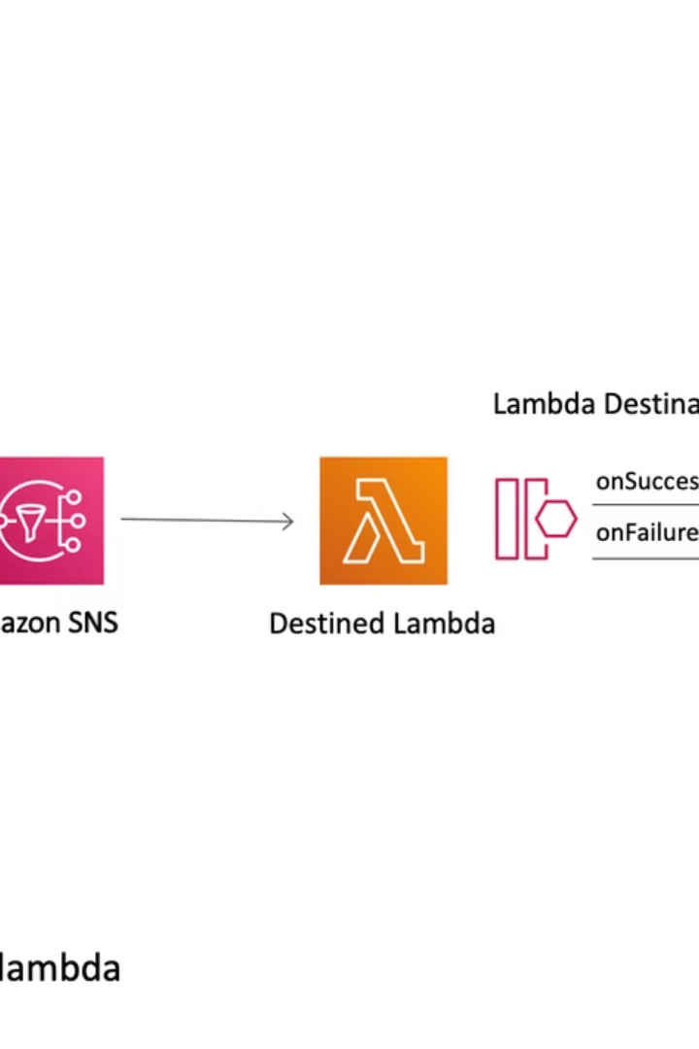

What is AWS SNS Delivery Retry?
AWS SNS Delivery Retry is a feature that ensures your messages are delivered even if the first attempt fails. If a message cannot be delivered to a subscriber
(e.g., due to a network issue or a server being down), SNS will automatically retry sending the message multiple times until it succeeds or reaches the maximum retry limit.
by Ram N Java

Slide 2
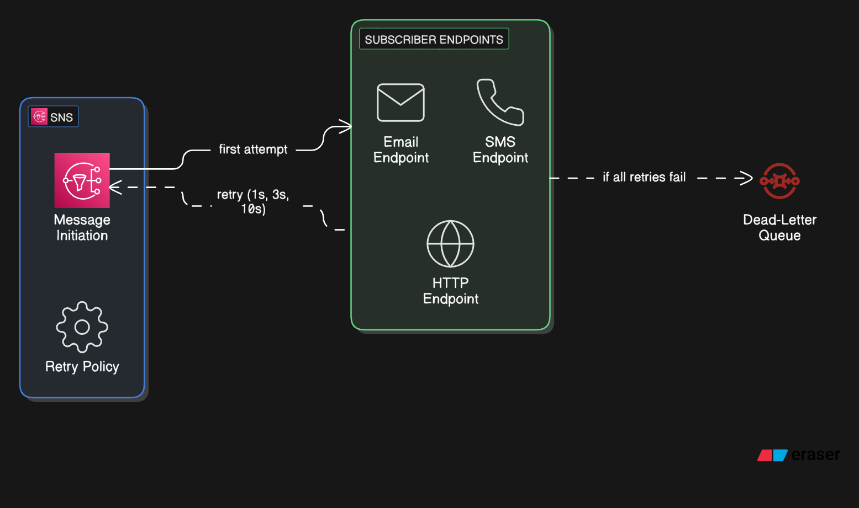

Slide 3
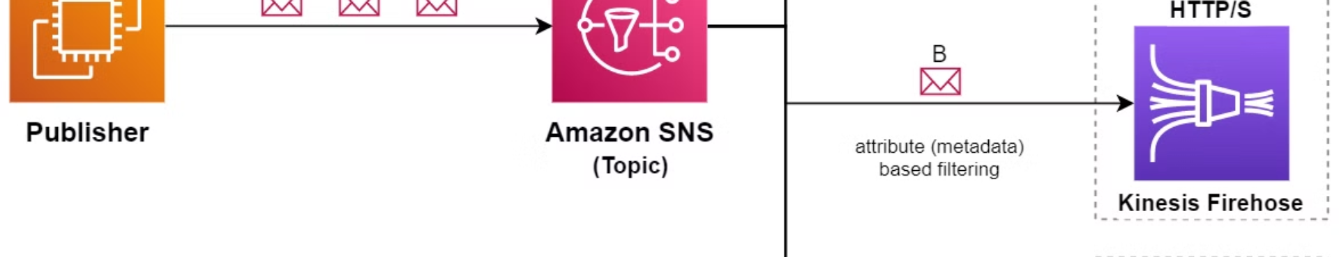
How Does Delivery Retry Work?
Retry Intervals
Retry Attempts
The time between retries increases gradually (e.g., 1 second, 3 seconds, 10 seconds, etc.).
If Delivery Fails
SNS will keep retrying for a specific number of times (retry limit) or until the message is successfully delivered.
First Attempt
SNS waits for a short time and tries again.
SNS tries to deliver the message to the subscriber.

Slide 4

Key Terms to Understand
Retry Policy
Dead-Letter Queue (DLQ)
A set of rules that defines how SNS should retry message delivery.
If a message cannot be delivered even after all retries, it can be sent to a Dead-Letter Queue for further analysis.
Maximum Retries: The total number of times SNS will retry.
Retry Intervals: The time gap between
each retry attempt.

Slide 5
Example of Delivery Retry
Imagine you are sending a weather alert to a subscriber's email:
Initial Attempt
1
SNS tries to send the email, but the email server is temporarily down.
2
First Retry
SNS waits for a few seconds and tries again.
Multiple Retries
3
If the server is still down, SNS retries a few more times.
4
Successful Delivery
If the email server comes back online, the message is delivered successfully.
Dead-Letter Queue
5
If all retries fail, the message is sent to a Dead-Letter Queue for review.

Slide 6
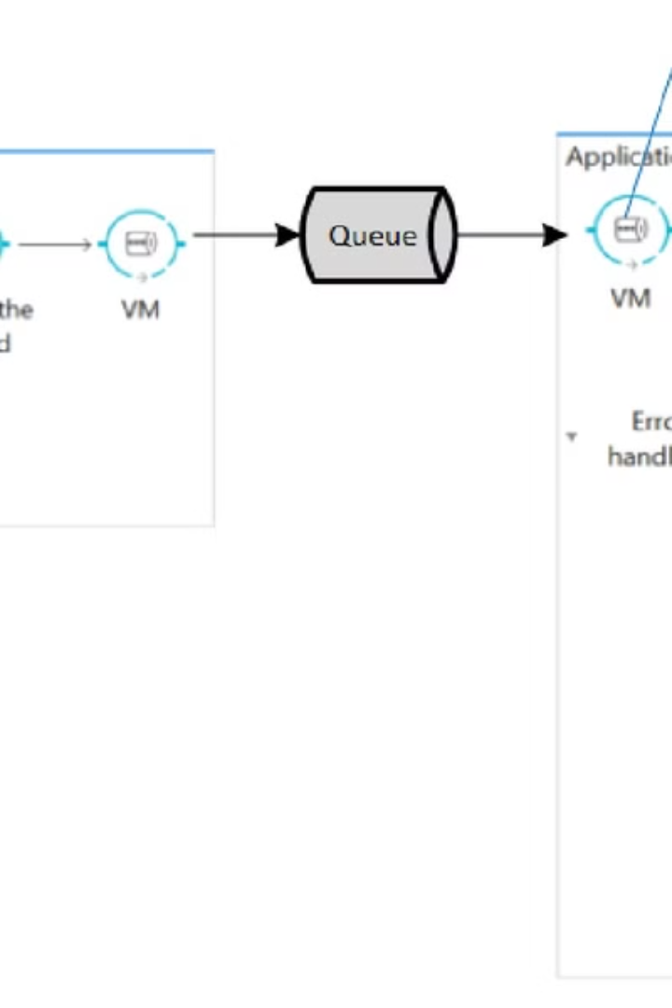
Why is Delivery Retry Important?
1
Reliability
2
No Lost Messages
It ensures that your messages are delivered even if there are temporary issues.
Prevents messages from being lost due to failures.
3
Better User Experience
Subscribers receive important notifications without delays.

Slide 7
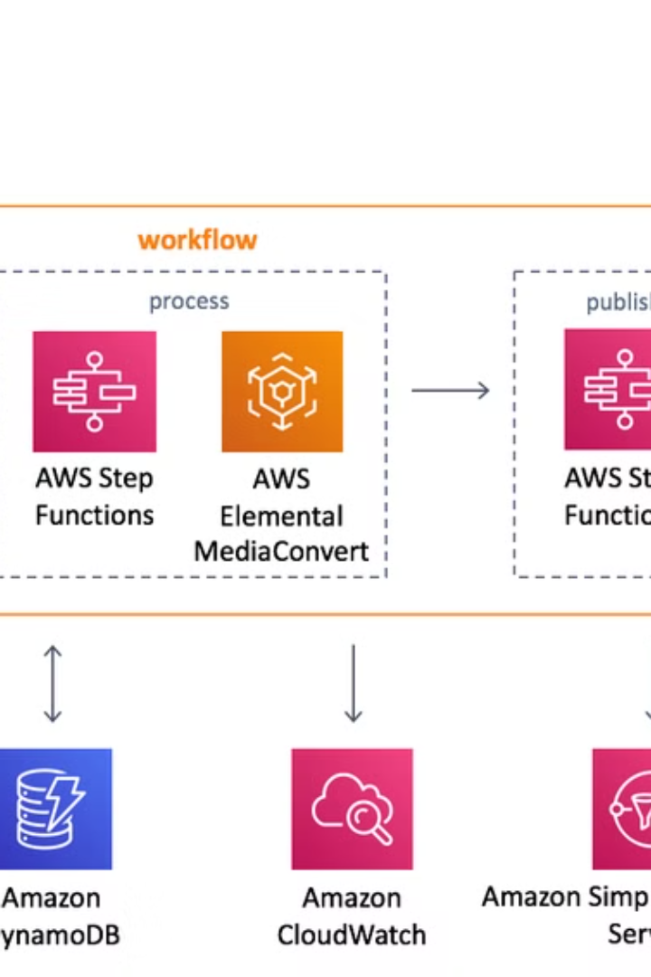
When to Use Delivery Retry
Critical Notifications
Unreliable Networks
For important alerts that must reach the subscriber (e.g., security alerts, payment reminders).
When subscribers are on networks that may experience temporary issues.
High-Volume Messaging
For applications sending a large number of messages where occasional failures are expected.

Slide 8
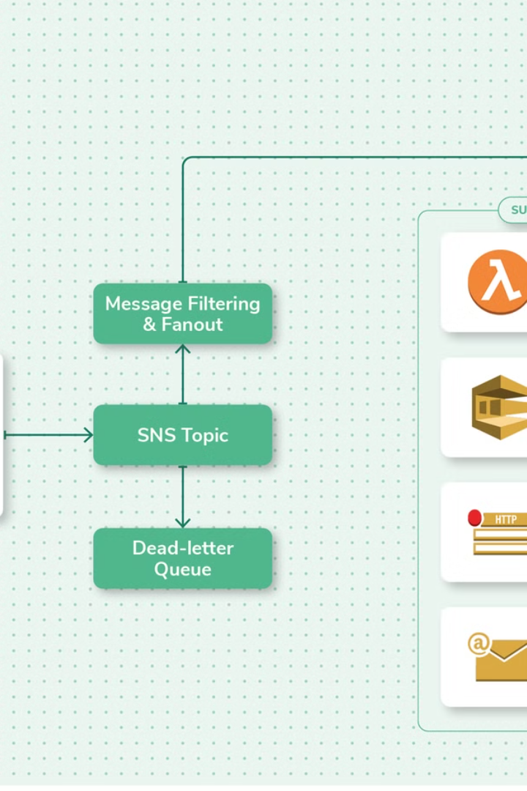
How to Set Up Delivery Retry in AWS SNS
Create a Topic
Set up an SNS topic (e.g., "WeatherAlerts").
Add Subscribers
Add subscribers (e.g., email, SMS, or HTTP endpoints).
Configure Retry Policy
Go to the Delivery retry policy section in the SNS console.
Set the maximum retries (e.g., 3 retries).
Set the retry intervals (e.g., 1 second, 3 seconds, 10 seconds).
Enable Dead-Letter Queue (Optional)
Create an SQS queue to act as a Dead-Letter Queue.
Link the DLQ to your SNS topic to capture failed messages.

Slide 9
Simple Summary
1
AWS SNS Delivery Retry ensures your messages are delivered even if the first attempt fails.
2
It retries sending the message multiple times with increasing delays between attempts.
3
If all retries fail, the message can be sent to a Dead-Letter Queue for further analysis.
4
This feature makes SNS more reliable and ensures no important messages are lost.

