Slide 1
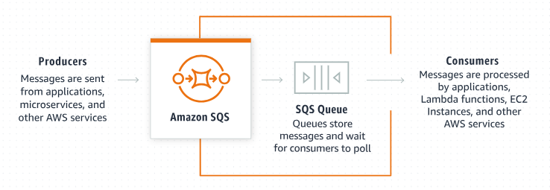
Hold That Message! Understanding Delivery Delays in Amazon SQS
What is Amazon SQS?
Amazon Simple Queue Service (SQS) is a tool provided by Amazon Web Services (AWS) that helps different parts of a computer application communicate by sending messages to each other.
Think of SQS as a post office where you send and receive messages.

Slide 2
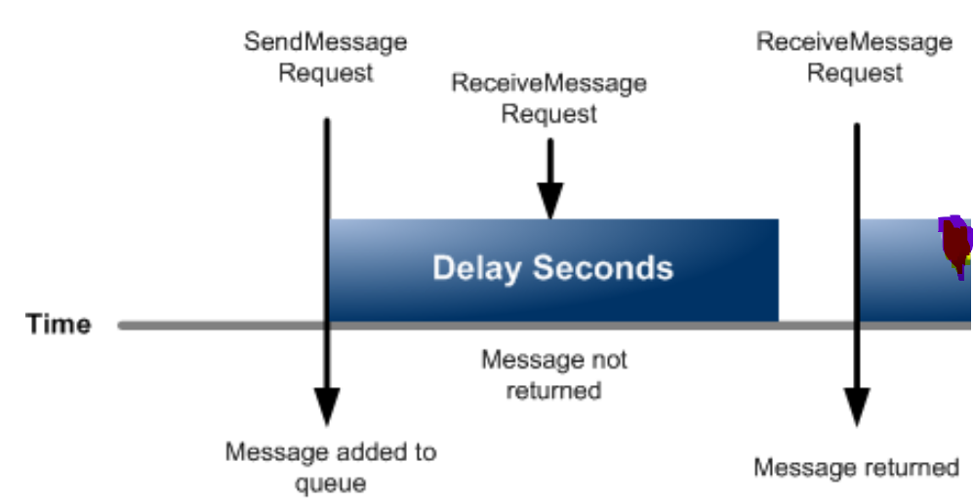
Hold That Message! Understanding Delivery Delays in Amazon SQS
What is Delivery Delay?
Delivery Delay in Amazon SQS is a feature that allows you to delay the delivery of a message for a certain period of time. This means that when you send a message to the queue, it won’t be immediately available to be read. Instead, it will wait for the specified delay time before it can be processed.

Slide 3
Hold That Message! Understanding Delivery Delays in Amazon SQS
How Does It Work?
Sending a Message: When you send a message to the queue, you can specify a delay time. For example, you can say, "Hold this message for 10 seconds before delivering it.“
Waiting Period: The message will sit in the queue for the delay period you specified.
Delivery: After the delay period has passed, the message becomes available for processing by the system.

Slide 4
Hold That Message! Understanding Delivery Delays in Amazon SQS
Real-Life Example
Imagine you have an online shopping website:
Order Confirmation: When a customer places an order, the system sends a confirmation message to the queue.
Delivery Delay: You set a delivery delay of 5 minutes for this message.
Processing the Message: After 5 minutes, the message is processed, and the customer receives a confirmation email.
This delay ensures that if the customer makes any last-minute changes to the order, there is enough time to accommodate those changes before the confirmation email is sent.
System Sends Confirmation
Message
Receive Confirmation
Message
Receive Confirmation
Message
9.00
Confirmation
Message Not returned
9.05
Confirmation
Message added to the Queue
Confirmation
Message Returned

Slide 5
Hold That Message! Understanding Delivery Delays in Amazon SQS
Why Use Delivery Delay?
Timing Control: Sometimes you want to control exactly when a message gets processed. For example, you might want to delay processing to wait for other tasks to complete.
Error Handling: If there’s a chance that something might go wrong immediately after a message is sent, a delay can provide a buffer to catch and fix issues.
Batch Processing: You might want to group tasks and process them together at specific times.

Slide 6
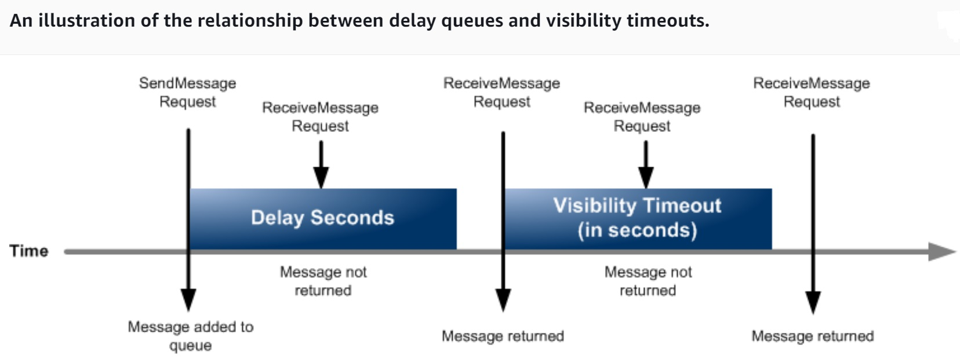
Hold That Message! Understanding Delivery Delays in Amazon SQS
5 mins
1 min
9.00
9.05
9.07
9.08
9.09

Slide 7
Hold That Message! Understanding Delivery Delays in Amazon SQS
Summary
Amazon SQS Delivery Delay allows you to control when messages in the queue are processed. By setting a delay time, you can make sure that messages wait for a specified period before being handled. This feature is useful for timing control, error handling, and batch processing in your applications.

