Slide 1
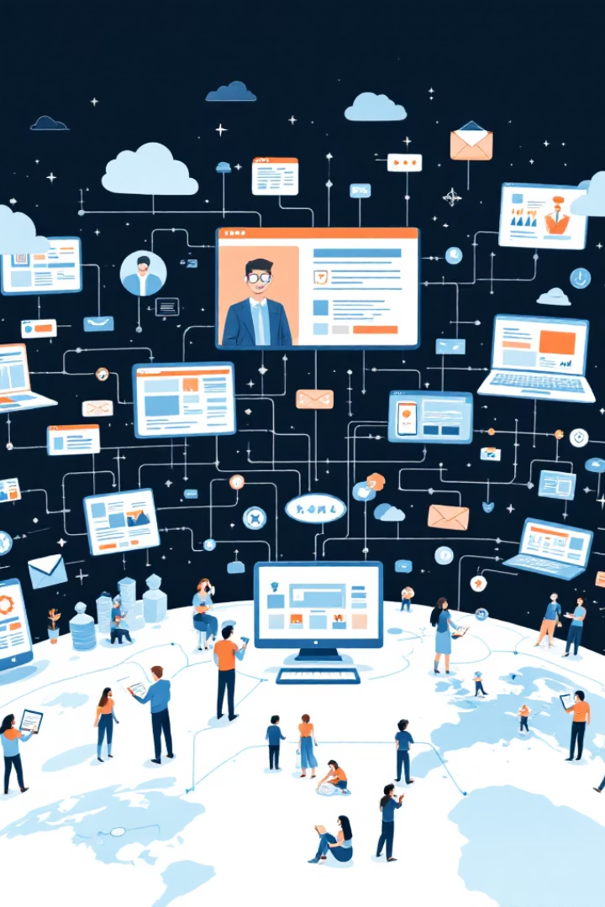

What is the Internet and
How it Works
The Internet is a large network that connects computers, phones, and other devices all over the world.
It allows people to:
Send messages
Watch videos
Read news
Search for information
Use apps and websites
You can think of the Internet like a digital highway system. Your device is like a car driving on these roads to visit different places like websites, apps, or games.
by Ram N Java

Slide 2
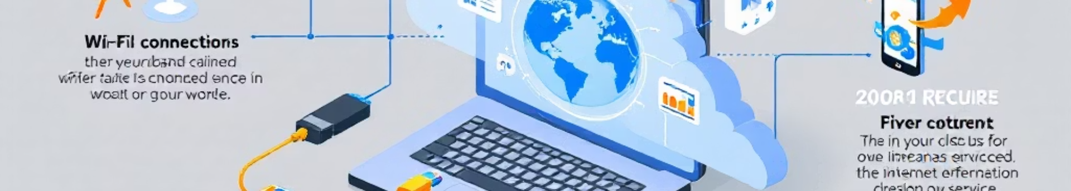
How Does the Internet Work?
1. Your Device Connects to the Internet
2. You Ask for Information
Your computer, phone, or tablet connects to the Internet using:
When you open a website (like www.google.com), your device sends a request to find that website.
Wi-Fi
Mobile data
But websites are not stored on your phone. They live on special computers called servers.
Broadband cable
This connection is provided by an Internet Service Provider (ISP) like Jio, Airtel, ACT, or BSNL.

Slide 3

How Does the Internet Work?
3. Finding the Right Server
4. Getting the Website Data
5.Showing the Website
Each website has a special address called an IP address (like a phone number). When you type a website name, your device asks a DNS server to find the correct IP address.
Your device sends the request to the correct server.
Your web browser (like Chrome or Firefox) puts all the packets together and shows the full website on your screen.
The server sends back the data (text, images, videos) in small parts called packets.
This all happens in just a few seconds.
Then your device knows where to go.
These packets travel through cables, routers, satellites, and signals to reach your device.

Slide 4
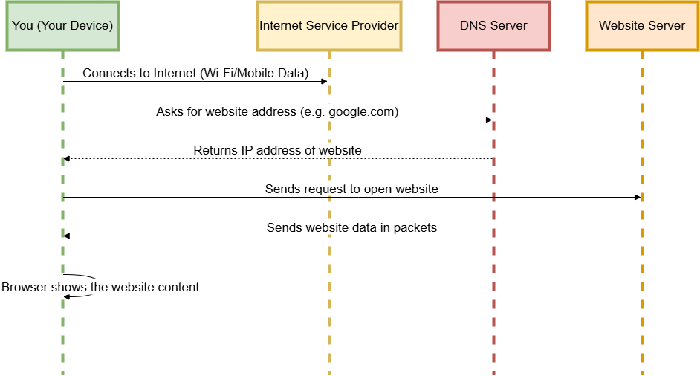

Slide 5
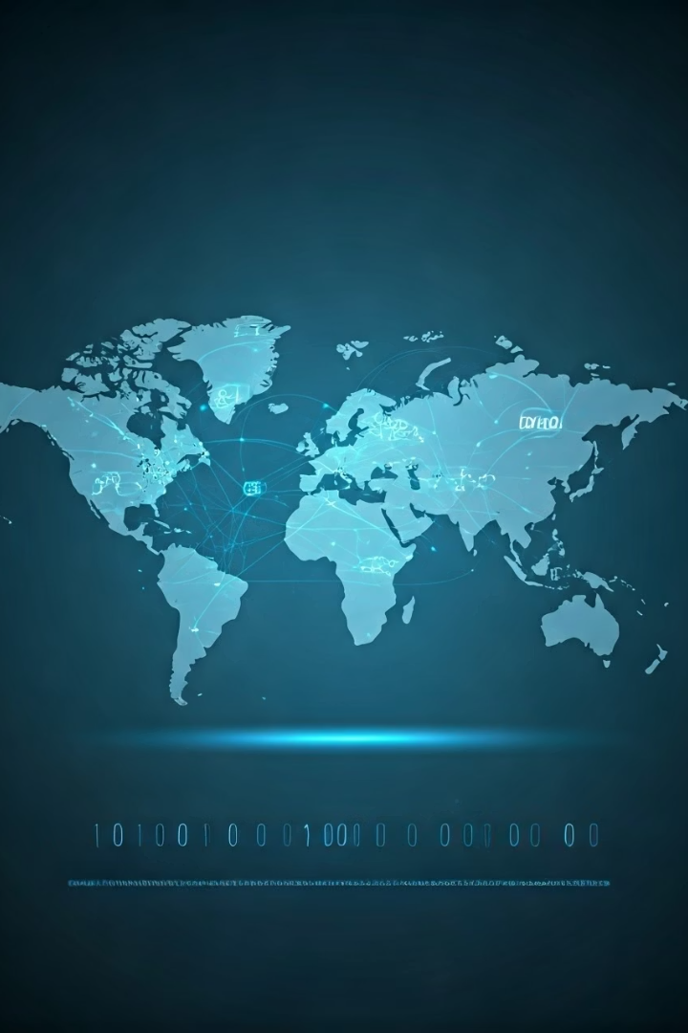




Summary
Global Connection
Request Process
Data Transfer
The Internet connects millions of devices around the world
Your device sends a request and finds the correct server
Your device receives data packets from servers
Display
Your browser displays the content on your screen

