Slide 1


AWS S3 Requester Pays – Explained for Beginners
In AWS S3, normally the bucket owner pays for storage and data transfer costs. But with Requester Pays, the person accessing (downloading) the files pays for the costs instead of the bucket owner.
by Ram N Java

Slide 2
🔹 Why Use Requester Pays?
✅ Reduces Costs for
Bucket Owner
✅ Useful for
Public Data Sharing
✅ Encourages Fair Usage
Only serious users will download, reducing unnecessary access.
You don’t have to pay when others download your files.
If you share large datasets, let users pay for their own access.

Slide 3
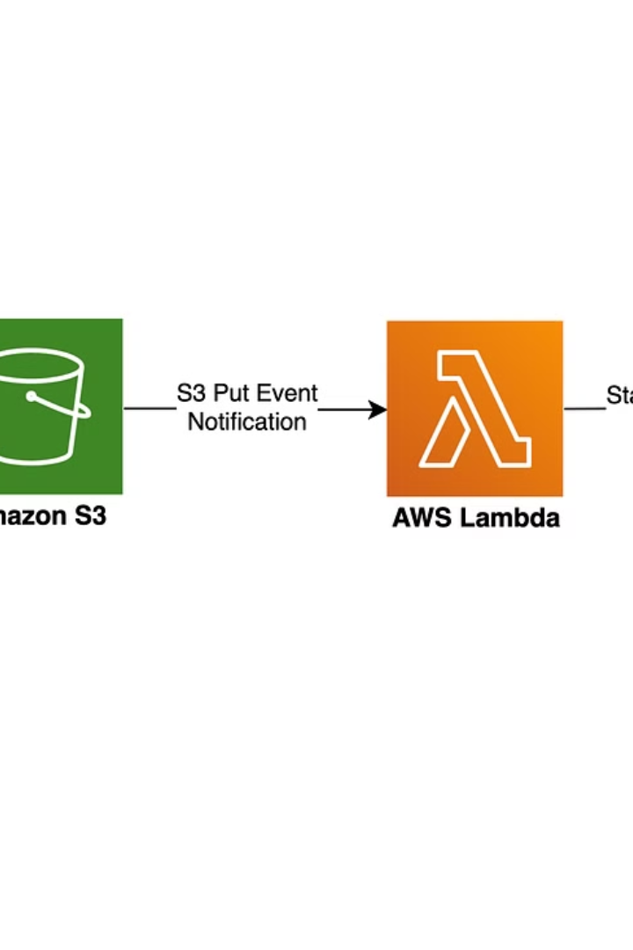
How Does Requester Pays Work?
1️⃣ Bucket Owner Enables "Requester Pays" – This setting is turned ON in S3.
2️⃣ Users Who Download Files Pay the Costs – The person downloading needs to have an AWS account.
3️⃣ Costs Include: - Data Transfer Fees (when downloading files) - Request Fees (GET, LIST, etc.)
4️⃣ AWS Bills the Requester, Not the Owner

Slide 4
🔹 How to Enable Requester Pays in S3?
1️⃣ Go to AWS S3 Console
1
2
2️⃣ Select your bucket
3️⃣ Go to "Properties"
3
4
4️⃣ Scroll to Requester Pays
5️⃣ Enable the setting and Save changes
5
6
✅ Now, anyone downloading files will be charged instead of you.

Slide 5

How a Requester Downloads from a "Requester Pays" Bucket?
1
Agreement to Pay
2
AWS CLI Command
If a user wants to download from a Requester Pays bucket, they must explicitly agree to pay.
Using AWS CLI, they can download like this:
aws s3 cp s3://example-bucket/file.txt --request-payer requester
3
Explanation
🔹 The --request-payer requester flag tells AWS that they accept the costs.

Slide 6



🔹 Things to Keep in Mind
✅ Not for Completely Public Data
2
If you want free public access, don’t enable Requester Pays.
✅ Users Need an AWS Account
1
Only AWS users can pay for requests.
✅ Storage Costs Still Paid by Owner
3
The bucket owner still pays for storing the files.

Slide 7




🔹 Final Thoughts
AWS S3 Requester Pays
1
Useful for data-sharing scenarios
Large Datasets
2
Owner doesn’t pay for everyone’s downloads
Cost Shifting
3
Cost shifts to users accessing the data
Fair Usage
4
Ensures fair usage and cost control
AWS S3 Requester Pays is useful for data-sharing scenarios, especially for large datasets where the owner doesn’t want to pay for everyone’s downloads. It shifts the cost to the users who access the data, ensuring fair usage and cost control. 🚀

