Slide 1




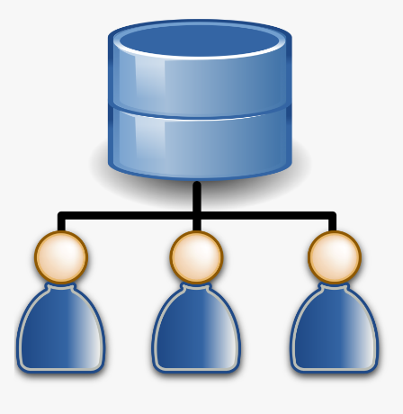

What is Single Sign On (SSO) | How SSO works with SAML
Authentication
7.Validate SAML Response & Token
Web App Server (SP)
Token
2.Request Access to Source
3.Generate SAML Auth request & redirect to Active Directory Server
8. Return Secure page to the User
6.Token Redirected
Active Directory Server (IDP)
1.User Opens Browser
4.User Authentication
5.SAML Token

Slide 2
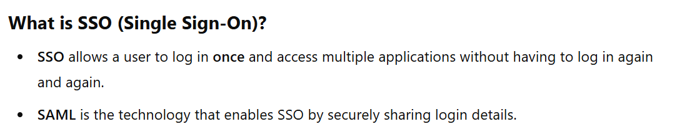
What is Single Sign On (SSO) | How SSO works with SAML

Slide 3
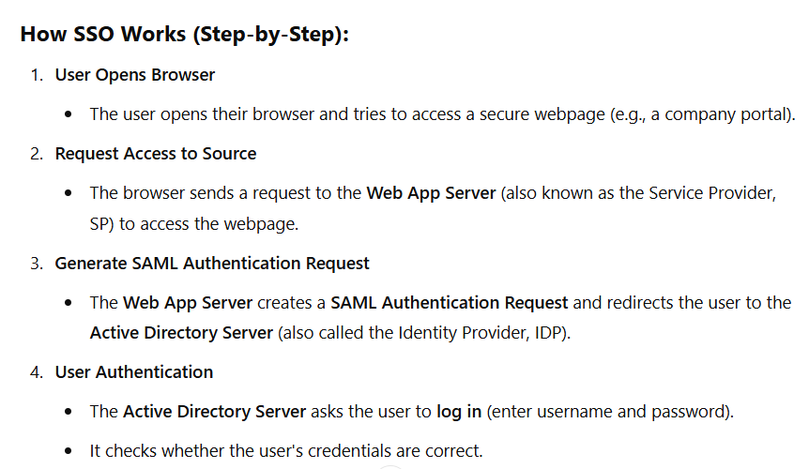
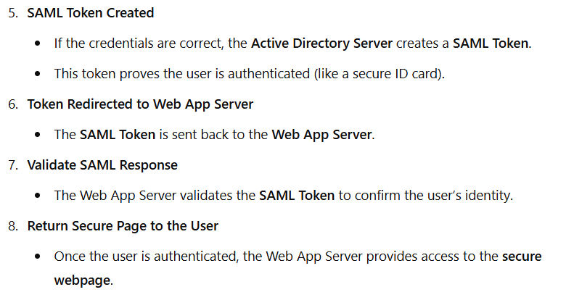
What is Single Sign On (SSO) | How SSO works with SAML

Slide 4
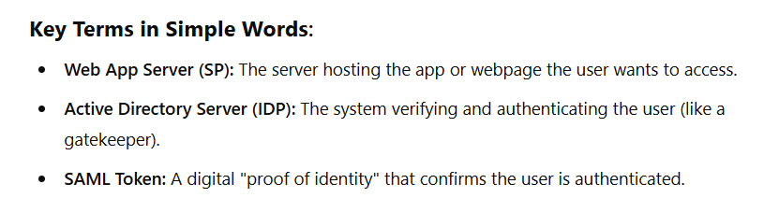
What is Single Sign On (SSO) | How SSO works with SAML

Slide 5
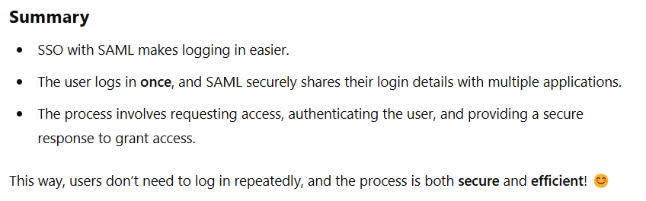
What is Single Sign On (SSO) | How SSO works with SAML

