Slide 1



AWS Simple Notification Service (SNS): Powering Distributed Messaging
AWS SNS (Simple Notification Service) is a fully managed messaging service provided by Amazon Web Services (AWS) that allows you to send notifications to a large number of subscribers, such as mobile devices, email addresses, or other services. It's a powerful tool for building distributed systems where you need to send updates or alerts to multiple recipients at once.
by Ram N Java

Slide 2

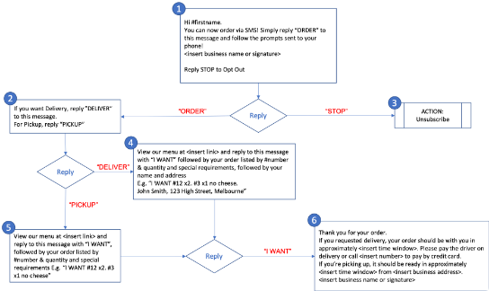
What Does AWS SNS Do?
Messaging Hub
People Recipients
System Recipients
AWS SNS is like a messaging hub that enables you to send notifications or messages to a group of recipients.
These recipients can be people (like sending SMS messages, emails, or push notifications to mobile devices)
Or systems (like sending messages to other AWS services such as Lambda, SQS, or HTTP endpoints).

Slide 3
Key Concepts of AWS SNS:
Topic and Publisher
Topic
Publisher
A topic is a logical access point that acts as a communication channel. It's where you send the notifications, and subscribers can receive messages published to that topic. You can think of a topic as a "broadcasting station."
A publisher is any application or service that sends a message to an SNS topic. For example, if you have an application that monitors website uptime, it might publish a notification to an
SNS topic whenever a site goes down.

Slide 4
Key Concepts of AWS SNS:
Subscriber and Message
Subscriber
Message
Subscribers are the recipients of messages. They can be email addresses, SMS numbers, AWS Lambda functions, HTTP/HTTPS endpoints, or even other AWS services like SQS (Simple Queue Service). When a message is published to a topic, all subscribers to that topic receive the message.
A message is the content that is sent to a topic. This could be a simple text message, a JSON object, or any type of data that you want to deliver to the subscribers.

Slide 5
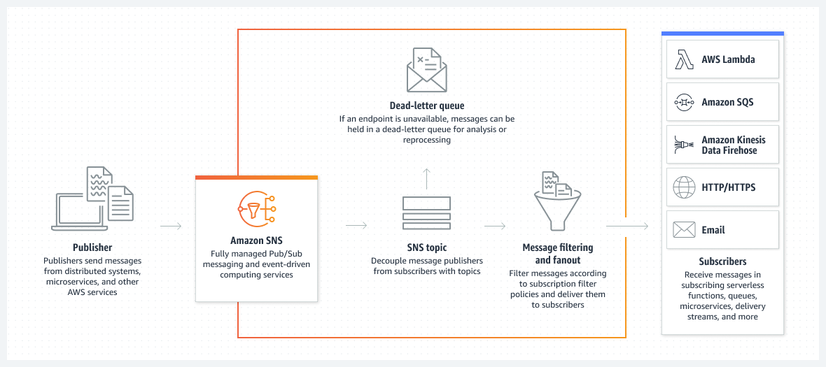
Application-to-application (A2A)
Amazon SNS is a managed messaging service that lets you decouple publishers from subscribers. This is useful for application-to-application messaging for microservices,
distributed systems, and serverless applications.

Slide 6
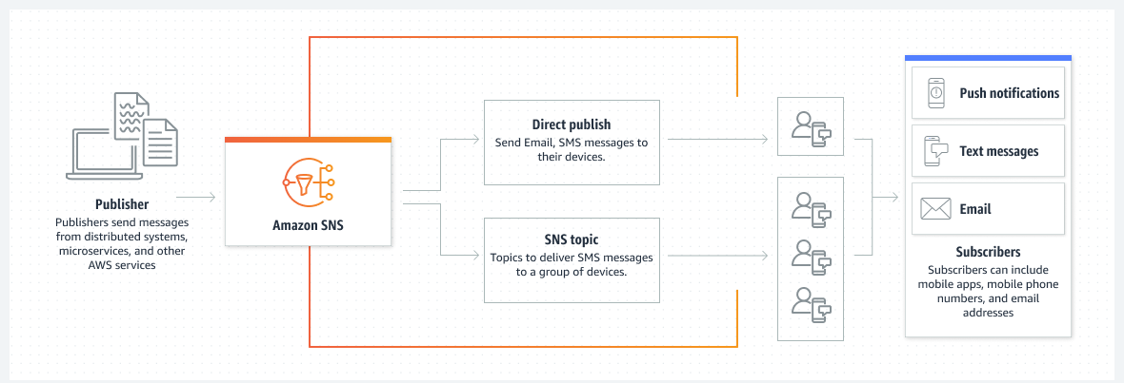
Application-to-person (A2P)
Amazon SNS lets you send push notifications to mobile apps, text messages to mobile phone numbers, and plain-text emails to email addresses. You can fan out messages with a topic, or publish to mobile endpoints directly..

Slide 7

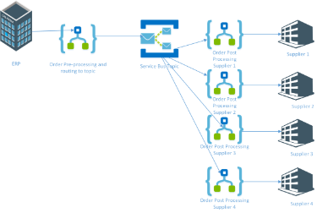
How AWS SNS Works:
Creating a Topic and Subscribing
Create a Topic
1
First, you create a topic to which messages will be published. For example, you might create a topic called "WebsiteAlerts" for your website monitoring application.
2
Subscribe to the Topic
Next, you add subscribers to the topic. These could be email addresses, phone numbers, or endpoints. For example, you might subscribe your support team's email address to the "WebsiteAlerts" topic.

Slide 8

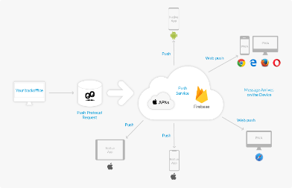
How AWS SNS Works:
Publishing and Receiving
Publish a Message
1
When an event occurs (like your website going down), your application publishes a message to the "WebsiteAlerts" topic.
AWS SNS then delivers that message to all the subscribers.
2
Receive the Notification
Subscribers receive the notification in the format they prefer (email, SMS, etc.), allowing them to take immediate action.

Slide 9

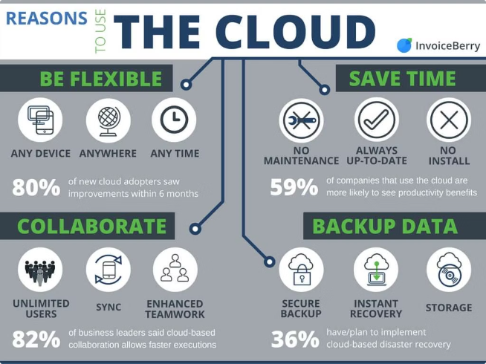
Benefits of AWS SNS
1
Scalability
SNS can handle a high volume of messages and send notifications to millions of subscribers simultaneously.
2
Flexibility
It supports multiple messaging formats and protocols, making it adaptable to various use cases.
3
Reliability
Built on AWS's infrastructure, SNS is designed to be highly available and fault-tolerant.
4
Cost-Effective
SNS charges you based on the number of requests and the amount of data transferred, making it a cost-effective solution for messaging.

Slide 10





Common Use Cases for AWS SNS
System Alerts
Send critical alerts or system updates to IT teams.
User Notifications
Send messages to users of an application, such as order confirmations or promotional offers.
Application Integration
Use SNS to decouple microservices by sending messages between different parts of your application.

Slide 11

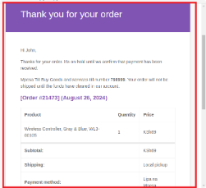




Example Scenario:
E-commerce Order Status Updates
Set Up Topic
Subscribe Customers
Publish Updates
Real-time Notifications
Imagine you have an
e-commerce site, and you want to notify customers when their order status changes. You could set up an SNS topic called "OrderStatus"
Publish a message to this topic whenever there's an update
Subscribe each customer's email or phone number to this topic
This way, customers get real-time notifications about their orders.

Slide 12

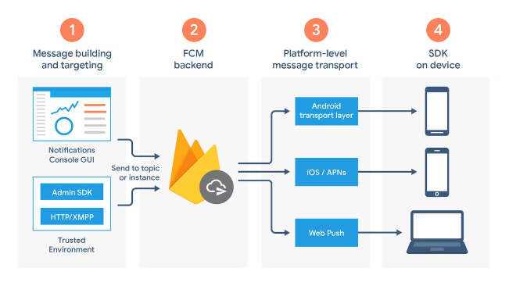
Summary: AWS SNS for Efficient Messaging
Versatile Service
AWS SNS is a versatile service that allows you to send notifications to a broad audience quickly and efficiently.
Ideal for Multiple Recipients
It's ideal for scenarios where you need to distribute messages to multiple recipients simultaneously, whether they're human users or other systems.
Key to Event-Driven Architecture
For beginners, understanding SNS is key to building responsive, event-driven architectures on AWS.

