Slide 1
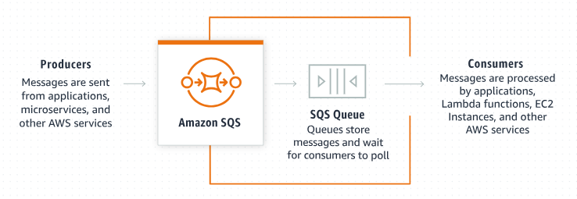
Amazon SQS Encryption: A Beginner's Guide to Securing Your Messages
What is Amazon SQS?
Amazon Simple Queue Service (Amazon SQS) is a managed message queuing service that enables you to decouple and scale microservices, distributed systems, and serverless applications.
With Amazon SQS, you can send, store, and receive messages between software components at any volume, without losing messages or requiring other services to be available.

Slide 2
Amazon SQS Encryption: A Beginner's Guide to Securing Your Messages
Why Use Encryption?
Encryption is the process of converting data into a secret code to prevent unauthorized access.
Encryption ensures that the messages you send and receive are secure and protected from being read by unauthorized users.
Only authorized parties with the correct decryption key can decode and read the information.
Encryption is crucial for protecting sensitive data. In the context of SQS, it ensures that the messages sent between parts of your application are secure and cannot be easily intercepted or read by unauthorized users.

Slide 3
Amazon SQS Encryption: A Beginner's Guide to Securing Your Messages
What is Amazon SQS Encryption?
Amazon SQS supports encryption to help protect the contents of messages. There are two types of encryption for Amazon SQS:
server-side encryption (SSE) and client-side encryption.
1. Server-Side Encryption (SSE):
When you enable server-side encryption (SSE), Amazon SQS encrypts all messages that are sent to this queue. The messages are stored in encrypted form and Amazon SQS decrypts a message only when it is sent to an authorized consumer. SSE encrypts the body of the message, but doesn't encrypt the following fields:
Queue metadata (queue name and attributes)
Message metadata (message ID, timestamp, and attributes)
Per-queue metrics
A message is encrypted only if it is sent after the encryption of a queue is enabled. Amazon SQS doesn't encrypt backlogged messages. Any encrypted message remains encrypted even if the queue encryption is disabled.
With SSE enabled, anonymous SendMessage and ReceiveMessage requests to the encrypted queue will be rejected. SQS security
best practises recommend against using anonymous requests. If you wish to send anonymous requests to an SQS queue, make sure to disable SSE.
When Amazon SQS moves a message from an encrypted source queue to an unencrypted dead-letter queue, the message remains encrypted.

Slide 4
Amazon SQS Encryption: A Beginner's Guide to Securing Your Messages
What is Amazon SQS Encryption? (Server-Side Encryption (SSE)
Data Protection: SSE uses AWS Key Management Service (KMS) keys to encrypt the body of the message.
Ease of Use: You can enable SSE for your SQS queue with a few clicks in the AWS Management Console, or through AWS SDKs and the AWS CLI.
Compliance: Using SSE helps you meet regulatory and compliance requirements by ensuring that your message data is encrypted at rest.
How to Enable SSE:
Create or Select an SQS Queue: In the AWS Management Console, either create a new SQS queue or select an existing one.
Enable SSE: Choose the KMS master key to use for encrypting your messages. You can use the default AWS managed CMK (customer master key) or create your own.
Save: Save your settings. Now, all messages sent to this queue will be encrypted.

Slide 5
Amazon SQS Encryption: A Beginner's Guide to Securing Your Messages
What is Amazon SQS Encryption?
2. Client-Side Encryption
With client-side encryption, you encrypt messages on the client-side before sending them to SQS. This gives you more control over the encryption process, but it also means you need to handle the encryption and decryption logic in your application.
More Control: You can use your own encryption libraries and keys.
Responsibility: You are responsible for key management and ensuring the encryption is implemented correctly.

Slide 6
Amazon SQS Encryption: A Beginner's Guide to Securing Your Messages
Benefits of SQS Encryption
Security: Protects sensitive data and ensures it cannot be read by unauthorized parties.
Compliance: Helps you meet data protection regulations and compliance requirements.
Peace of Mind: Knowing your data is encrypted can help you focus on other aspects of your application without worrying about data security.

Slide 7
Amazon SQS Encryption: A Beginner's Guide to Securing Your Messages
Summary
Amazon SQS Encryption helps secure the messages you send and receive through SQS by encrypting the message content. You can choose between server-side encryption, which is managed by AWS, or client-side encryption, which gives you more control but requires you to handle the encryption process. By using encryption, you ensure that your data remains secure and compliant with regulatory requirements.

