Slide 1
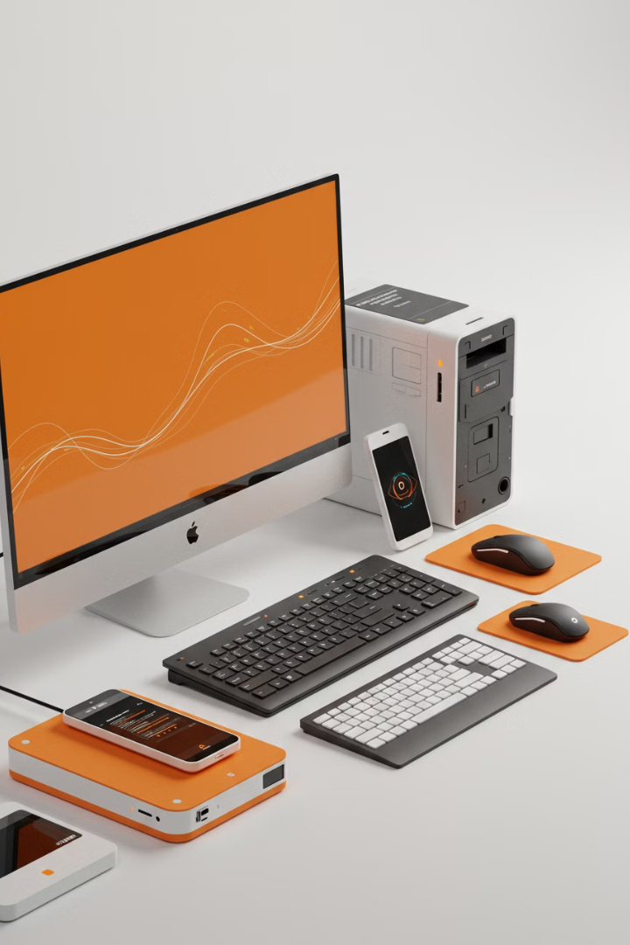

Input and Output Devices in a Computer
A computer works by taking an input, processing it, and then giving an output. Input devices are tools that help you send data to the computer, while output devices show you or give you the results from the computer.
by Ram N Java

Slide 2
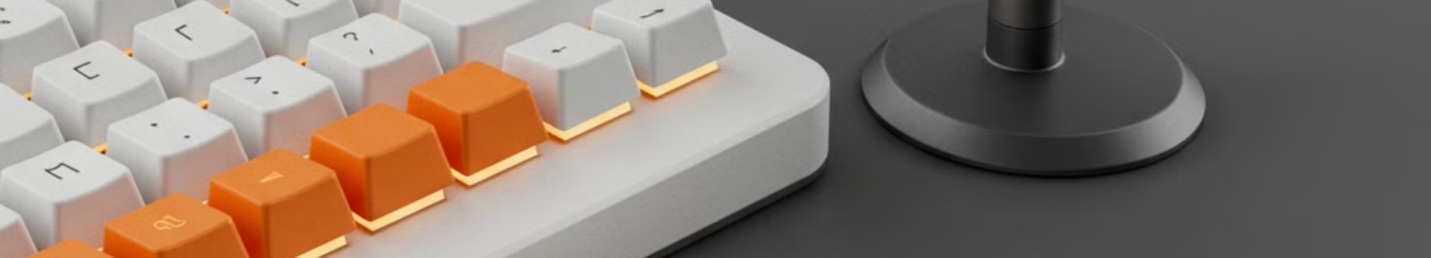
What are Input Devices?
Keyboard
Mouse
Microphone
Used to type letters, numbers, and commands.
Used to move the cursor on the screen and click on things.
Used to record sound or speak to the computer.
Example: Typing an email or
a document.
Example: Clicking on icons or dragging files.
Example: Speaking to a voice assistant like Siri or Alexa.
Input devices are tools that allow you to send information to the computer. They help you communicate with the computer.

Slide 3
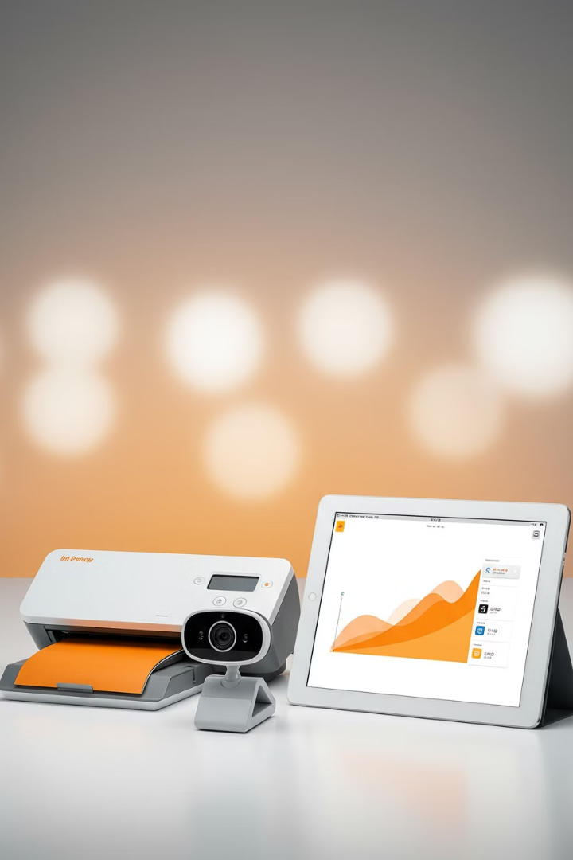
Other Input Devices
1
Scanner
2
Webcam
Used to copy images or documents into the computer.
Used to capture video or take photos.
Example: Video calling with friends or family.
Example: Scanning a photo to save it digitally.
3
Touchscreen
Allows you to touch the screen to give commands.
Example: Using a smartphone or tablet.

Slide 4
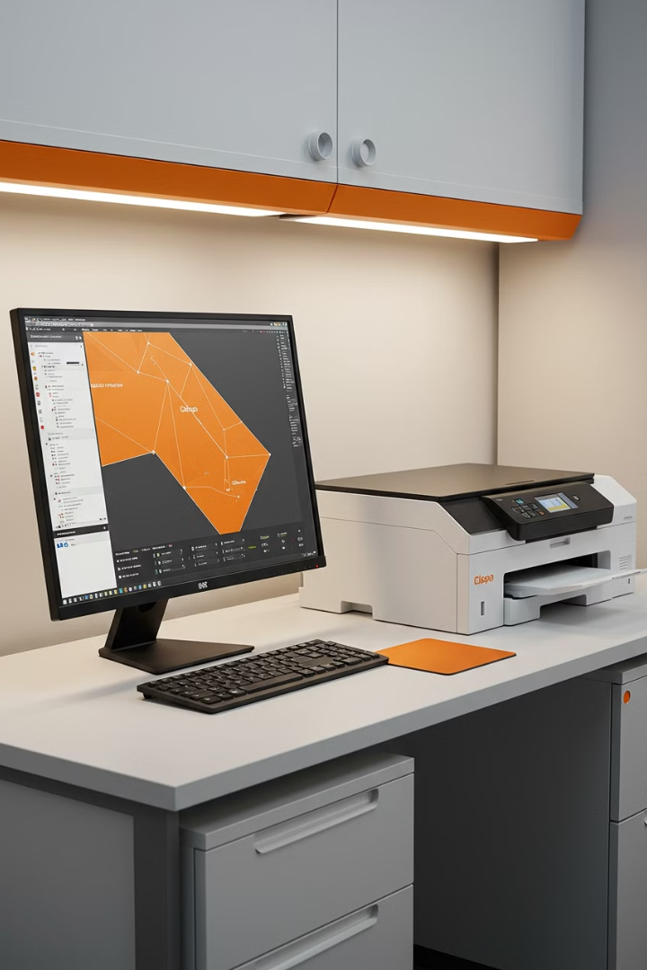
What are Output Devices?
Monitor (Screen)
Displays text, images, and videos.
Example: Watching a movie or reading an article.
Printer
Prints documents or images on paper.
Example: Printing a school assignment or a photo.
Output devices are tools that show or give you the results from the computer. They help the computer communicate with you.

Slide 5
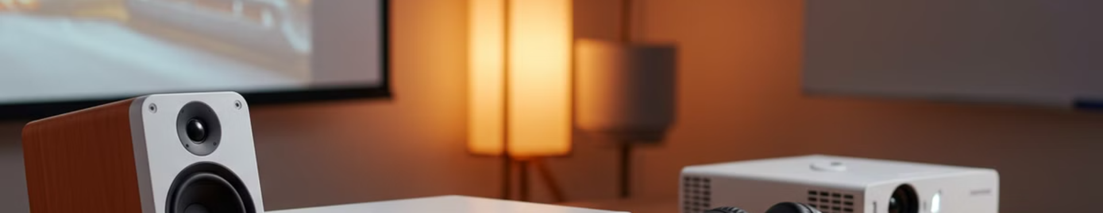



Other Output Devices
Speakers
Headphones
Projector
Play sound or music from the computer.
Similar to speakers but for private listening.
Displays the computer screen on a larger surface, like a wall.
Example: Listening to songs or watching a video with sound.
Example: Listening to music without disturbing others.
Example: Giving a presentation in a classroom or meeting.

Slide 6
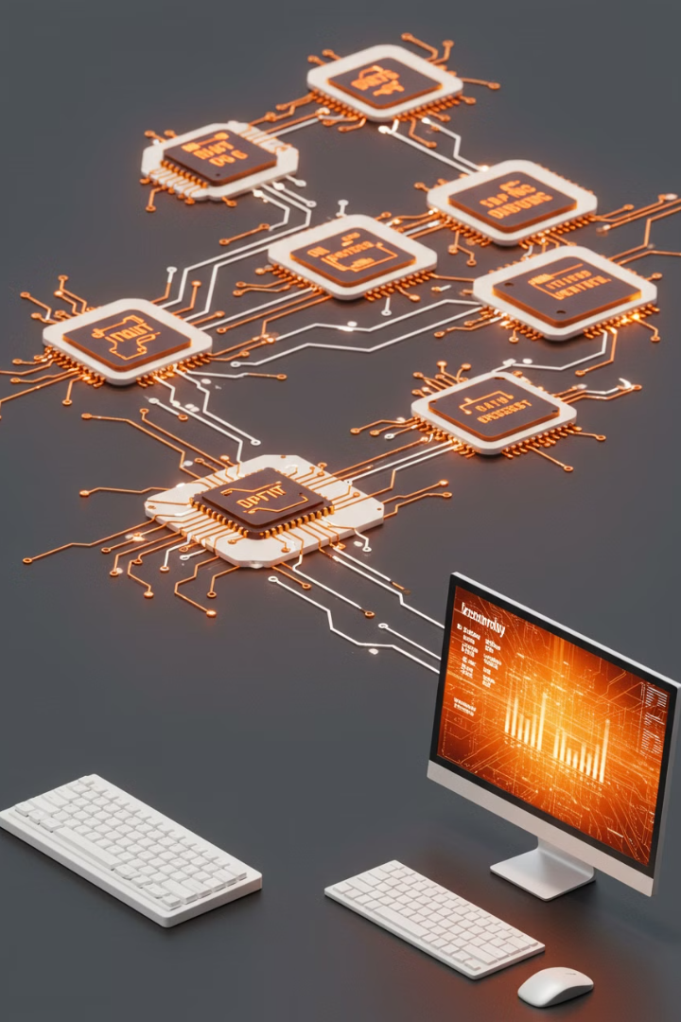



How Input and Output Devices Work Together
You Provide Input
You use an input device (like a keyboard or mouse) to send data to the computer.
Example: Typing a message on the keyboard.
The Computer Processes the Input
The computer takes the input and processes it.
Example: The computer saves the message you typed.
The Computer Provides Output
The computer sends the result to an output device.
Example: The message appears on the monitor or is printed by the printer.

Slide 7




Why Input and Output Devices are Important?
Ease of Use
Communication
Input devices like the keyboard and mouse make it easier to control the computer.
They help you interact with the computer and get the results you need.
1
2
Entertainment
Sharing Information
4
3
Devices like monitors and speakers make watching movies, playing games, and listening to music enjoyable.
Output devices like the printer and speakers allow you to share information with others.

Slide 8




Summary
Communication
1
Together, they facilitate interaction
Daily Utility
2
For typing, printing, watching videos
Output Devices
3
Monitor, printer, speakers
Input Devices
4
Keyboard, mouse, microphone
Input Devices: Tools like the keyboard, mouse, and microphone help you send data to the computer.
Output Devices: Tools like the monitor, printer, and speakers show you or give you the results from the computer.
Together, input and output devices help you communicate with the computer and make it useful for daily tasks like typing, printing, or watching videos.

