Slide 1


AWS S3 Website Hosting: Simple and Cost-Effective
Welcome to this presentation on AWS S3 Website hosting. We'll explore what an AWS S3 Website is, why you might want to use it, and how to set one up. This guide is perfect for beginners looking to host a professional-looking static website quickly and affordably.
by Ram N Java

Slide 2
Understanding AWS S3 Websites
What is an AWS S3 Website?
What is a Static Website?
AWS S3 Website refers to a static website hosted on Amazon Simple Storage Service (S3). S3 is typically used to store files, but it can also serve files directly to users, which makes it great for hosting simple, static websites.
A static website is a type of website that doesn't need a server to process information. It only contains files like:
HTML: The content of the webpage.
CSS: The styles (colors, fonts, layout).
JavaScript: Basic interactivity like menus or animations.
There's no backend (like databases or processing code), so it's simpler and cheaper to host.

Slide 3
How to Host a Website on AWS S3
1
Create an S3 Bucket
Go to the AWS Management Console. Create a bucket with the name matching
your website domain (e.g., example.com).
2
Enable Static Website Hosting
In the bucket properties, enable the "Static website hosting" option.
Specify the homepage file (like index.html) and error file (like 404.html).
3
Upload Website Files
Upload your HTML, CSS, JavaScript, and other static files to the S3 bucket.
4
Set Permissions
Make the bucket public so visitors can access your website.
5
Access Your Website
You'll get a URL (like http://example-bucket.s3-website-region.amazonaws.com)
to view your website.

Slide 4
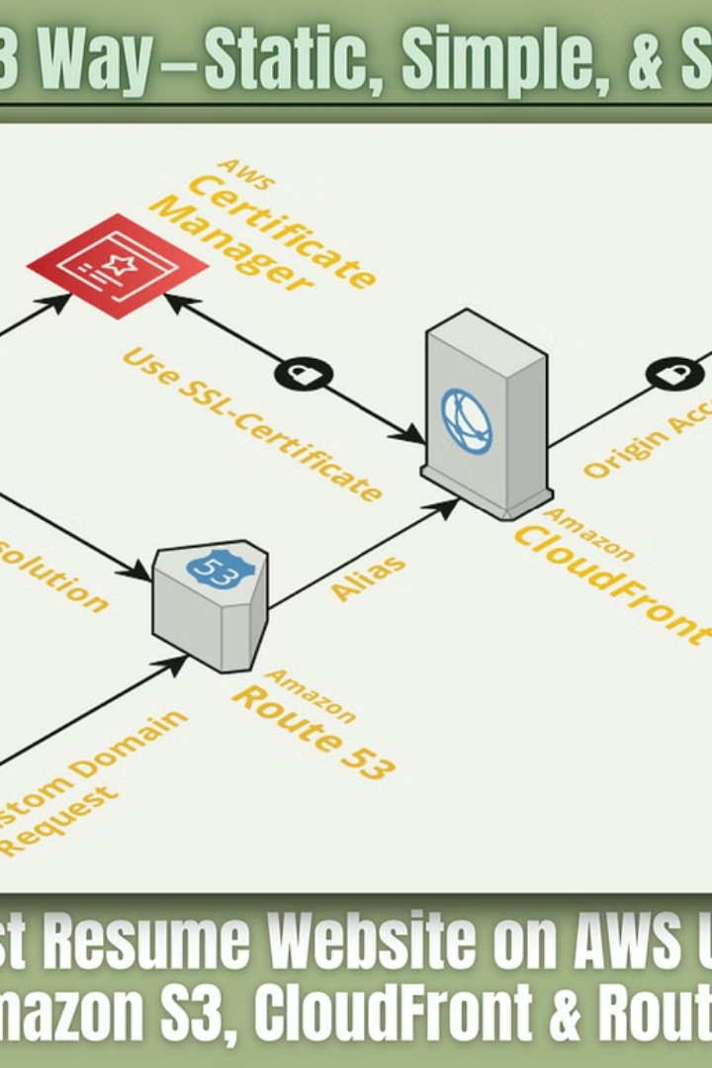
Benefits of Using AWS S3 for Websites
Cost-Effective
Scalable
S3 is very affordable, especially for small websites.
Your website can handle a large number of visitors without additional setup.
Fast
Easy Setup
S3 integrates with services like CloudFront (CDN) for faster delivery.
Hosting a static site on S3 is simple and requires minimal maintenance.

Slide 5
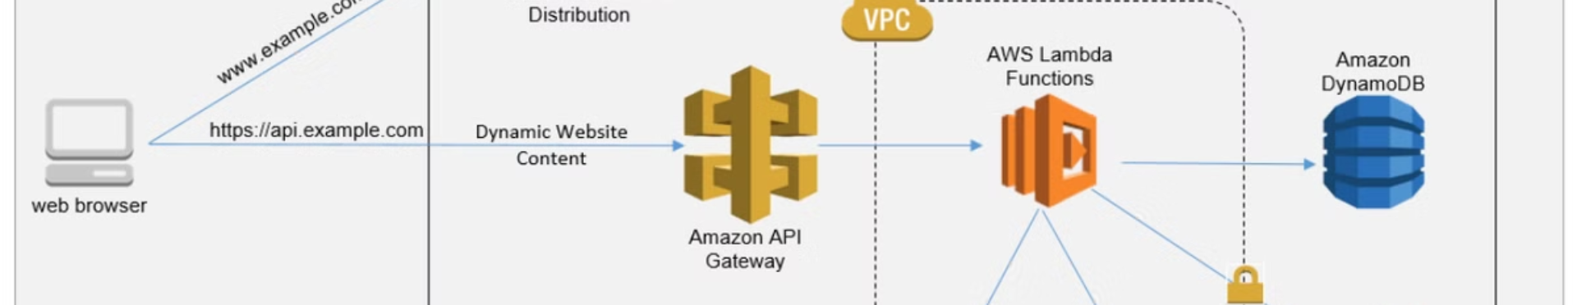
Key Points to Remember
Static Only
Custom Domain
Security
AWS S3 websites cannot run server-side code like PHP or Python.
You can configure a custom domain using AWS Route 53 or other domain registrars.
Use HTTPS for security by integrating with CloudFront and SSL certificates.
By using AWS S3 for static websites, beginners can host a professional-looking site quickly and affordably!

