Slide 1
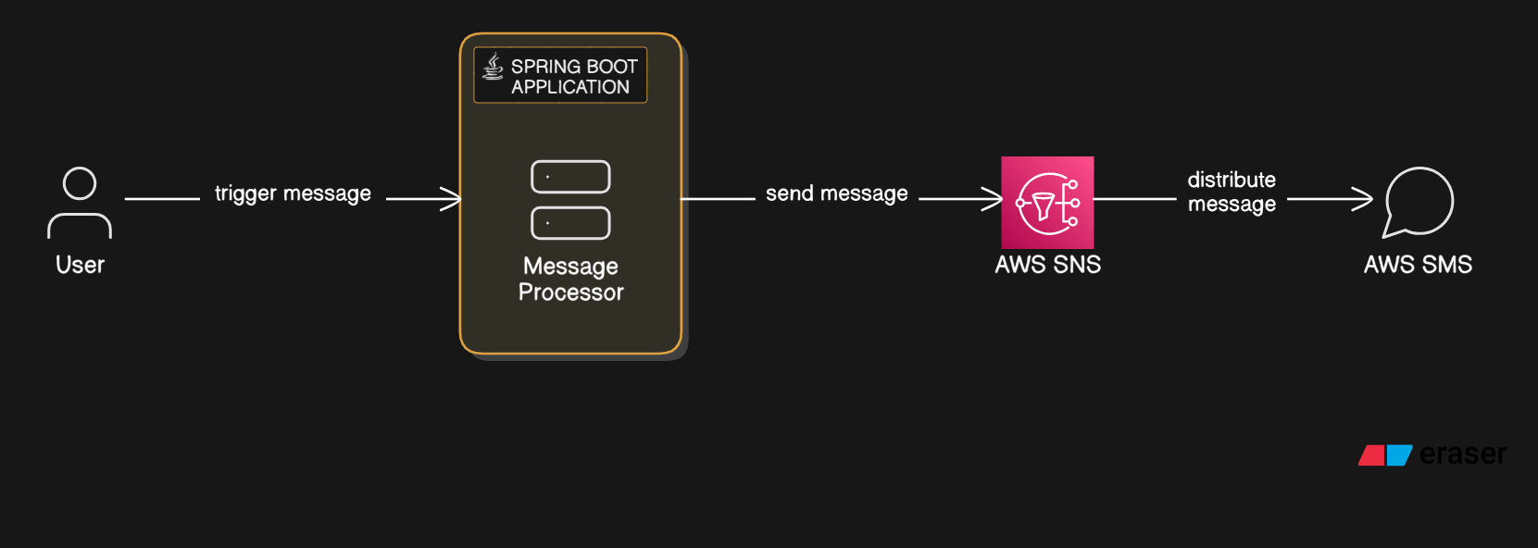


How to Send SMS using AWS SNS Without a Topic in Spring Boot

Slide 2
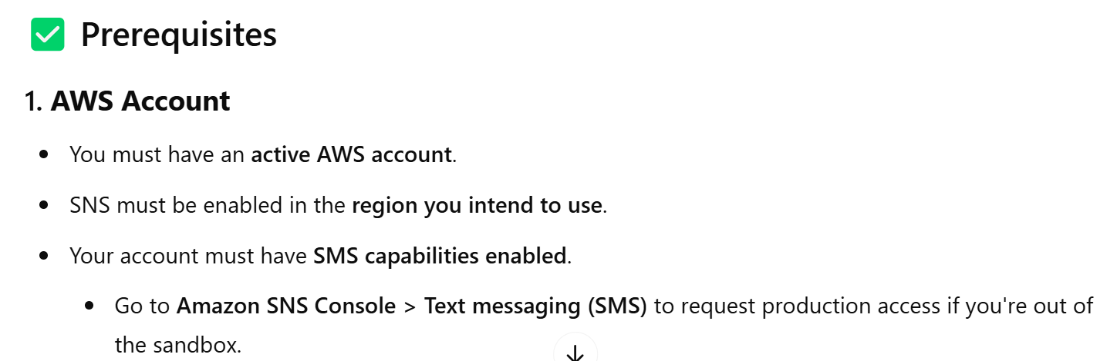

How to Send SMS using AWS SNS Without a Topic in Spring Boot

