Slide 1
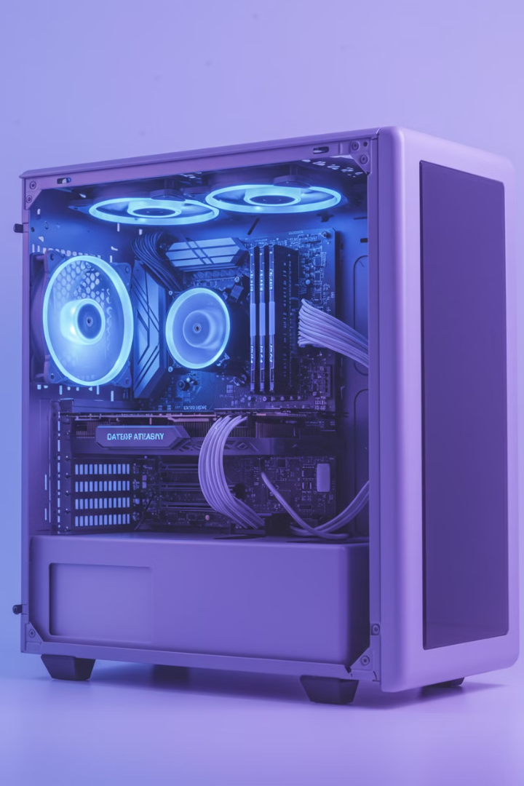

Computer Cooling Systems
A cooling system in a computer is like a fan or air conditioner for your computer's parts. It keeps the computer from getting too hot because when computers work, they generate heat, and too much heat can cause problems.
by Ram N Java

Slide 2
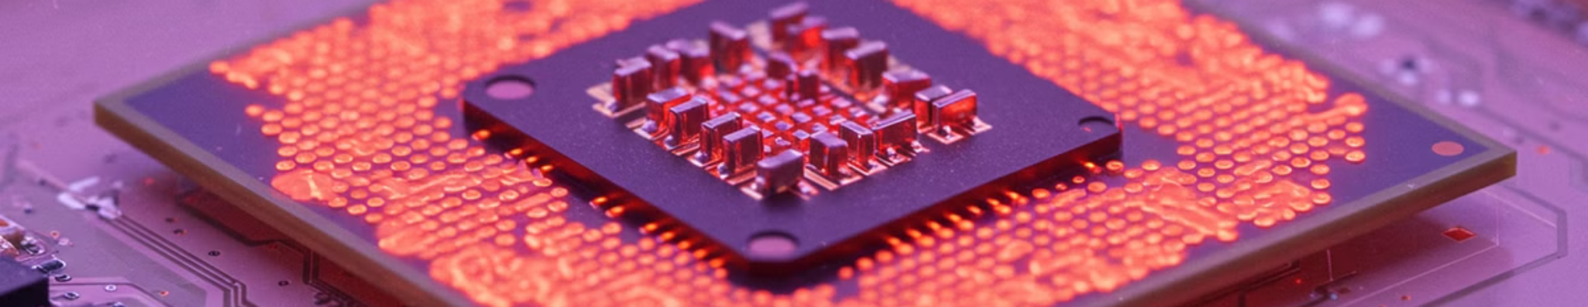
Why Do Computers Need Cooling?
1
Heat is Bad
2
Keeps Things Running Smoothly
When computers run, parts like the CPU (brain of the computer) and GPU (graphics card) get hot.
A cooling system helps the computer stay at the right temperature so it can work fast and reliably.
Too much heat can slow down the computer, cause crashes, or even damage the parts.

Slide 3
How Does a Cooling System Work?
A cooling system removes heat from the computer and sends it outside. There are two main types of cooling systems:
Air Cooling
Liquid Cooling
Fans are the most common way to cool a computer.
This is a more advanced way to cool a computer.
How it works:
How it works:
Fans blow cool air into the computer and push hot air out.
A liquid (like water) flows through tubes and absorbs heat from the computer parts.
Some fans are placed on the CPU, GPU, or inside the computer case.
The hot liquid is then cooled down by a radiator and fans.
Example: When you hear a loud noise from your computer, it's often the fans working hard to cool it down.
Example: Liquid cooling is often used in gaming computers or high-performance PCs because it's very effective.

Slide 4
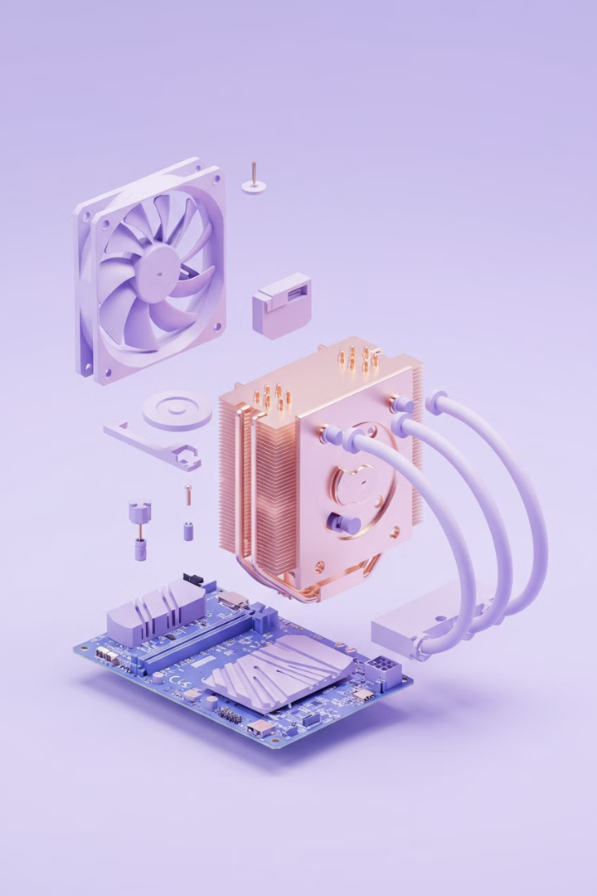




Parts of a Cooling System
Fans
Heat Sink
Thermal Paste
Small spinning blades that move air in and out of the computer.
A metal block with fins that sits on top of the CPU or GPU.
A special paste applied between the CPU/GPU and the heat sink.
It absorbs heat and spreads it out so the fans can blow it away.
It helps transfer heat from the chip to the heat sink.
They are placed on the CPU, GPU, and case.
Liquid Cooling Parts
Water Block: Attaches to the CPU/GPU to absorb heat.
Radiator: Cools the hot liquid.
Pump: Moves the liquid through the system.

Slide 5



Why is Cooling Important?
Better Performance
1
A cool computer runs faster and smoother
Extends Lifespan
2
Keeping components cool helps them last longer
Prevents Overheating
3
Avoids slowdowns, crashes, and damage
Overheating can cause the computer to slow down, crash, or even break. Keeping the computer cool helps its parts last longer. A cool computer runs faster and smoother, especially during heavy tasks like gaming or video editing.

Slide 6
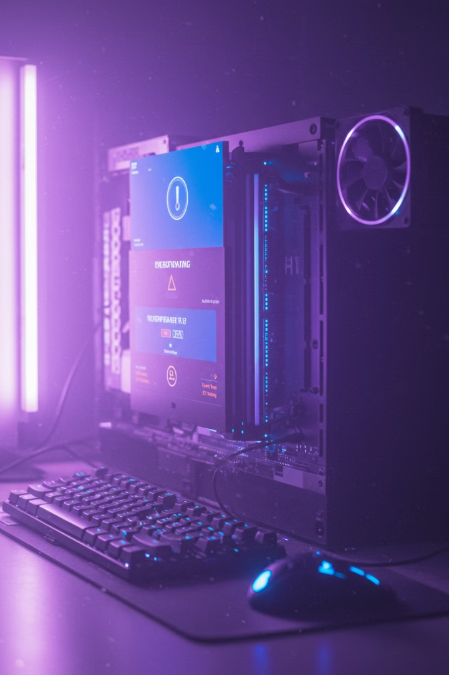
Signs Your Computer Needs Better Cooling
Loud Fan Noise
If the fans are always loud, it means they're working too hard to cool the computer.
Computer Feels Hot
If the computer feels very hot to the touch, it might need
better cooling.
Frequent Crashes
If the computer shuts down or freezes often,
it could be overheating.
Slow Performance
Overheating can cause the computer to slow down to
protect itself.

Slide 7
How to Keep Your Computer Cool
Clean the Fans
Dust can block the fans and make them less effective. Clean them regularly.
Improve Airflow
Make sure the computer has enough space around it for air to flow in and out.
Add More Fans
If your computer gets too hot, you can add extra fans to the case.
Use a Cooling Pad
For laptops, a cooling pad with built-in fans can help keep it cool.
Upgrade the Cooling System
If you have a high-performance computer, consider upgrading to a better air cooler or liquid cooling system.

Slide 8




Summary
Cooling System Basics
Components
1
2
A cooling system is essential for keeping your computer from getting too hot.
It uses fans, heat sinks, and sometimes liquid cooling to remove heat.
Consequences
Benefits
Without proper cooling, your computer can overheat, slow down, or even get damaged.
Keeps the computer running smoothly and prevents damage.
4
3
So, make sure your computer stays cool for the best performance!

