Slide 1
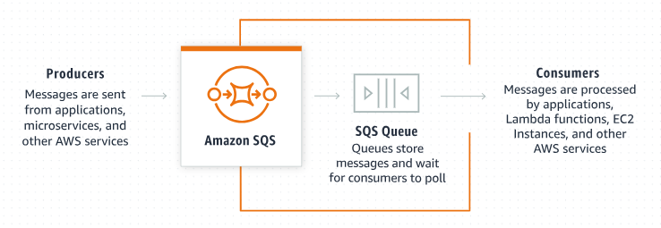
Java Integration with Amazon SQS: Sending and Receiving Product Objects
To send and receive a Product object using Amazon SQS in Java, the process involves creating a Product class, serializing the object to JSON (or another format), sending it as an SQS message, and deserializing it when receiving.

Slide 2
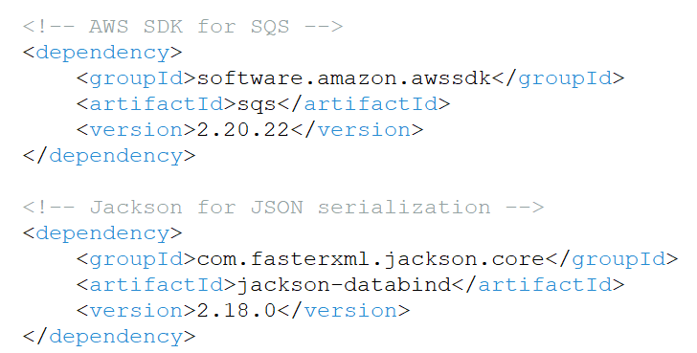
Java Integration with Amazon SQS: Sending and Receiving Product Objects
Step 1. Set Up AWS SDK in Maven

Slide 3
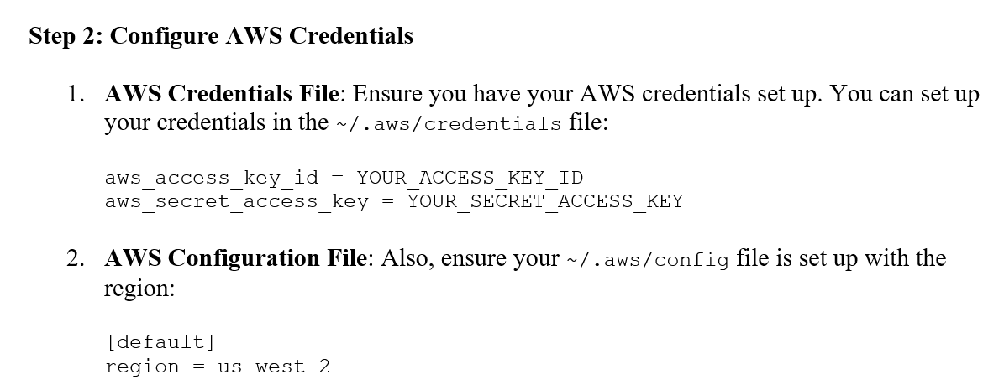
Java Integration with Amazon SQS: Sending and Receiving Product Objects

