Slide 1


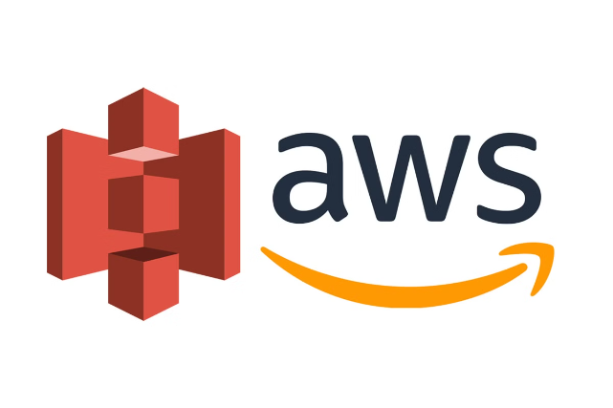

AWS S3:
Scalable Cloud Storage
Amazon Simple Storage Service (S3) is a versatile cloud storage solution offered by Amazon Web Services (AWS). It provides scalable, secure, and durable storage for any type of data, allowing users to store and retrieve any amount of information from anywhere on the web. S3's flexibility makes it ideal for a wide range of use cases, including backups, data archiving, and as a data lake for big data analytics.
by Ram N Java

Slide 2

Key Features of AWS S3
1
Scalability
2
Durability and Availability
S3 automatically scales to handle any amount of data and large numbers of requests. Whether you're storing a few megabytes or petabytes of data, S3 scales seamlessly to accommodate your needs.
S3 is designed for 99.999999999% (11 9's) durability and 99.99% availability. This means your data is highly protected and available almost all the time.
3
Security
4
Cost-Effective
S3 provides multiple security features, including encryption at-rest and in-transit, fine-grained access controls, and integration with AWS Identity and Access Management (IAM) to manage user permissions.
S3 offers a pay-as-you-go pricing model, meaning you only pay for the storage and requests you use. There are no upfront costs or long-term commitments.

Slide 3

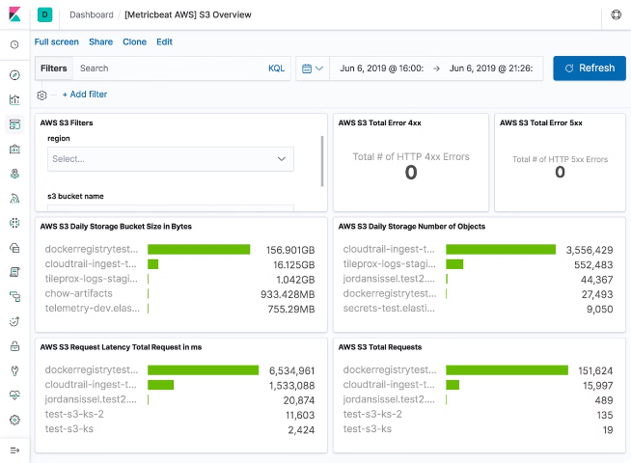
Data Management Features
Versioning
S3 allows you to keep multiple versions of an object, providing an additional layer of data protection and enabling easy recovery of previous versions.
Lifecycle Policies
Automatically transition objects to different storage classes or delete them after a certain period, optimizing storage costs and data management.
Replication
Replicate data across different AWS regions to improve data availability and disaster recovery capabilities.

Slide 4
Basic Concepts: Buckets
What are Buckets?
Naming Convention
Organization
Buckets are containers for storing objects in AWS S3. Each object is stored in a bucket, and you can create and name your buckets according to your organizational needs.
Bucket names must be globally unique across all of AWS. This ensures that each bucket has a distinct identity within the S3 ecosystem.
Buckets help in organizing and managing your data efficiently, allowing you to group related objects together.

Slide 5

Basic Concepts: Objects and Keys
Objects
Keys
Data and Metadata
Objects are the fundamental entities stored in S3. Each object consists of data, metadata, and a unique identifier (key).
A key is a unique identifier for an object within a bucket. The key is used to retrieve the object and acts as its "address" within the bucket.
Objects store both the actual data and associated metadata, which provides additional information about the object's properties and characteristics.

Slide 6
AWS S3 Regions
Regional Storage
Benefits
Global Service
AWS S3 buckets are created in specific regions, which allows you to choose the location where your data is physically stored.
Choosing a specific region can help optimize latency, minimize costs, or address regulatory requirements for data storage locations.
While buckets are
region-specific, S3 itself is a global service, allowing you to access and manage your data from anywhere in the world.

Slide 7

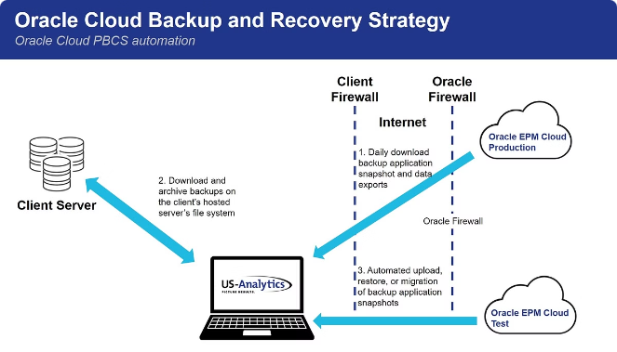
Use Case: Backup and Restore
1
Data Selection
Choose the data you want to back up, whether it's from on-premises environments or other AWS services.
2
S3 Storage
Utilize S3's durability and cost-effectiveness to securely
store your backup data.
3
Versioning
Enable versioning to keep multiple versions of your backups, allowing for point-in-time recovery.
4
Restore Process
When needed, easily restore your data from S3 to its original location or a new destination.

Slide 8


Use Case: Data Archiving
S3 Glacier
S3 Glacier is designed for long-term data archiving with very low costs, ideal for infrequently accessed data.
S3 Glacier Deep Archive
For even longer-term storage needs, S3 Glacier Deep Archive offers the lowest cost storage option in the AWS Cloud.
Lifecycle Policies
Automatically transition data between storage classes to optimize costs based on access patterns.
Compliance
Meet regulatory requirements for long-term data retention with secure and durable archival storage.

Slide 9





Use Case: Content Storage and Distribution
Upload Content
Configure Distribution
Access Content
Scale and Optimize
Store static content such as images, videos, and documents in S3 buckets.
Websites, mobile apps, and other applications can now quickly access and serve the content to users worldwide.
Set up Amazon CloudFront or other content delivery networks to distribute your content globally.
S3 automatically scales to handle traffic spikes and optimizes content delivery for improved user experience.

Slide 10
Use Case: Big Data Analytics
Data Lake
Analytics Services
Scalability
S3 serves as a data lake where large volumes of data can be stored and analyzed using various AWS analytics services.
Utilize services like Amazon Redshift, AWS Glue, and Amazon Athena to perform complex analyses on your
S3-stored data.
S3's ability to handle massive amounts of data makes it ideal for big data workloads and analytics at any scale.

Slide 11

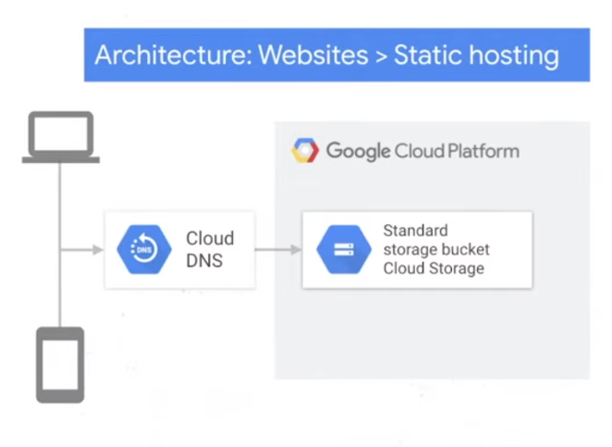
Use Case: Application Hosting
Static Website Hosting
S3 can be used to host static websites, storing HTML, CSS,
JavaScript, and other static files.
Cost-Effective
Hosting static content on S3 is often more cost-effective than using traditional web servers.
Scalability
S3 automatically scales to handle traffic spikes, ensuring your website remains available during high-demand periods.
Integration
Easily integrate with other AWS services for dynamic content, authentication, and more advanced functionalities.

Slide 12
Getting Started with AWS S3
Create an AWS Account
1
If you don't already have an AWS account, you need to create one at https://aws.amazon.com/.
2
Access S3
Once logged in, navigate to the
S3 service from the AWS Management Console.
Create a Bucket
3
Click "Create bucket," give it a unique name, choose the region, and configure any additional settings.
4
Upload Objects
Click on your newly created bucket, then click "Upload" to start adding files to your bucket.
Set Permissions
5
Configure permissions to control who can access your bucket and objects.
6
Access Your Data
You can access your data using the AWS Management Console, AWS CLI, or AWS SDKs.

