Slide 1
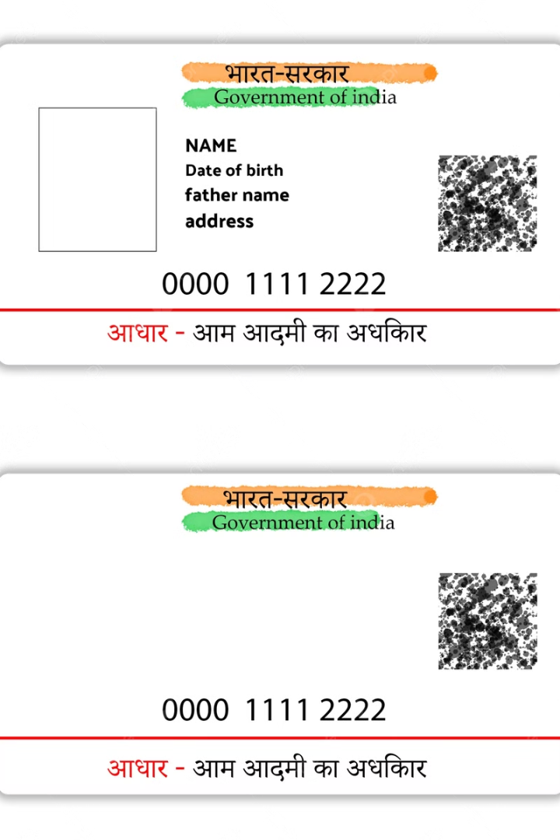

AADHAR CARD – WHAT IS IT?
The Aadhar Card is a unique identity card given to people in India. It is issued by the Government of India and contains a 12-digit unique number for each person.
by Ram N Java

Slide 2

What Does an Aadhaar Card Contain?
1
Your Name
2
Your 12-Digit Aadhar Number
Your full name as per records.
A unique number given only to you.
3
Your Photo
4
Your Address
Your picture for identification.
Your home address.
5
Your Date of Birth
6
Your Biometric Data
Your birth details.
Your fingerprints and eye scan (Iris scan) for security.

Slide 3








Why is Aadhaar Card Important?
Proof of Identity
Proof of Address
Government Benefits
Bank Account
It helps prove who you are.
It can be used as an address proof for official work.
Needed for getting subsidies and government schemes.
Helps in opening a bank account easily.
Mobile SIM Card
Income Tax &
PAN Card
School Admissions
Passport Application
Required when getting a new mobile number.
Often required for admission to schools and educational institutions.
Needed for applying for a passport.
Needed for filing taxes and linking with a PAN card.

Slide 4

IMPORTANT THINGS TO KNOW
Aadhar is FREE
Aadhar is NOT a Citizenship Card
Keep it Safe
There is no charge to get an Aadhar card.
Do not share your Aadhar number with unknown people to avoid fraud.
It is only an identity card, not proof of Indian citizenship.
Update If Needed
Available in Digital Form
You can update your address or details if they change.
You can download e-Aadhaar from the official website.

Slide 5
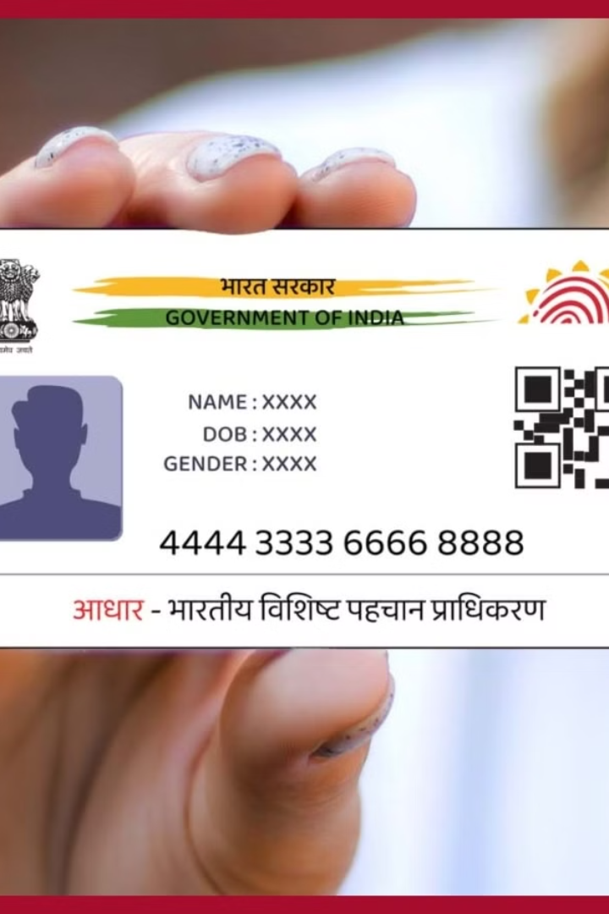
HOW TO APPLY FOR AADHAAR CARD?
Visit an Aadhaar Enrollment Center
Find the nearest center online.
Provide Documents
Carry identity proof (like PAN card) and address proof (like electricity bill).
Biometric Scanning
Your fingerprints, eye scan, and photo will be taken.
Receive Aadhaar Number
The card will be sent by post or can be downloaded online.

Slide 6

CONCLUSION
The Aadhar Card is an important identity document for people in India. It helps in getting government benefits, opening bank accounts, and verifying identity. Always keep your Aadhar details safe and use them responsibly.

