Slide 1
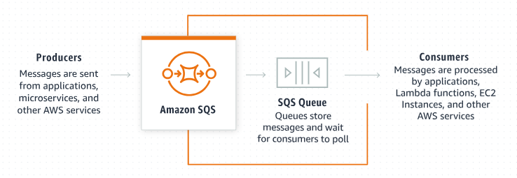
Amazon SQS Explained Simply: How to Send and Receive Messages in the Cloud
What is Amazon SQS?
Amazon SQS stands for Amazon Simple Queue Service. It’s a service provided by Amazon Web Services (AWS) that helps different parts of an application communicate by sending messages to a queue. This way, the parts can work independently and efficiently without needing to directly interact with each other in real time.

Slide 2
Amazon SQS Explained Simply: How to Send and Receive Messages in the Cloud
How does it work?
1. Message Queue: Think of a message queue as a line (or queue) where messages wait to be processed. When a part of your application (like a web server) has some data or a task that needs to be processed (like user information or an image to be processed), it sends a message to the SQS queue.

Slide 3
Amazon SQS Explained Simply: How to Send and Receive Messages in the Cloud
How does it work?
2. Producer: The part of your application that sends messages to the queue is called the producer. It could be a web server, a backend service, or any component that generates data.

Slide 4
Amazon SQS Explained Simply: How to Send and Receive Messages in the Cloud
How does it work?
3. Consumer: The part of your application that receives messages from the queue and processes them is called the consumer. It could be a worker service, a background job, or any component that handles tasks.

Slide 5
Amazon SQS Explained Simply: How to Send and Receive Messages in the Cloud
How does it work?
4. Decoupling: By using SQS, producers and consumers don’t need to know about each other or communicate directly. They just interact with the queue. This makes your application more modular and easier to manage and scale

Slide 6
Amazon SQS Explained Simply: How to Send and Receive Messages in the Cloud
Why use Amazon SQS?
Reliability: Messages are stored in the queue until they are successfully processed. If something goes wrong, the message can be retried.
Scalability: SQS can handle a large number of messages, so it’s great for applications that need to process a high volume of tasks.
Flexibility: Different parts of your application can work at their own pace. Producers can send messages quickly, and consumers can process them as they become available.
Asynchronous Processing: Tasks can be handled asynchronously, meaning the producer doesn’t have to wait for the consumer to finish processing before it can move on to other tasks.

Slide 7
Amazon SQS Explained Simply: How to Send and Receive Messages in the Cloud
Example Scenario:
Imagine you have a website where users can upload photos to be processed (like adding filters). Here’s how SQS would help:
Upload: A user uploads a photo.
Send to Queue: The website (producer) sends a message to the SQS queue with information about the uploaded photo.
Process: A worker service (consumer) picks up the message from the queue and processes the photo (e.g., resizing, adding filters).
Complete: Once the photo is processed, the worker can send a notification back to the user or store the processed photo in a database and then deletes the message from the queue once processing is complete.
This setup ensures that the photo processing happens asynchronously, without slowing down the user experience.

