Slide 1
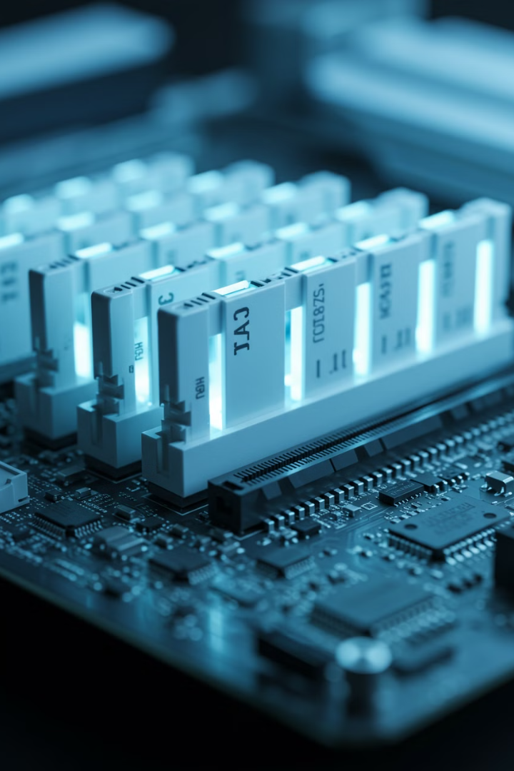

Random Access Memory (RAM) – Simple Explanation
RAM is the short-term memory of a computer or smartphone. It stores data temporarily while you are using apps, files, or games. When you turn off the device, the data in RAM is erased.
by Ram N Java

Slide 2

Why is RAM Important?
1
Makes Devices Faster
2
Helps in Multitasking
More RAM allows the computer or phone to run apps smoothly.
Lets you open many apps at the same time without slowing down.
3
Supports Gaming & Heavy Tasks
Large RAM is needed for video editing, gaming, and advanced software.

Slide 3
How Does RAM Work?
The Process
RAM is Like a Desk
Hard Drive is Like a Cupboard
When you open an app, RAM temporarily stores its data. When you close the app, RAM clears the data.
It holds the things you are using right now. Quick access but limited space.
It stores data for a long time but is slower to access.

Slide 4
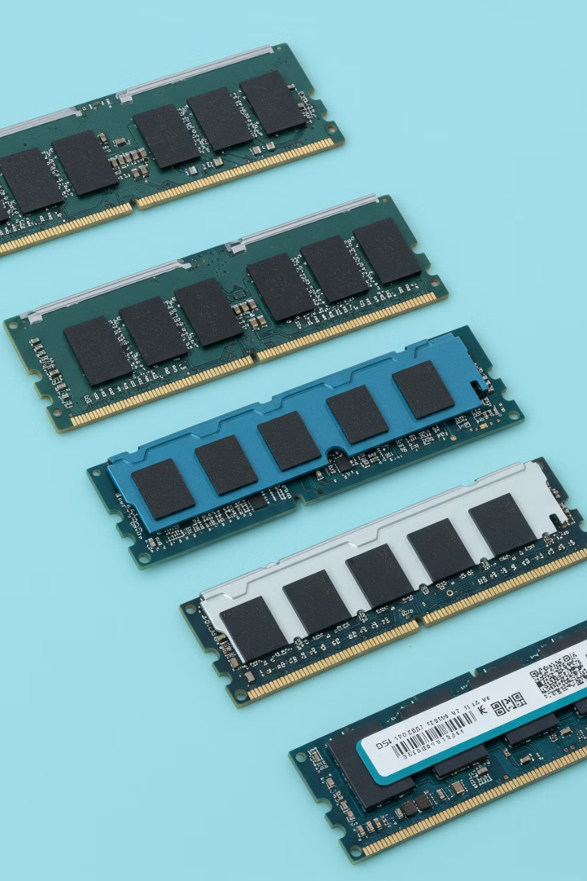
Types of RAM
DDR4 & DDR5
Modern RAMs used in new computers and laptops. Faster data transfer speeds.
LPDDR
Low Power RAM used in smartphones for better battery life. Optimized for mobile devices.

Slide 5
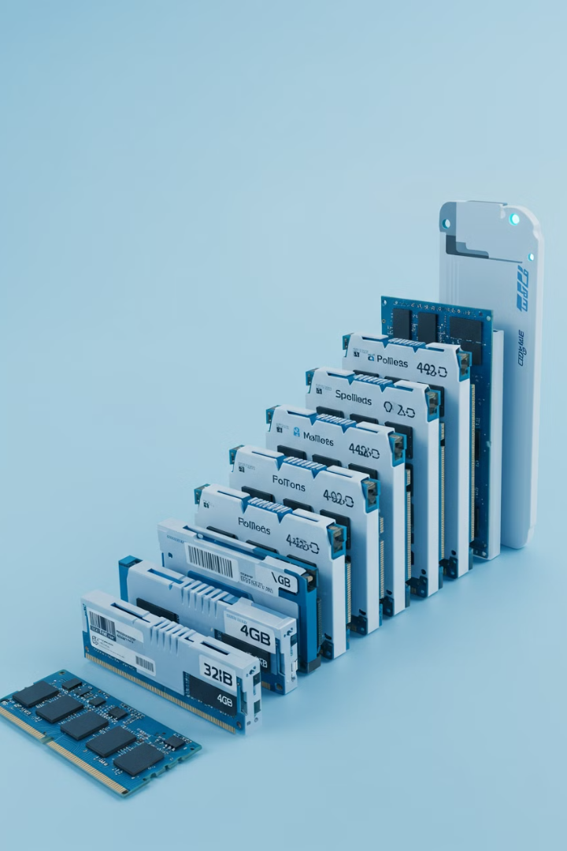
Common RAM Sizes
4GB RAM
Basic use like browsing and watching videos. Entry-level performance.
8GB RAM
Good for multitasking and light gaming. Standard for most users.
16GB RAM
Ideal for professional work, heavy gaming, and video editing.
32GB+ RAM
Used for advanced tasks like 3D design and high-end gaming.

Slide 6
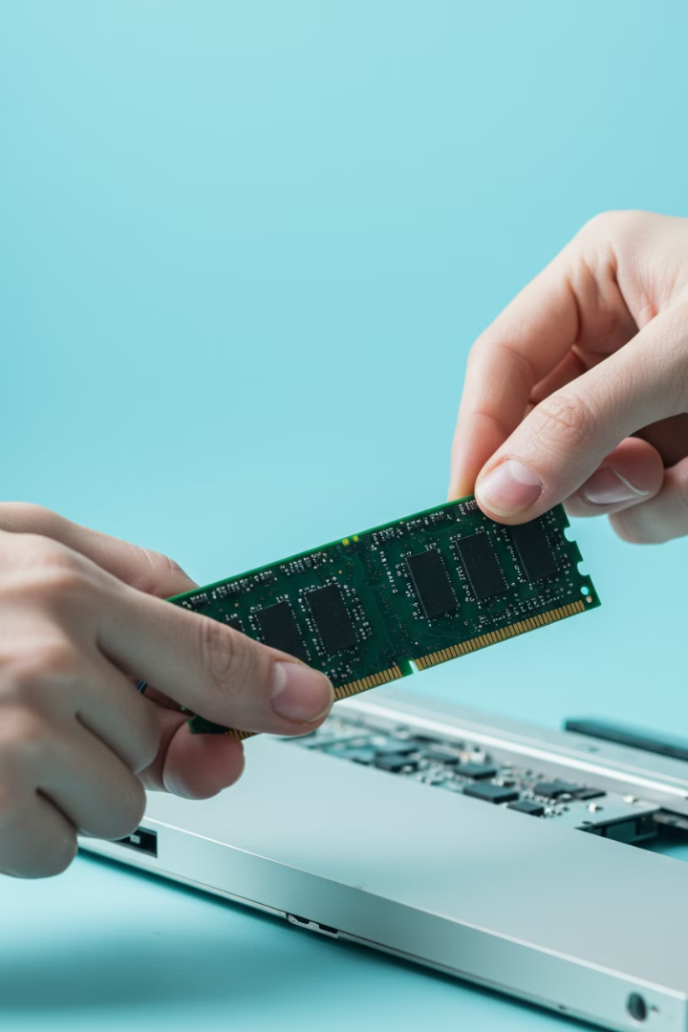



Conclusion
Essential for Speed
Better Performance
Temporary Storage
RAM is essential for making a computer or phone work fast and smoothly.
The more RAM a device has, the better its performance for demanding tasks.
RAM only stores data temporarily. Important files should be saved on hard drives or SSDs.

