Slide 1
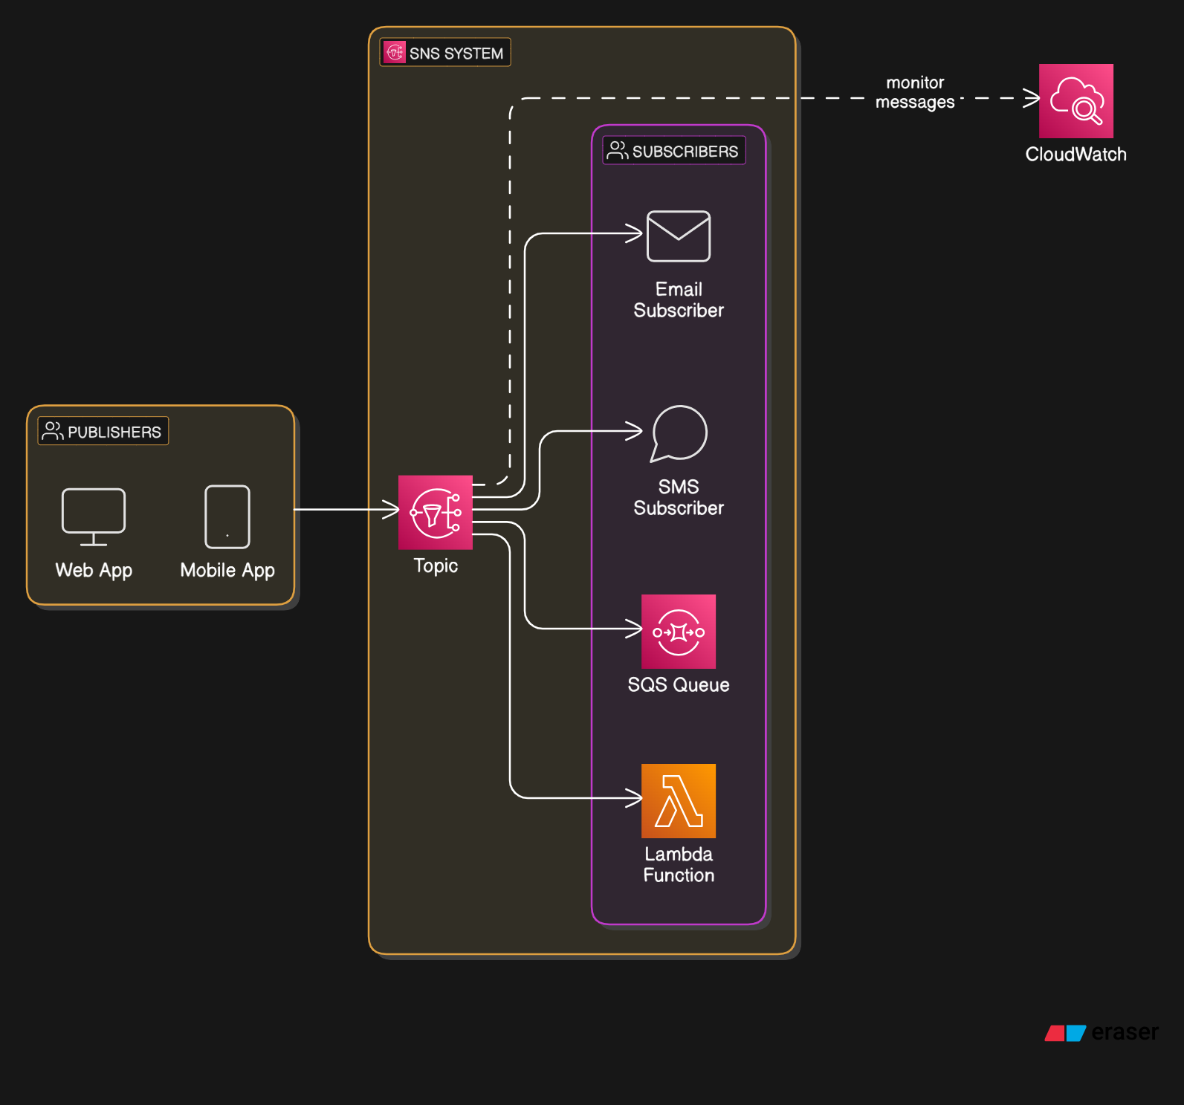

Slide 2
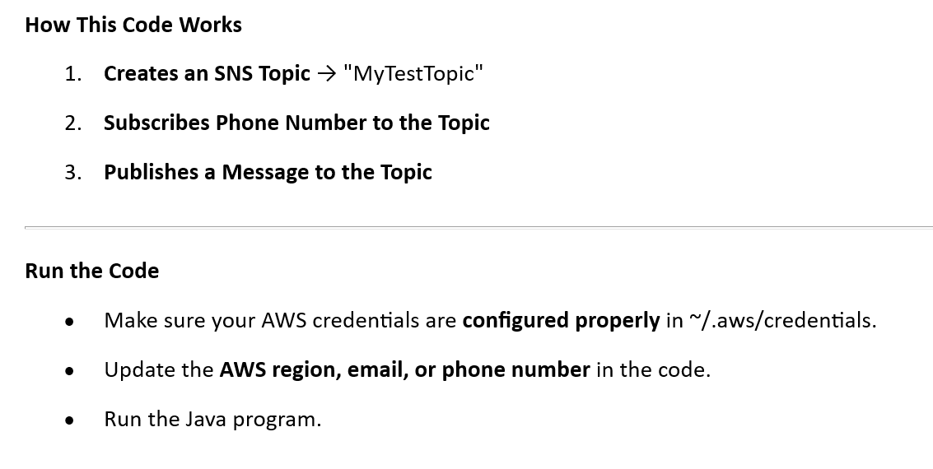
How to Send SMS Using AWS SNS Topics in Java!

