Slide 1
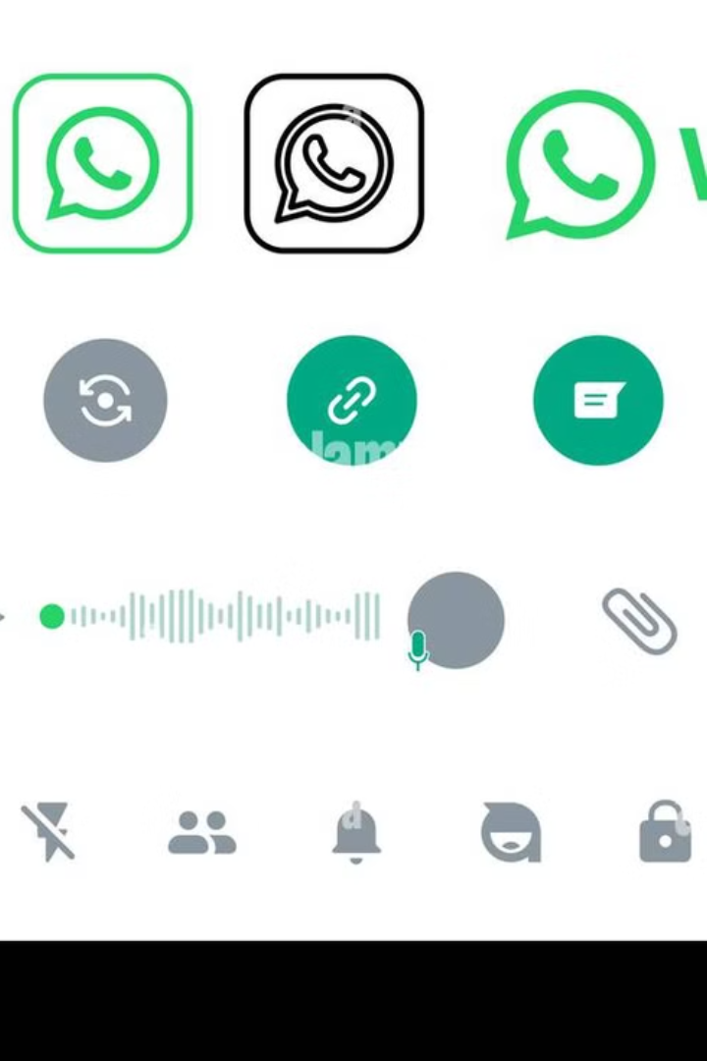

WhatsApp Architecture and Technologies
WhatsApp is a widely used messaging application that enables users to send texts, make voice and video calls, and share various media files. Its design focuses on speed, reliability, and security to ensure a seamless communication experience. Let's break down its architecture and the technologies it employs in simple terms.
by Ram N Java

Slide 2
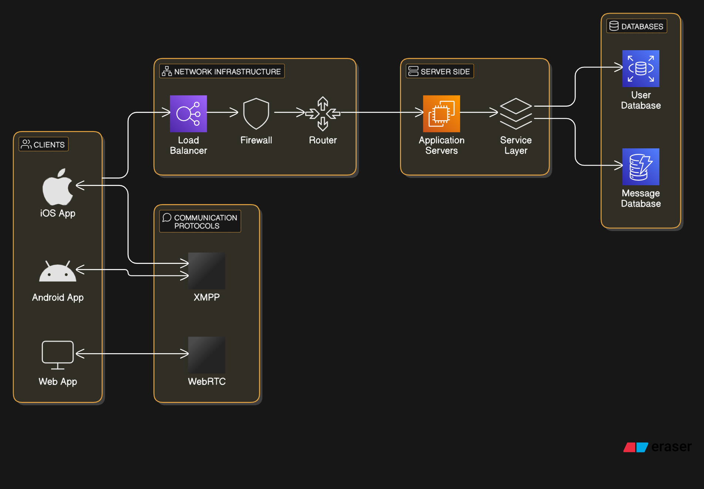

Slide 3




Client-Server Architecture
Client (Your Device)
WhatsApp Server
Recipient's Device
Sends and receives messages
Receives and forwards messages
Receives messages from server
WhatsApp operates on a client-server model. In this setup, your device (client) communicates with WhatsApp's central servers to send and receive messages. When you send a message, it's first transmitted to the server, which then forwards it to the recipient's device. This method ensures efficient and reliable message delivery.

Slide 4




Programming Languages and Technologies
Erlang
XMPP
WhatsApp's backend is primarily built using Erlang, a programming language known for handling numerous simultaneous connections efficiently. This makes it ideal for real-time applications like WhatsApp.
WhatsApp utilizes a customized version of XMPP, an open standard communication protocol designed for instant messaging. This protocol facilitates the exchange of messages and presence information between clients through the server.
Java/Swift
Java for Android apps, Swift for iPhones.

Slide 5
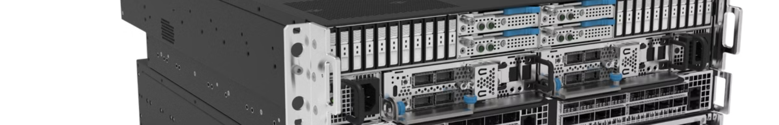
Data Storage
SQLite
Mnesia
On your device, WhatsApp uses SQLite, a lightweight database, to store messages and media locally. This allows you to access your chat history even when offline.
On server side, Stores user data (like contacts) and works super fast with Erlang.
Server Storage
Temporary Storage
Messages are temporarily stored on WhatsApp's servers using a "store and forward" mechanism. Once the message is delivered to the recipient, it's deleted from the server. If undelivered after 30 days, it's also deleted.
If a message cannot be delivered immediately (for example, if the recipient is offline), it stays on the server for a short time and is then sent when possible.

Slide 6
Security Measures
End-to-End Encryption
Signal Protocol
WhatsApp implements end-to-end encryption, ensuring that only the sender and recipient can read the messages. Not even WhatsApp can access the content of the messages, enhancing user privacy.
WhatsApp uses the Signal Protocol for encryption, ensuring that your messages remain private and secure.

Slide 7
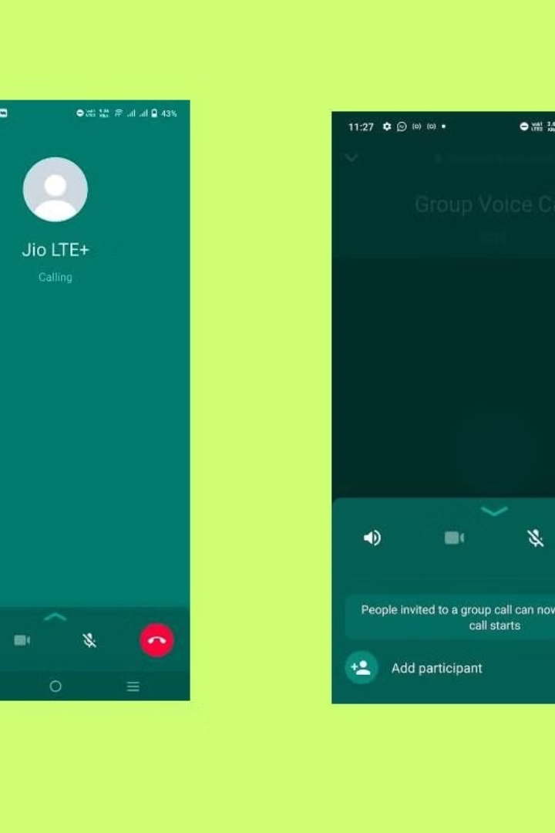
Multimedia Handling and Calls
Media Upload and Retrieval
Voice and Video Calls
For calls, WhatsApp uses technologies like WebRTC (for real-time communication) and the Opus Codec (for high-quality audio), ensuring clear and smooth calls.
When you send media files like photos or videos, they're uploaded to an HTTP server, and a link to the content is sent to the recipient along with a thumbnail. This approach optimizes the delivery of large files.

