Slide 1
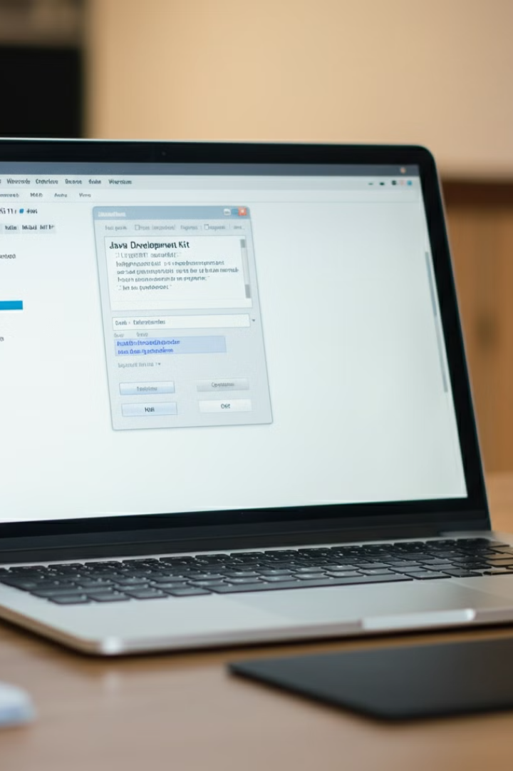

Installing JDK 11 on Windows 11: A Step-by-Step Guide
This guide will walk you through the process of installing
Java Development Kit (JDK) 11 on your Windows 11 machine. JDK is essential for developing Java applications and running Java programs. Follow these steps carefully to ensure a successful installation and setup.
by Ram N Java

Slide 2

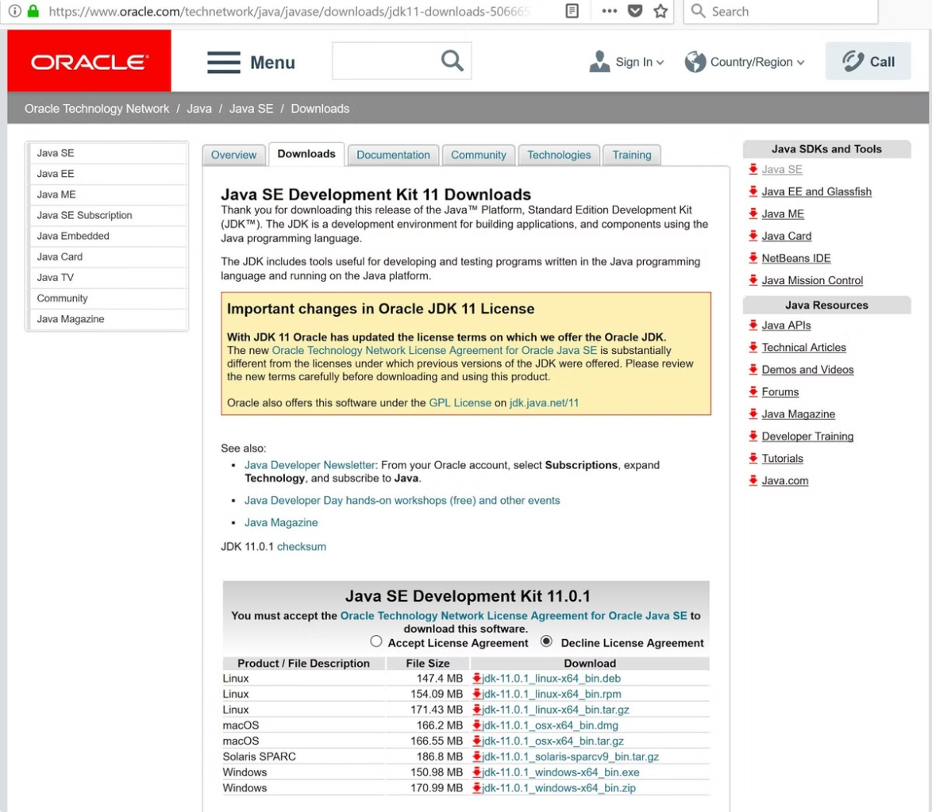
Step 1: Download JDK 11
1
Visit Oracle Website
Go to the Oracle website: Open your web browser and visit the official Oracle JDK download page: https://www.oracle.com/java/technologies/javase-jdk11-downloads.html
2
Download the Installer
Scroll down to the section that says
Java SE Development Kit 11. Look for the
Windows x64 Installer. Click on the download link for the .exe file.
3
Accept License Agreement
Before the download starts, you will need to accept the Oracle License Agreement by clicking the checkbox.
4
Save the File
Once the download starts, save the installer file to your computer.

Slide 3
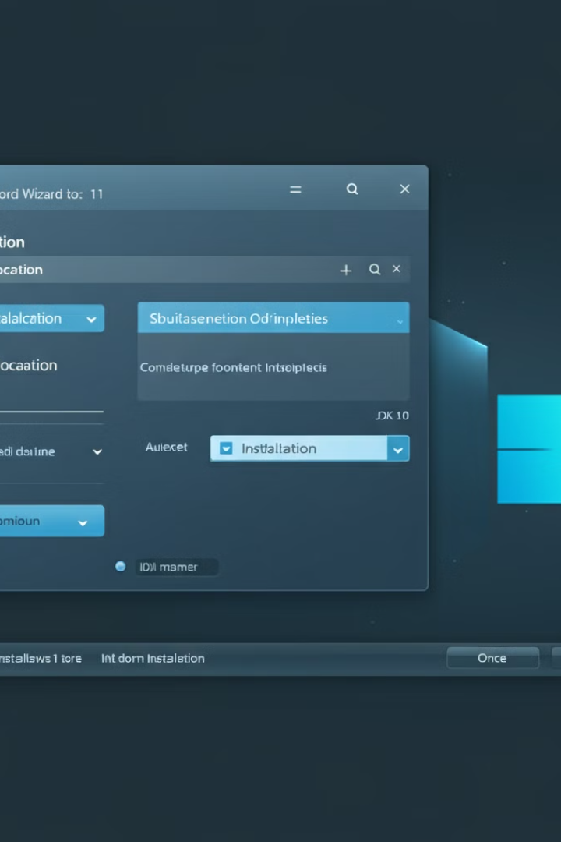



Step 2: Install JDK 11 (Part 1)
Run the Installer
After the download is complete, navigate to the location where you saved the file (usually in the Downloads folder). Double-click the .exe file to run the installer.
Follow Setup Wizard
The JDK Setup Wizard will open. Click Next to begin the installation.
Choose Installation Location
The installer will suggest a default folder, usually something like C:\Program Files\Java\jdk-11.x.x. You can leave it as the default or choose a different location. Click Next.

Slide 4
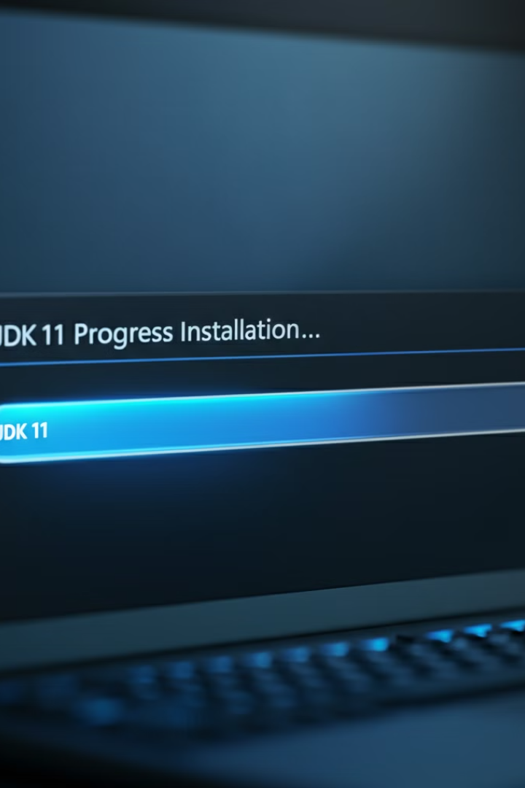


Step 2: Install JDK 11
(Part 2)
Start Installation
The installation process will start. Wait for it to complete. It usually takes a few minutes.
Complete Installation
Once the installation is done, click Close to exit the setup wizard.

Slide 5

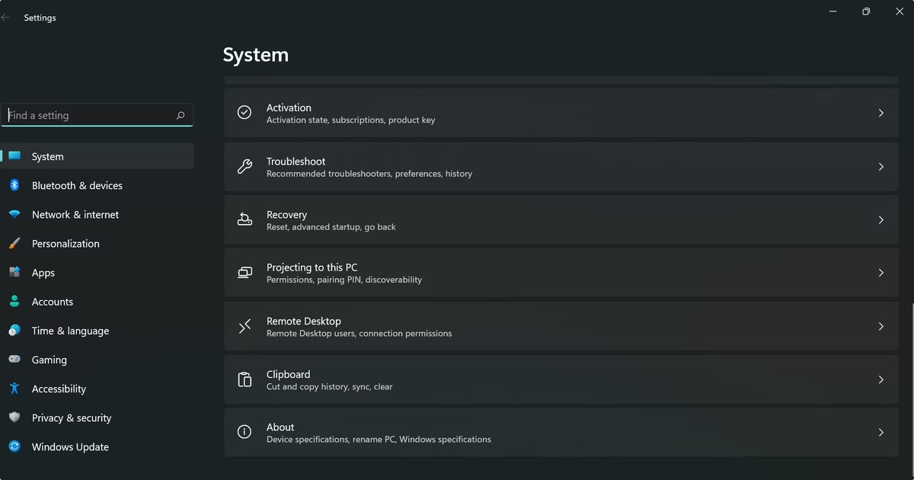
Step 3: Set Up Environment Variables
(Part 1)
To run Java from the command line or to use it in development tools, you need to set environment variables.
1
Open Start Menu
Click on the Start button and search for Environment Variables. Choose Edit the system environment variables.
2
Access Environment Variables
In the System Properties window, click on the Environment Variables button.
3
Edit Path Variable
In the Environment Variables window, under System Variables, find the variable called Path and click on Edit.
4
Add JDK 11 Path
In the Edit Environment Variable window, click New and add the following path (adjust if needed based on where you installed it): C:\Program Files\Java\jdk-11.x.x\bin Then, click OK.

Slide 6
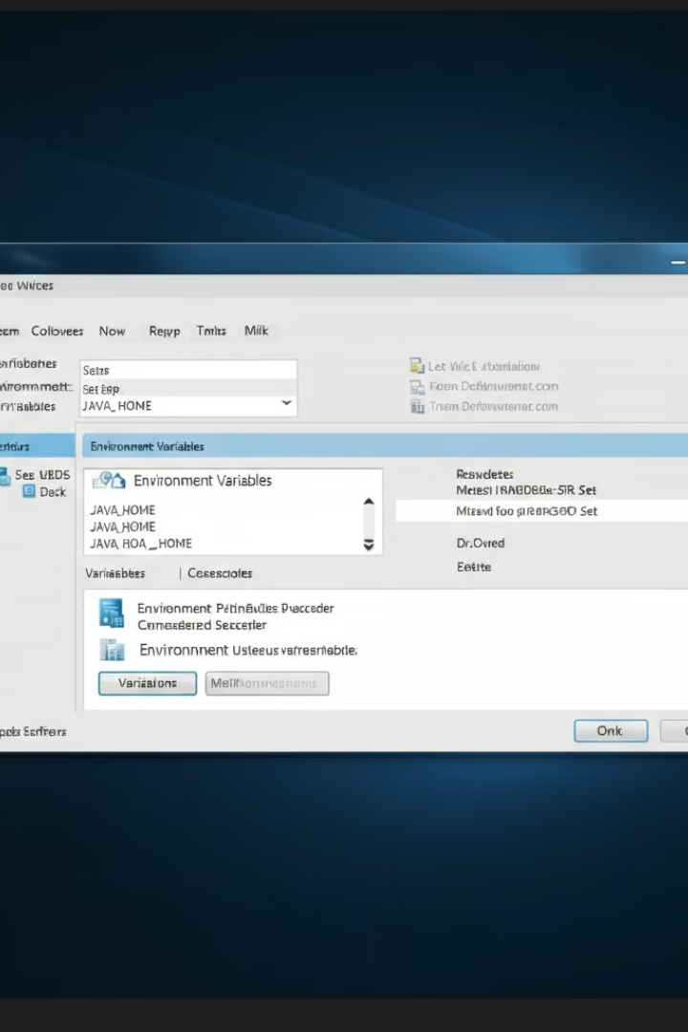
Step 3: Set Up Environment Variables (Part 2)
Set JAVA_HOME
In the Environment Variables window, click New under System Variables.
Set the Variable Name to JAVA_HOME.
Set the Variable Value to the path of your JDK folder (without the \bin), like this: C:\Program Files\Java\jdk-11.x.x - Click OK to save.
Save Changes
Close all windows by clicking OK.

Slide 7
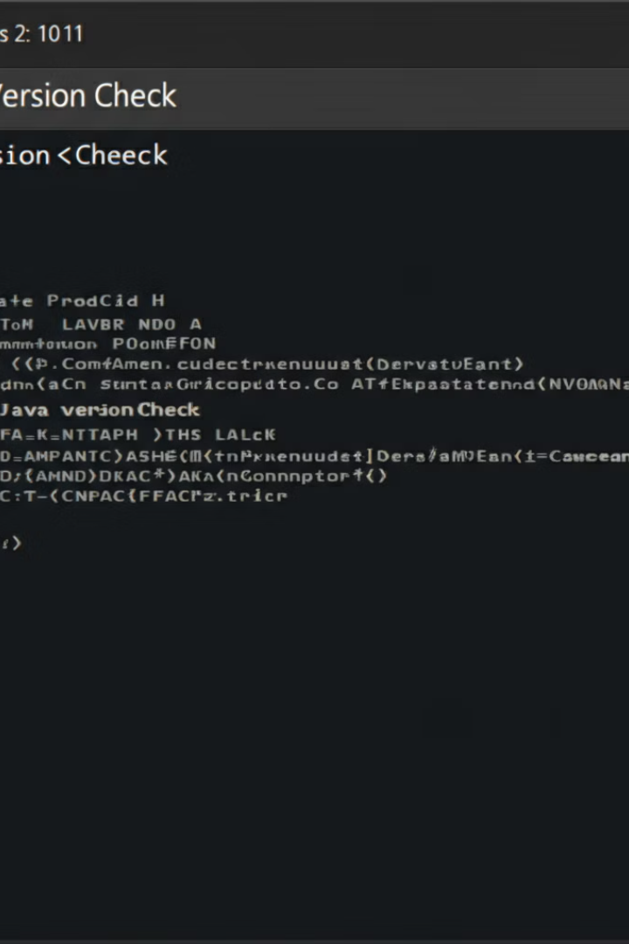
Step 4: Verify the Installation
1
Open Command Prompt
Press the Windows key and type cmd, then press Enter to open the Command Prompt.
2
Check Java Version
Type the following command and press Enter:
java -version If everything is installed correctly, you will see something like:
java version "11.x.x"
Java(TM) SE Runtime Environment
Java HotSpot(TM) 64-Bit Server VM
3
Verify Compiler
Type this command to verify the JDK is working:
javac -version It should display the version of the Java compiler (javac), confirming the installation.

Slide 8

Conclusion
1
Successful Installation
2
Ready for Development
3
Next Steps
Consider exploring Java IDEs like Eclipse or IntelliJ IDEA to enhance your Java development experience.
You have successfully installed JDK 11 on your Windows 11 machine!
Now, you're ready to start writing and running Java programs.

