Slide 1
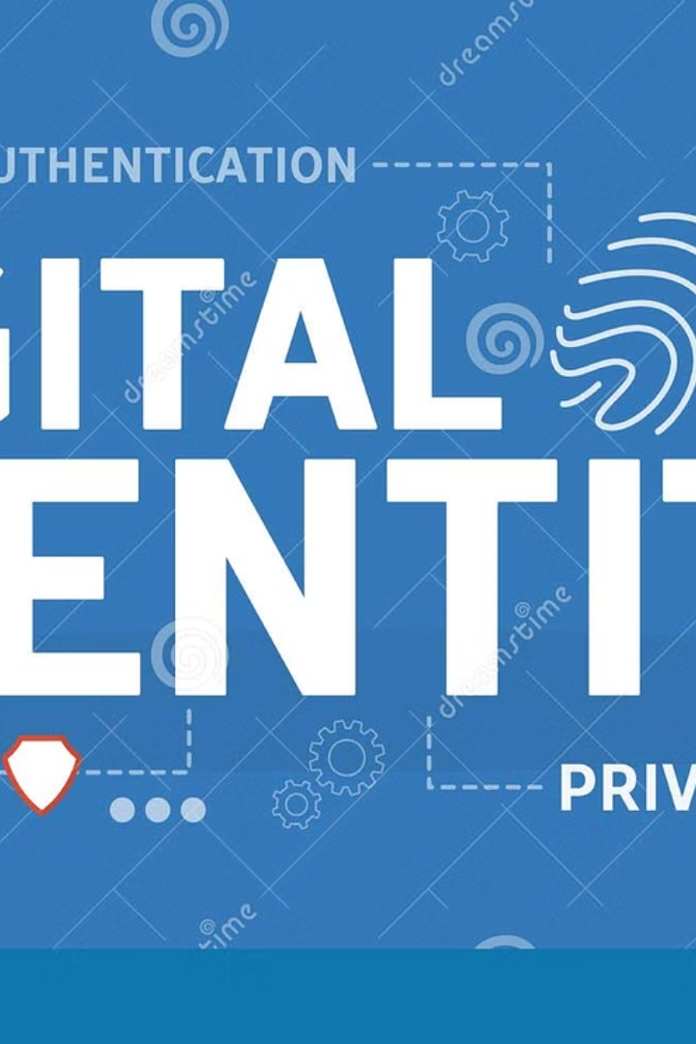

JSON Web Token (JWT): Secure Identity Verification
A JSON Web Token (JWT) is a compact, URL-safe means of representing claims to be transferred between two parties. In simpler terms, it's a secure way for a website or application to confirm your identity and share information about you.
by Ram N Java

Slide 2
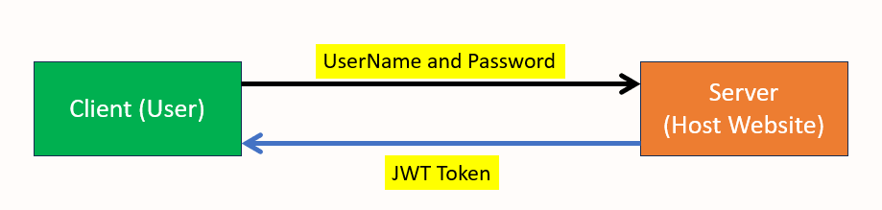
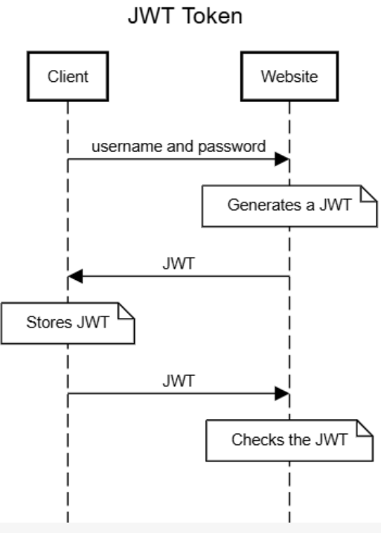

Slide 3
How JWT Works
1
Authentication
When you log in to a website,
you provide your username and password.
2
Token Creation
The website verifies your credentials and,
if they're correct, generates a JWT. This token contains
information about you, such as your user ID and roles.
3
Token Storage
The JWT is sent to your browser, which stores it.
4
Subsequent Requests
For any future requests to the website, your browser sends the
JWT along with the request.
5
Verification
The website checks the JWT to ensure it's valid and hasn't been tampered with.
If it's valid, the website processes your request.

Slide 4

Why JWT is Useful
Stateless Authentication
Security
The website doesn't need to remember your login state between requests. The JWT carries all the necessary information.
JWTs are signed, making it difficult for unauthorized parties to alter the information they contain.
Efficiency
Since the JWT contains all the necessary information, the website doesn't need to query a database for each request, improving performance.

Slide 5
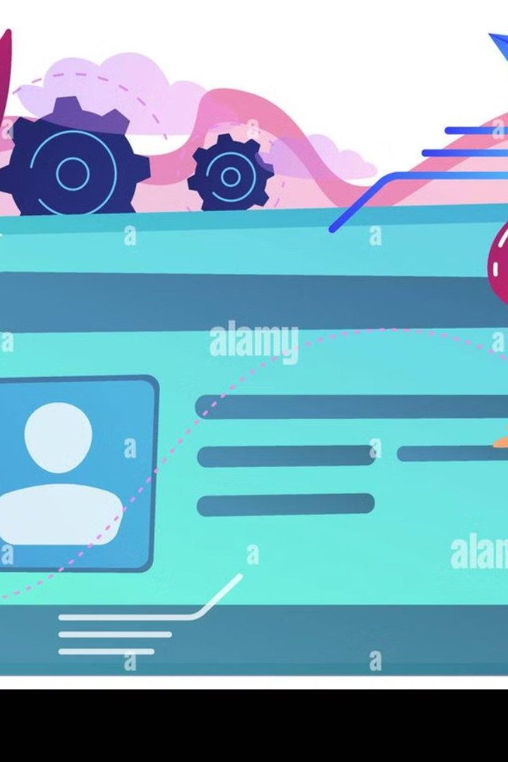
JWT: Your Digital ID Card
In summary, a JWT is like a digital ID card that proves your identity to a website, allowing you to access its services without needing to log in repeatedly.

