Slide 1
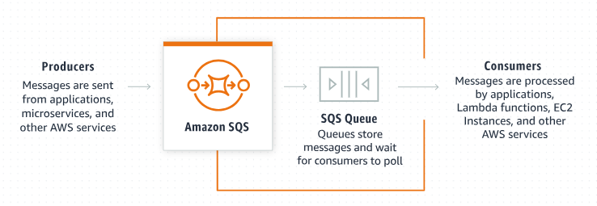
Understanding Amazon Simple Queue Service (SQS)
Amazon Simple Queue Service (SQS) is a fully managed message queuing service that enables you to decouple and scale microservices, distributed systems, and serverless applications.

Slide 2
Components of Amazon SQS
Producer
The component that sends messages to the SQS queue.
SQS Queue
The queue that stores messages until they are processed by the consumer.
Consumer
The component that retrieves and processes messages from the SQS queue.

Slide 3
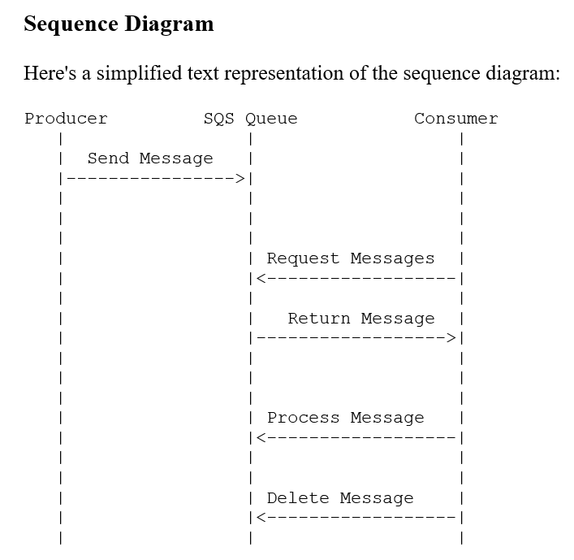
Sequence of Interactions in SQS

Slide 4
Sequence of Interactions in SQS
Producer sends a message
1
The producer sends a message to the SQS queue.
2
SQS queue stores the message
The message is stored in the queue until a consumer is ready to process it.
Consumer requests messages
3
The consumer requests messages from the SQS queue.
4
SQS queue returns a message
The queue returns a message to the consumer.
Consumer processes the message
5
The consumer processes the received message.
6
Consumer deletes the message
After processing, the consumer deletes the message from the queue to ensure it is not processed again.

Slide 5





Detailed Sequence Diagram
Send Message
The producer sends a message to the SQS queue using the SendMessage action. The message is then stored in the queue and is available for processing.
Request Messages
The consumer requests messages from the queue using the ReceiveMessage action. The request can specify the maximum number of messages to retrieve and a wait time.
Return Message
The SQS queue returns one or more messages to the consumer. The messages are temporarily hidden from other consumers (visibility timeout) to allow processing.
Process Message
The consumer processes the message. This can involve various operations depending on the application's logic.
Delete Message
After successfully processing the message, the consumer deletes it from the queue using the DeleteMessage action. Deleting the message ensures it won't be processed again.

Slide 6




Key Benefits of Amazon SQS
Decoupling
Scalability
SQS decouples the producer and consumer, allowing them to operate independently.
Multiple producers and consumers can interact with the queue, enabling horizontal scaling.
Message Durability
Visibility Timeout
Messages are stored redundantly across multiple servers and data centers.
When a message is received, it is hidden from other consumers for a specified period (visibility timeout) to allow processing.

Slide 7
Decoupling in Amazon SQS
1
Independent Operation
SQS allows producers and consumers to operate independently, improving system flexibility.
2
Reduced Dependencies
By decoupling components, SQS reduces direct dependencies between different parts of a distributed system.
3
Improved Fault Tolerance
Decoupling enables better fault tolerance, as issues in one component don't directly impact others.

Slide 8
Scalability with Amazon SQS
Multiple Producers
Multiple Consumers
Elastic Scaling
SQS supports multiple producers sending messages to the same queue, allowing for easy scaling of message generation.
Multiple consumers can process messages from the same queue, enabling parallel processing and improved throughput.
The number of producers and consumers can be dynamically adjusted based on workload, providing elastic scalability.

Slide 9
Message Durability in Amazon SQS
1
Redundant Storage
Messages in SQS are stored redundantly across multiple servers and data centers, ensuring high durability.
2
Data Center Failures
Even in the event of data center failures, messages remain accessible and protected.
3
Message Persistence
Messages are persisted for a configurable retention period, allowing for reliable message processing.

Slide 10
Visibility Timeout in Amazon SQS
1
Message Received
When a consumer receives a message from the queue, the visibility timeout begins.
2
Message Hidden
During the visibility timeout, the message is hidden from other consumers to prevent duplicate processing.
3
Processing Time
The consumer has the duration of the visibility timeout to process the message.
4
Message Deletion or Return
If the message is processed successfully, it's deleted. If not processed within the timeout, it becomes visible again for other consumers.

Slide 11
SendMessage Action in Amazon SQS
1
Producer Initiation
The producer initiates the SendMessage action to send a message to the SQS queue.
2
Message Content
The message can contain any type of data, up to 256 KB in size.
3
Queue Storage
Upon successful SendMessage action, the message is stored in the queue and becomes available for processing.

Slide 12




ReceiveMessage Action in Amazon SQS
Consumer Request
The consumer initiates the ReceiveMessage action to request messages from the SQS queue.
Specify Parameters
The request can specify the maximum number of messages to retrieve and a wait time.
Queue Response
The SQS queue returns one or more messages to the consumer based on the specified parameters.
Visibility Timeout Start
As messages are returned, their visibility timeout begins, temporarily hiding them from other consumers.

Slide 13
Message Processing in Amazon SQS
Receive Message
1
The consumer receives the message from the SQS queue.
2
Parse Content
The consumer parses the message content to extract relevant information.
Execute Logic
3
The consumer executes its application-specific logic based on the message content.
4
Handle Errors
If errors occur during processing, the consumer implements appropriate error handling.
Confirm Completion
5
Upon successful processing, the consumer confirms the completion of the message handling.

Slide 14
DeleteMessage Action in Amazon SQS
1
Processing Completion
After successfully processing the message, the consumer initiates the DeleteMessage action.
2
Message Removal
The DeleteMessage action removes the processed message from the SQS queue.
3
Prevent Reprocessing
Deleting the message ensures it won't be processed again by other consumers.
4
Queue Management
Proper use of DeleteMessage helps maintain an efficient and clutter-free queue.

Slide 15
Building Scalable Systems with
Amazon SQS
Microservices Architecture
Load Balancing
Fault Tolerance
By distributing messages across multiple consumers, SQS enables natural load balancing in distributed systems.
The decoupled nature of
SQS-based systems improves fault tolerance, as components can fail independently without affecting the entire system.
SQS facilitates communication between microservices, allowing for a more modular and scalable architecture.

Slide 16




Best Practices for Using Amazon SQS
Use Batch Operations
Utilize batch operations for sending, receiving, and deleting messages to improve efficiency and reduce costs.
Optimize Visibility Timeout
Set an appropriate visibility timeout based on the expected processing time of your messages.
Monitor Queue Metrics
Regularly monitor queue metrics to ensure optimal performance and identify potential issues.
Implement Security Measures
Use appropriate security measures, such as encryption and access controls, to protect your queue and message data.

Slide 17
Conclusion: The Power of Amazon SQS
1
Scalable and Resilient Systems
2
Flexible Message Management
Using SQS, you can build scalable and resilient distributed systems by decoupling the components that produce and consume messages.
SQS provides a flexible and managed solution for message queuing, allowing developers to focus on application logic rather than infrastructure management.
3
Integration with AWS Ecosystem
4
Continued Innovation
As part of the AWS ecosystem, SQS integrates seamlessly with other AWS services, enabling powerful and complex distributed architectures.
With ongoing updates and improvements from AWS, Amazon SQS continues to evolve, providing new features and capabilities for modern application development.

