Slide 1
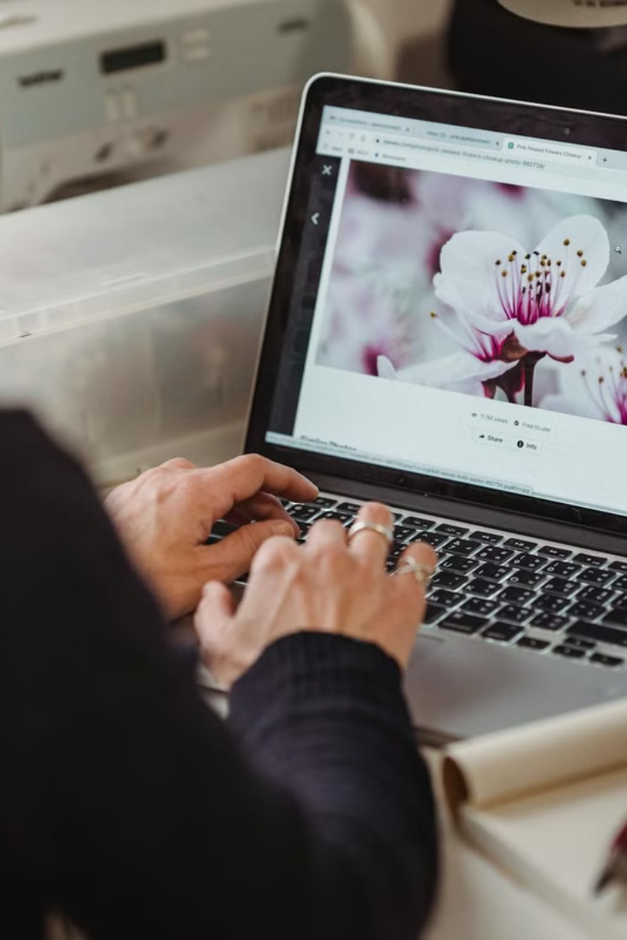

How to Use a Web Browser
A web browser is a program that helps you visit websites like Google, YouTube, Facebook, and more on the internet. Common browsers include Google Chrome, Mozilla Firefox, and Microsoft Edge.
by Ram N Java

Slide 2



How to Open a Web Browser
On a Computer
Double-click the browser icon (Chrome, Firefox, or Edge) on your desktop or taskbar.
On a Phone/Tablet
Tap the browser app in your app menu.

Slide 3
Main Parts of a Browser
Address Bar
Tabs
Back and Forward Buttons
The long box at the top where you type website addresses (like www.google.com).
These let you open multiple websites in the same window.
Help you go to the last page or next page you visited.
Reload Button
Home Button
Bookmarks Bar
Click to refresh the page if it doesn't load properly.
Takes you back to your default homepage.
A place where you can save favorite websites for quick access.
Menu or Settings
Usually in the top right corner. This gives you options like history, downloads, and browser settings.

Slide 4

How to Visit a Website
Click on the address bar at the top
This is where you'll type the website address
Type the website name
Like www.youtube.com
Press Enter on your keyboard
The browser will load the website

Slide 5
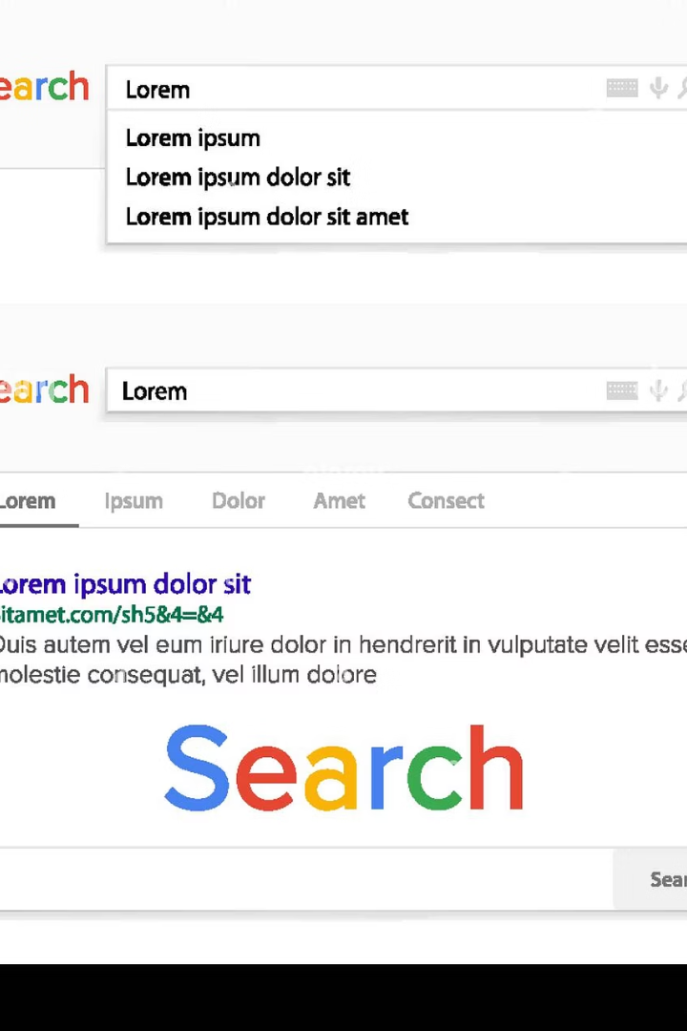



How to Search the Internet
Type in what you want to search
Like "best pizza near me"
Press Enter
This submits your search query
View the list of results
From a search engine like Google or Bing

Slide 6






How to Open a New Tab
A new blank tab opens
Ready for your next task
Click the plus (+) button
Located near the top tab area
Type in another website or search
Begin your next browsing activity

Slide 7

How to Bookmark a Website
Creating a Bookmark
Finding Bookmarks Later
On PC, click the three-dot menu → Bookmarks
Open the website you like
On phones, tap ⋮ → Bookmarks
Click the star icon on the right side of the address bar
Choose a name and folder
Click Done
The website is now saved in your Bookmarks Bar or Bookmark Folder

Slide 8
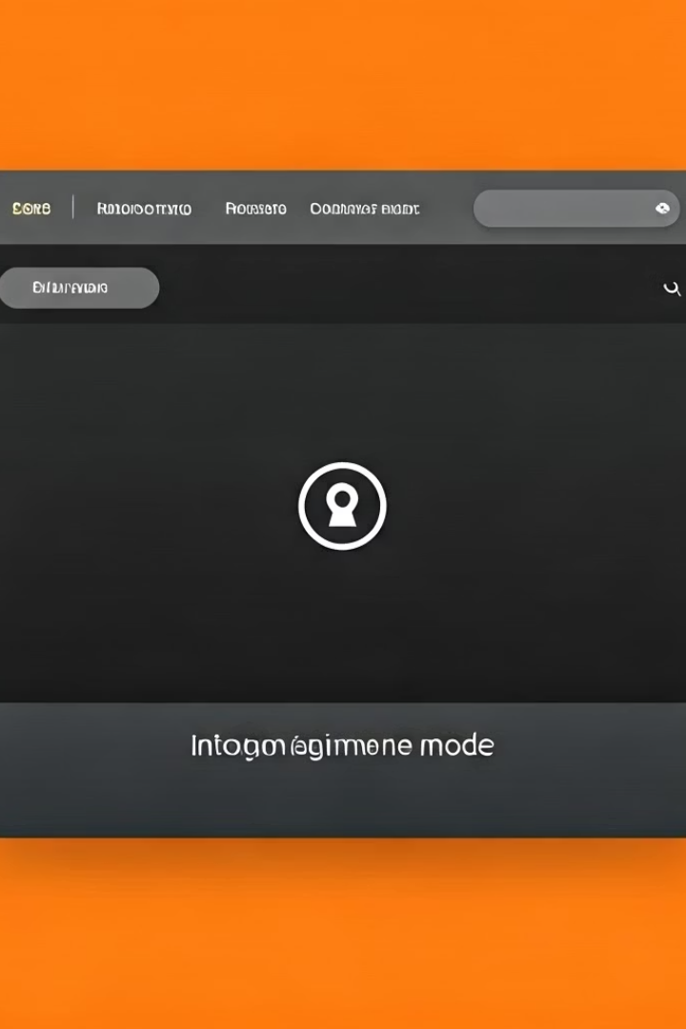



Private or Incognito Browsing
This lets you browse without saving your history.
In Chrome
Click the three dots (top-right) > New Incognito Window
In Firefox
Click the three lines > New Private Window
In Edge
Click the three dots > New InPrivate Window

Slide 9



How to Download Files
Click a download link or button on a website
Find the file you want to download
The file will start downloading automatically
You'll see progress at the bottom of the browser
You can find it in your Downloads folder
Access your files when download completes

Slide 10
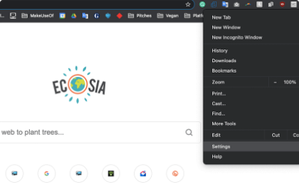
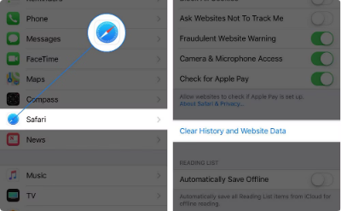
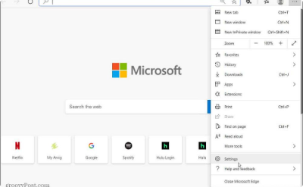
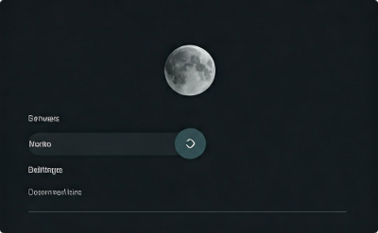
Changing Settings
Click the three dots (Chrome/Edge) or three lines (Firefox) in the top-right corner.
Change your homepage
Clear your browsing history
Manage downloads
Turn on dark mode or other features
Change where files are saved
Set the page that opens when you start your browser
Remove records of websites you've visited
Customize your browsing experience

Slide 11
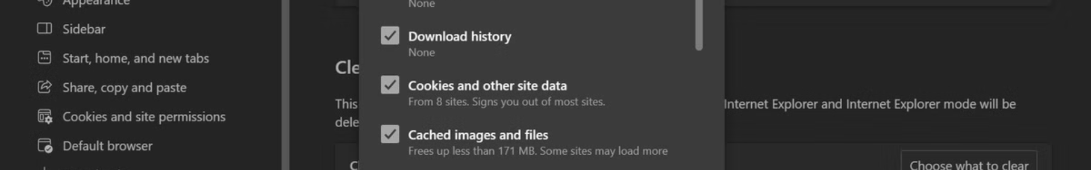



Clearing Browser History
If you want to delete visited websites:
Click ⋮ (menu) → History → Clear browsing data
Access the history clearing options
Select what to delete
Choose from options like history, cookies, and more
Click Clear data
Confirm and complete the deletion process

Slide 12


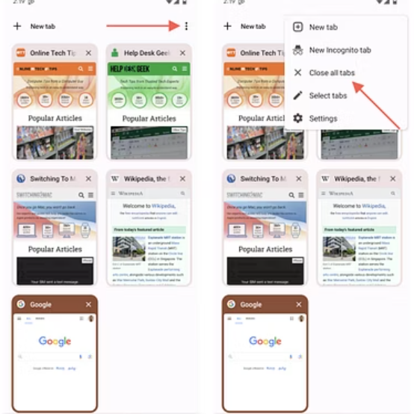


How to Close Tabs or Browser
To close a tab
To close the whole browser
Click the small X on the tab
Click the X in the top corner of the window

Slide 13






Tips for Safe Browsing
Only open trusted websites
Stick to sites you know and trust
Look for https in the address bar
It means the site is secure
Don't click on suspicious links or pop-ups
They could contain malware or scams

Slide 14
Changing Your Browser (Chrome, Firefox, Edge)
Chrome
Fast, good for Google services (Gmail, YouTube)
Firefox
More privacy-focused
Edge
Good for Windows users, uses less battery
You can download a new browser from your current browser by searching:
"Download Google Chrome"
"Download Mozilla Firefox"
"Download Microsoft Edge"

Slide 15
Basic Troubleshooting
1
2
3
Page not loading?
Browser is slow?
Ads popping up?
Press the refresh button (🔄)
Close unused tabs or restart the browser
Avoid clicking suspicious links
Final Tips for Beginners
Always type website names carefully (e.g., amazon.com not amaz0n.com)
Use bookmarks for frequently visited sites
Close tabs you're not using to speed up the browser
Never enter passwords on suspicious websites
Now you're ready to browse the internet safely and easily! 🚀

