Slide 1
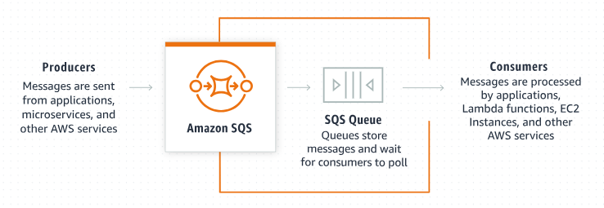
Seamless Messaging: Integrating Amazon SQS with Java Applications
Integrating Amazon SQS (Simple Queue Service) with a Java application is straightforward, especially with the help of the AWS SDK for Java

Slide 2
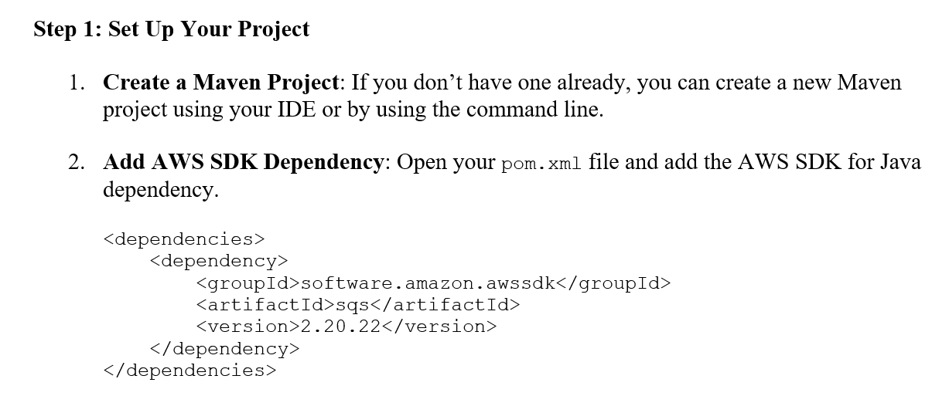
Seamless Messaging: Integrating Amazon SQS with Java Applications

Slide 3
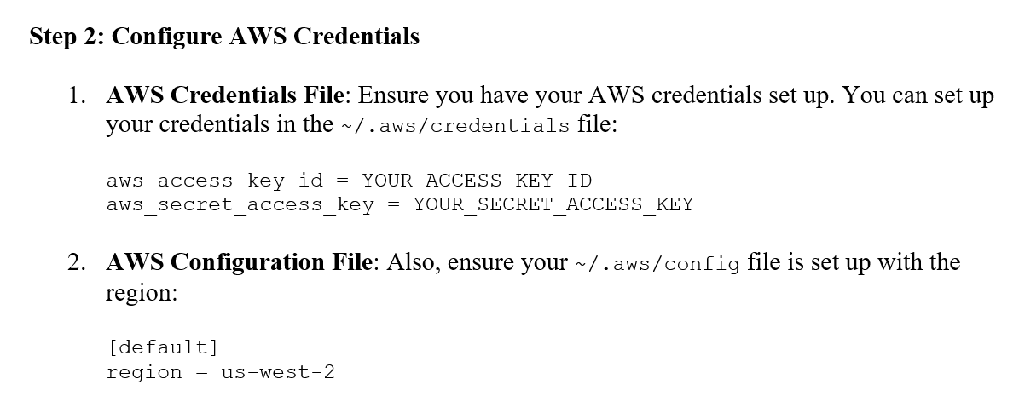
Seamless Messaging: Integrating Amazon SQS with Java Applications

