Slide 1
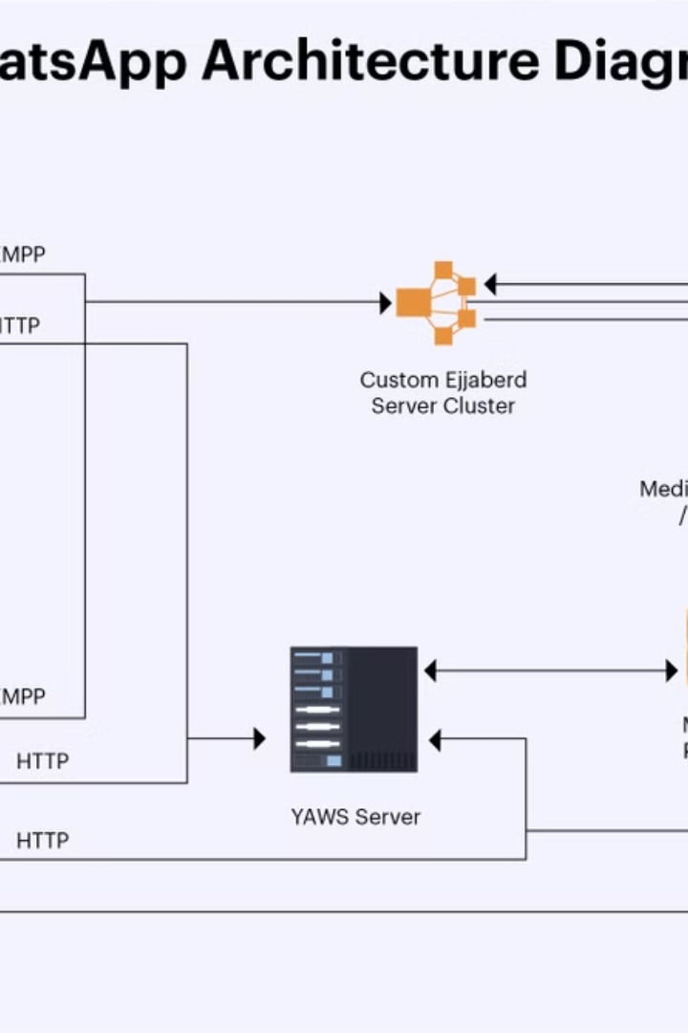

WhatsApp Block Diagram - Explained for Beginners
A block diagram is a simple way to show how WhatsApp works behind the scenes.
by Ram N Java

Slide 2
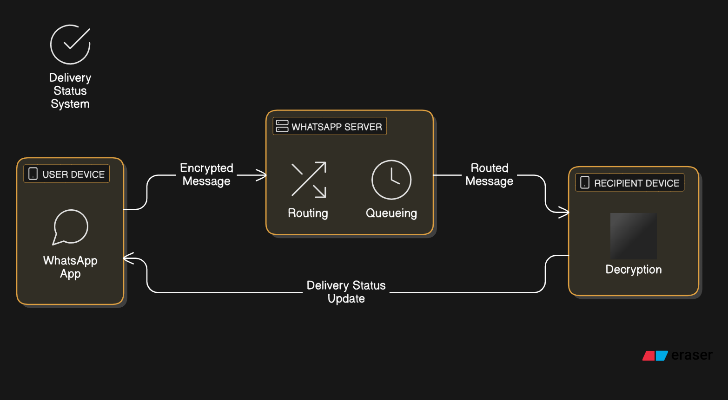

Slide 3
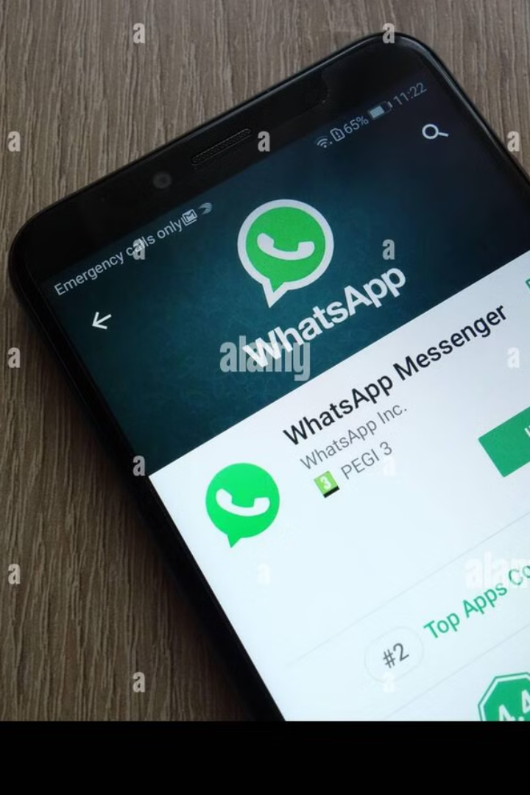
Key Components in the WhatsApp Block Diagram
1
User Device (Phone)
2
WhatsApp App
This is your smartphone, where you use the WhatsApp app to send and receive messages.
The app on your phone takes your message and encrypts it.
Encryption means that your message is converted into a secret code so that no one else can read it.
You type a message, hit "Send", and the process begins.

Slide 4

More Key Components
3
WhatsApp Server
4
Recipient's Device (Phone)
The central system where all messages pass through.
The phone of the person you're messaging.
It does the following:
When their phone connects to the internet, the server sends the encrypted message.
Routes messages: Forwards your message to the recipient.
Queues messages: If the recipient is offline, it holds the message until they come online.
The message is then decrypted and displayed in their chat window.
5
Delivery Status System
WhatsApp uses a system of ticks to show the status of your message:
One tick: Message sent to the server.
Two ticks: Message delivered to the recipient's phone.
Blue ticks: Message read by the recipient.

Slide 5







How It Works - Simplified Flow
Send Message
You send a message from your device.
Encrypt
The WhatsApp app encrypts the message for security.
Server Processing
The message travels to the WhatsApp server.
Message Delivery
If the recipient is online, the server instantly forwards the message.
Message Queue
If they're offline, the message is stored in the queue until their phone connects.
Decryption
Once delivered, the recipient's phone decrypts the message, and they can read it.
Status Update
Delivery statuses are updated in real time on your phone.

Slide 6
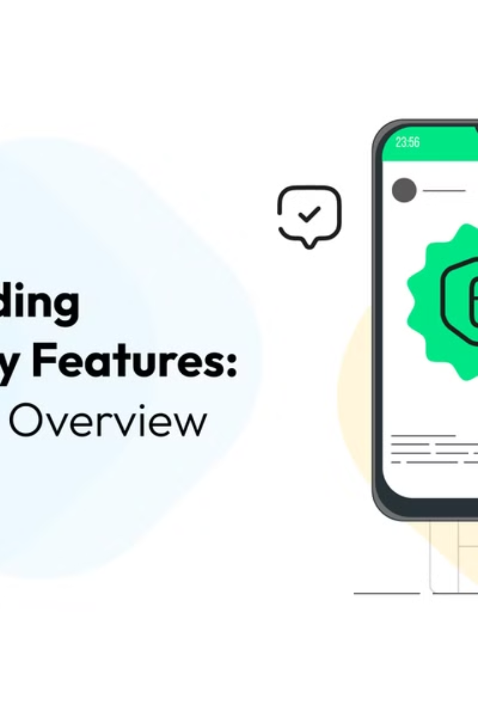




Why This System is Great
End-to-End Encryption
Reliable Delivery
Only the sender and recipient can read the message.
Messages are stored in a queue if the recipient is offline.
Real-Time Updates
Efficient Design
You can see when your message is sent, delivered, and read.
Ensures fast communication with minimal delays.

