Slide 1
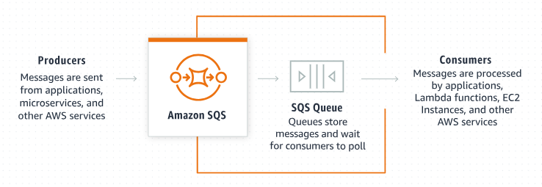
Get Started with Amazon SQS: Building Queues Like a Pro (For Beginners)
Amazon SQS: A message queuing service
Amazon SQS provides queues for high-throughput, system-to-system messaging.
You can use queues to decouple heavyweight processes and to buffer and batch work.
Amazon SQS stores messages until microservices and serverless applications process them.

Slide 2
Get Started with Amazon SQS: Building Queues Like a Pro (For Beginners)
How it works?
Amazon SQS allows producers to send messages to a queue.
Messages are then stored in an SQS Queue.
When consumers are ready to process new messages they poll them from the queue.
Applications, microservices, and multiple AWS services can take the role of producers or consumers.

Slide 3
Get Started with Amazon SQS: Building Queues Like a Pro (For Beginners)
Benefits and features:
1. Highly scalable Standard and FIFO queues
Queues scale elastically with your application.
Nearly unlimited throughput and no limit to the number of messages per queue in Standard queues.
First-In-First-Out delivery and exactly once processing in FIFO queues.
2. Durability and availability
Your queues are distributed on multiple servers. Redundant infrastructure provides highly concurrent access to messages.
3. Security
Protection in transit and at rest. Transmit sensitive data in encrypted queues. Send messages in a Virtual Private Cloud.
4. Batching
Send, receive, or delete messages in batches of up to 10 messages or 256KB to save costs.

