Slide 1
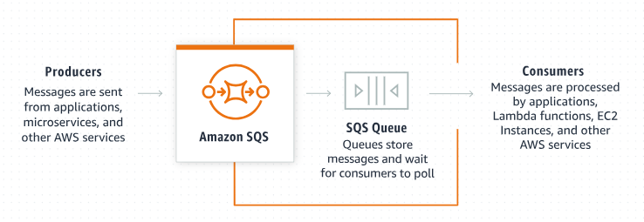
Integrating Amazon SQS with Spring Boot : Sending and Receiving Messages
AWS SQS (Simple Queue Service) is a fully managed, distributed messaging system provided by AWS. The SQS acts as a message broker, enabling one component or service to send messages to a queue while other components or services can consume messages from that queue.
This architecture allows for asynchronous communication, where messages are placed by producers in the queue and processed by consumers at their own pace, effectively decoupling the producer and consumer.

Slide 2
Integrating Amazon SQS with Spring Boot : Sending and Receiving Messages
Spring Cloud AWS
Spring Cloud AWS is part of the Spring ecosystem and is designed to simplify the integration of AWS (Amazon Web Services) services into Spring applications.
Spring Cloud AWS provides a set of tools and libraries that make it easier for developers to build cloud-native applications on the AWS platform using the Spring Framework. Its SQS module allows us to send and receive messages to and from SQS queues within your Spring application.

Slide 3
Integrating Amazon SQS with Spring Boot : Sending and Receiving Messages
Prerequisites
Before beginning this tutorial, these are the prerequisites that must be met:
We must have an AWS account to utilize AWS services. If you do not have an AWS account, you can sign up at aws.amazon.com/console
We need a user with programmatic access (secret ID and secret key) in order to access AWS services.
A simple Spring Boot 3 application.

Slide 4
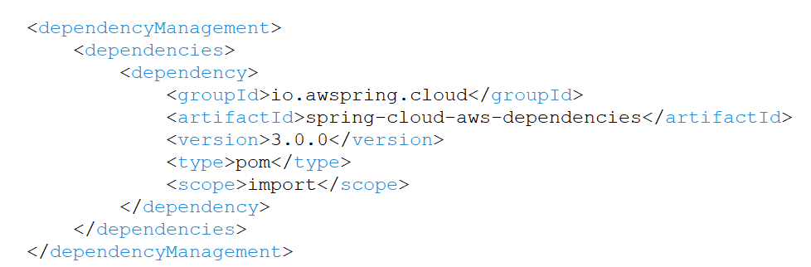
Integrating Amazon SQS with Spring Boot : Sending and Receiving Messages
To simplify dependency management, we will use
Spring Cloud AWS’s Bill of Materials (BOM)

Slide 5
Integrating Amazon SQS with Spring Boot : Sending and Receiving Messages
Message Acknowledgements
Acknowledging the completion of message processing is important so the message can be removed from the queue.
There are three acknowledgment modes available:
ON_SUCCESS – Acknowledges a message after successful processing.
ALWAYS – Acknowledges a message after processing, regardless of success or error.
MANUAL – The framework does not acknowledge messages automatically, and Acknowledgement objects can be received in the listener method. In this mode, you must send acknowledgments manually.

Slide 6
Integrating Amazon SQS with Spring Boot : Sending and Receiving Messages
Manual Acknowledgment
To handle message acknowledgments manually, we can use the SqsMessageListenerContainerFactory bean and set the default mode to MANUAL.
To perform manual acknowledgment, we use the static method Acknowledgement.acknowledge().
If required, we can also attach a callback to our acknowledgment with AcknowledgementResultCallback. This helps in making sure that acknowledgments have been received by AWS properly.

Slide 7
Integrating Amazon SQS with Spring Boot : Sending and Receiving Messages
Automatic Acknowledgement
When using the @SqsListener annotation, message acknowledgment is automatically handled by the framework once the annotated method successfully processes the message. This simplifies the message processing flow, guaranteeing that messages are not processed multiple times, thereby reducing the risk of message loss in the application.

Slide 8
Integrating Amazon SQS with Spring Boot : Sending and Receiving Messages
Polling Messages with SqsTemplate
To receive a message, we interact with the SQS API to check for new messages. In this method, messages are not pushed from the server to us.
To implement short polling, we utilize the receive() method of the SqsTemplate within an infinite loop, consistently checking the queue’s status. If the queue is empty, the receive() method returns an empty response.

