Slide 1
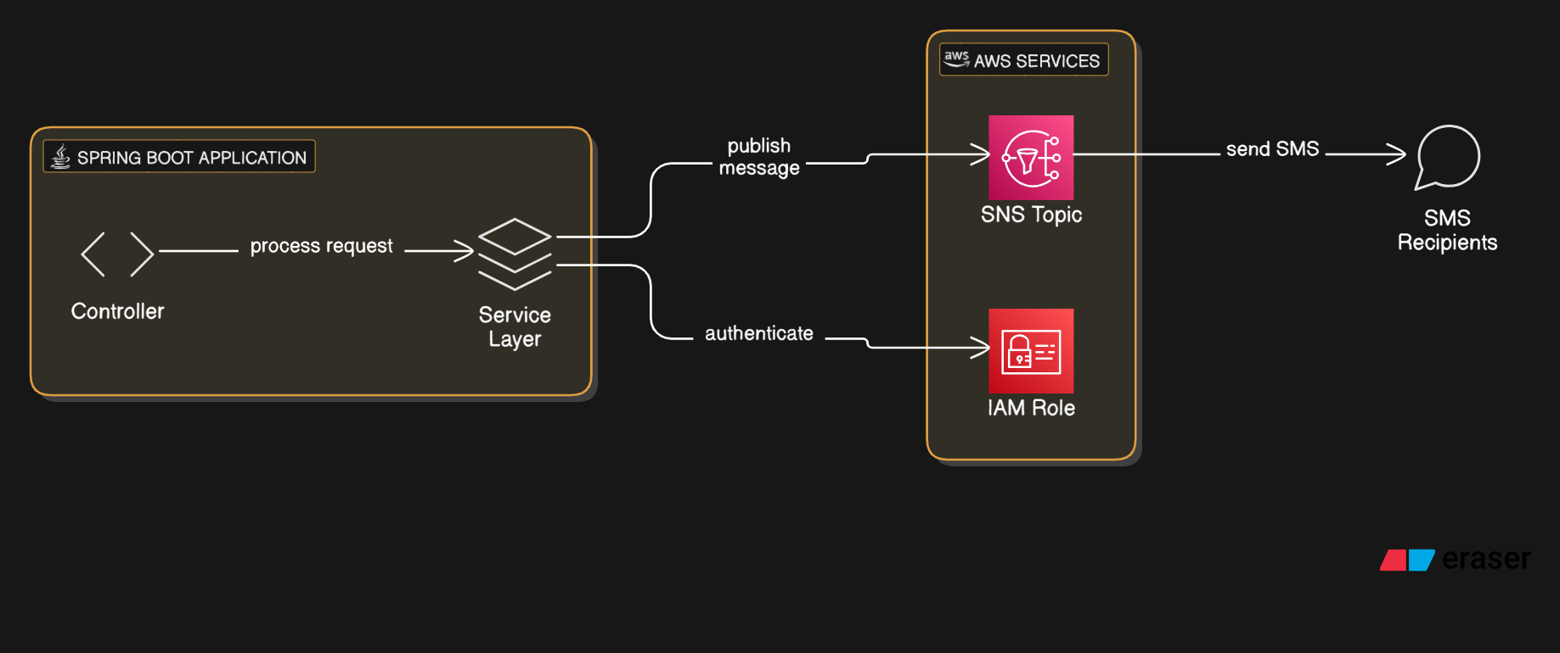

How to send SMS using AWS SNS Topic in a Spring Boot application

Slide 2
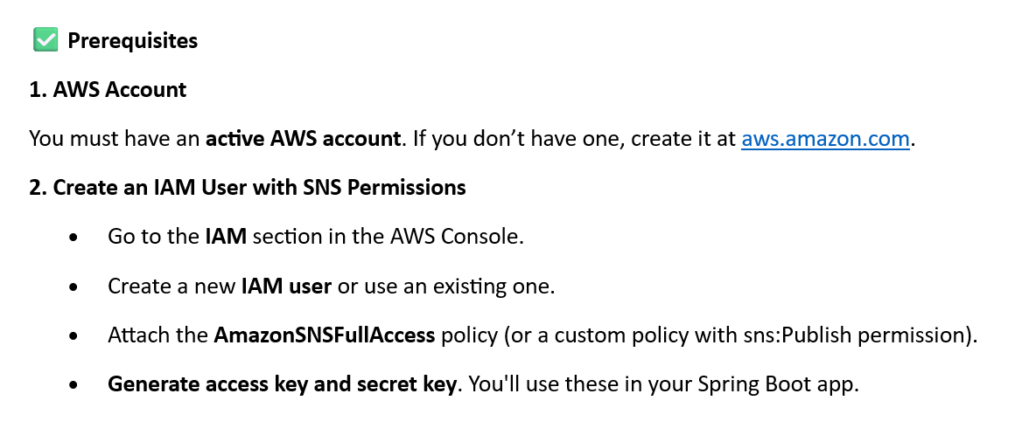
How to send SMS using AWS SNS Topic in a Spring Boot application

Slide 3
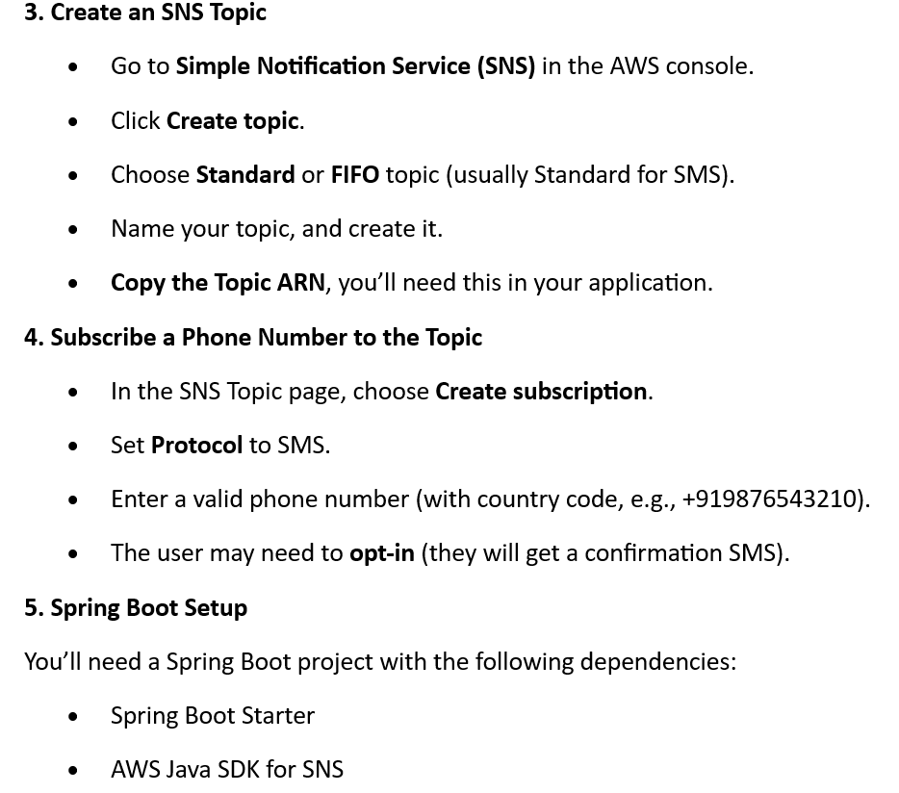
How to send SMS using AWS SNS Topic in a Spring Boot application

