Slide 1
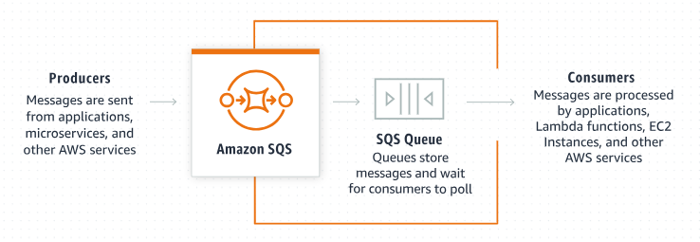
Introduction to Amazon SQS Encryption: A Beginner's Guide
Amazon SQS (Simple Queue Service):
Amazon SQS is a service provided by AWS that allows you to send, store, and receive messages between software components in a distributed system. It helps decouple the components of an application, enabling them to communicate asynchronously.

Slide 2
Introduction to Amazon SQS Encryption: A Beginner's Guide
Why Encryption?
Encryption ensures that the data in your messages is protected and cannot be read by unauthorized parties. This is crucial for maintaining the confidentiality and integrity of your data, especially when dealing with sensitive information.

Slide 3
Introduction to Amazon SQS Encryption: A Beginner's Guide
Amazon SQS Encryption:
Amazon SQS Encryption: Amazon SQS offers encryption to secure your data both in transit and at rest. Let's break down these two concepts:
Encryption at Rest:
What It Means: Encryption at rest protects your data while it is stored in queues.
How It Works: When you enable encryption at rest for an SQS queue, the service uses AWS Key Management Service (KMS) to encrypt the message body and any message attributes before storing them. AWS KMS manages the keys and handles the encryption and decryption processes.
Encryption in Transit:
What It Means: Encryption in transit protects your data as it travels from one point to another.
How It Works: Amazon SQS automatically uses HTTPS (HyperText Transfer Protocol Secure) to encrypt messages as they move between your applications and SQS queues. This ensures that the data is secure during transmission.

Slide 4
Introduction to Amazon SQS Encryption: A Beginner's Guide
Setting Up Amazon SQS Encryption:
Creating a KMS Key:
Go to the AWS Management Console.
Navigate to AWS Key Management Service (KMS).
Create a new key or use an existing key.
Enabling Encryption for a Queue:
When creating a new SQS queue or updating an existing one, you can enable encryption by selecting the KMS key you created.
This can be done through the AWS Management Console, AWS CLI, or AWS SDKs.

Slide 5
Introduction to Amazon SQS Encryption: A Beginner's Guide
Benefits of Using Amazon SQS Encryption:
Data Protection: Ensures that your data is protected from unauthorized access.
Compliance: Helps meet regulatory and compliance requirements for data security.
Integration with AWS Services: Seamlessly integrates with other AWS services like CloudTrail for auditing and monitoring.

Slide 6
Introduction to Amazon SQS Encryption: A Beginner's Guide
Example Scenario:
Imagine you have an application that processes orders for an online store. When a customer places an order, the order details are sent as a message to an SQS queue. By enabling encryption, you ensure that these order details (which might include sensitive customer information) are securely stored and transmitted, protecting them from potential security threats.

Slide 7
Introduction to Amazon SQS Encryption: A Beginner's Guide
Conclusion:
Amazon SQS encryption is a powerful feature that enhances the security of your messaging system. By understanding and implementing it, you can ensure that your data is safeguarded, meeting both security standards and compliance requirements.

