Slide 1


Ransomware
What is Ransomware?
Ransomware is a type of computer virus or malicious software (malware) that locks your files or computer and demands money (a ransom) to unlock them.
by Ram N Java

Slide 2





How Does Ransomware Work?
Entry Points
Silent Infection
System Lockdown
You may click a bad link, open a fake email attachment, or download an infected file.
The ransomware enters your computer without you knowing.
It locks your files, photos, or even the entire system.
Ransom Demand
No Guarantees
A message appears saying you must pay money to unlock your files.
Even if you pay, there is no guarantee your files will be restored.

Slide 3






What Happens to Your Files?
Hacker Control
Only the hacker has the key to unlock them.
Encryption
Your files are encrypted, which means they are turned into unreadable code.
Inaccessible Files
You can't open or use the files unless you get that key.

Slide 4
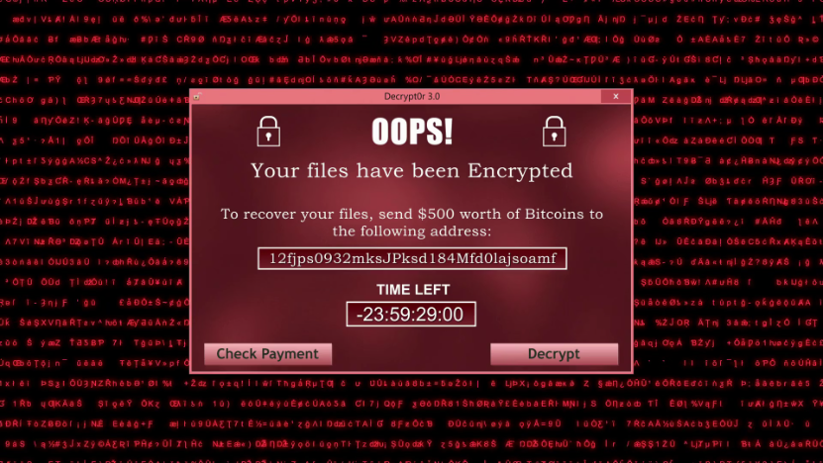
What Does It Look Like?
What Can You Lose?
Important documents
Family photos and videos
Business files
Full access to your computer
A screen message saying "Your files have been encrypted."
A countdown timer showing how much time you have to pay the ransom.
Instructions to pay using cryptocurrency like Bitcoin.

Slide 5





How to Protect Yourself from Ransomware
Be Cautious Online
Do not click suspicious links or emails.
Be very careful with unknown email attachments or links.
Maintain Backups
Always keep backups of your files in a safe place.
Use Security Software
Use strong antivirus software and keep it updated.
Keep Systems Updated
Keep your computer and software updated with the latest security fixes.
Enable Extra Protection
Use Two-Factor Authentication on important accounts.

Slide 6





What to Do If You Get Infected
Don't Pay
Do not pay the ransom.
Disconnect
Disconnect from the internet immediately to stop the spread.
Run Security Software
Use a trusted antivirus program to try to remove the virus.
Seek Professional Help
If needed, take your device to a professional or contact cybersecurity help.
Restore Backups
Restore your files from a backup if you have one

Slide 7


In Simple Words
Digital Kidnapper
Protection Through Backups
Ransomware is like a digital kidnapper that locks your computer or files and asks for money to unlock them.
Be careful online and always back up your important data.

