Slide 1

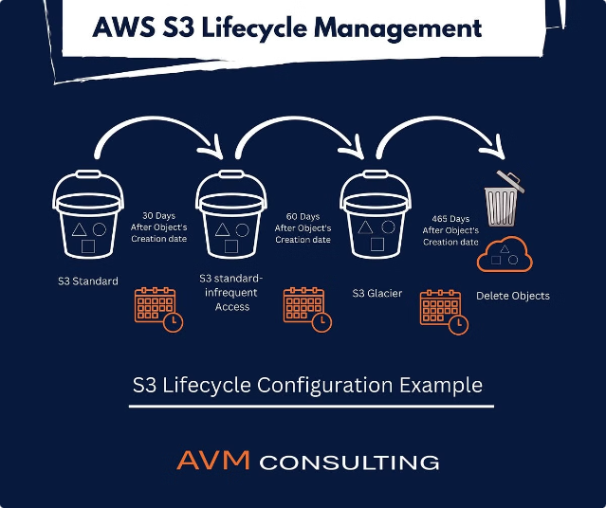

Introduction to AWS S3 Lifecycle Rules
Discover how to leverage AWS S3 Lifecycle Rules to automate data management and optimize storage costs for your cloud-based applications.
by Ram N Java

Slide 2

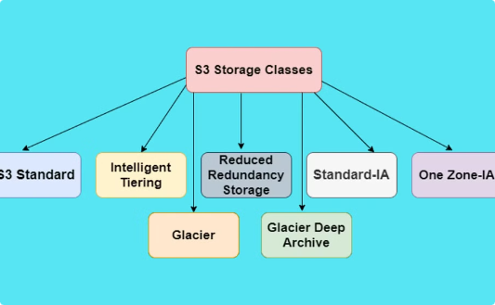
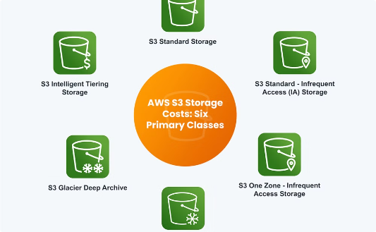
What are AWS S3 Lifecycle Rules?
Automated Object Management
Transition Between Storage Classes
Expire and Delete Objects
Lifecycle Rules can also be configured to permanently delete objects after a certain period of time, ensuring you don't pay for storing data you no longer need.
AWS S3 Lifecycle Rules allow you to automatically manage the lifecycle of objects stored in your S3 buckets, transitioning them between different storage classes or deleting them based on predefined conditions.
Lifecycle Rules can move your objects from one S3 storage class (like Standard) to a more cost-effective class (like Glacier) as they age, optimizing your storage costs over time.

Slide 3

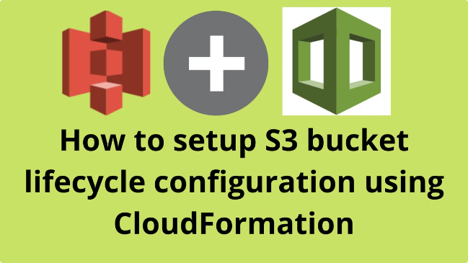
Why use S3 Lifecycle Rules?
Cost Optimization
Automated Data Management
Lifecycle rules allow you to automatically transition data to
lower-cost storage classes or delete expired objects, reducing your overall AWS S3 storage costs.
Lifecycle rules take the manual effort out of managing your data throughout its lifespan, ensuring objects are moved or deleted based on predefined policies.
Regulatory Compliance
Lifecycle rules can help you adhere to data retention policies and regulations by automatically deleting data that has reached the end of its required storage period.

Slide 4


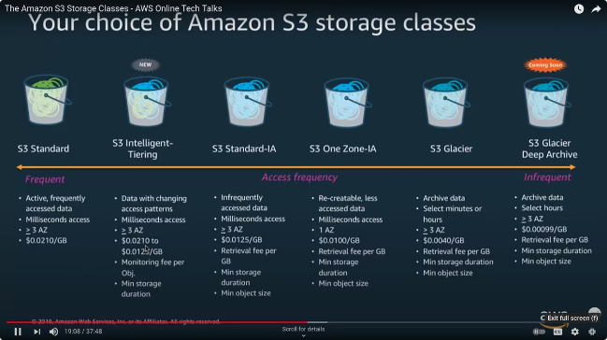


How do S3 Lifecycle Rules work?
Define Lifecycle Actions
Lifecycle Rules allow you to specify actions to take on objects, such as transitioning between storage classes or deleting expired objects.
Set Transition Triggers
You can configure rules to automatically move objects to lower-cost storage classes based on age or access patterns.
Schedule Expiration
Lifecycle Rules can be used to delete objects after a specified time period, freeing up storage and reducing costs.

Slide 5
Transition actions in S3 Lifecycle Rules
Move to cheaper storage classes
Migrate to different S3 tiers
S3 Lifecycle Rules allow you to automatically transition objects to lower-cost storage classes like S3 Glacier or S3 Glacier Deep Archive after a specified period of time. This helps optimize storage costs for data that is accessed less frequently.
You can configure a rule to move objects from the Standard storage class to the Infrequent Access (IA) class, which has a lower cost per GB but higher retrieval fees. This is useful for data that is accessed occasionally.

Slide 6
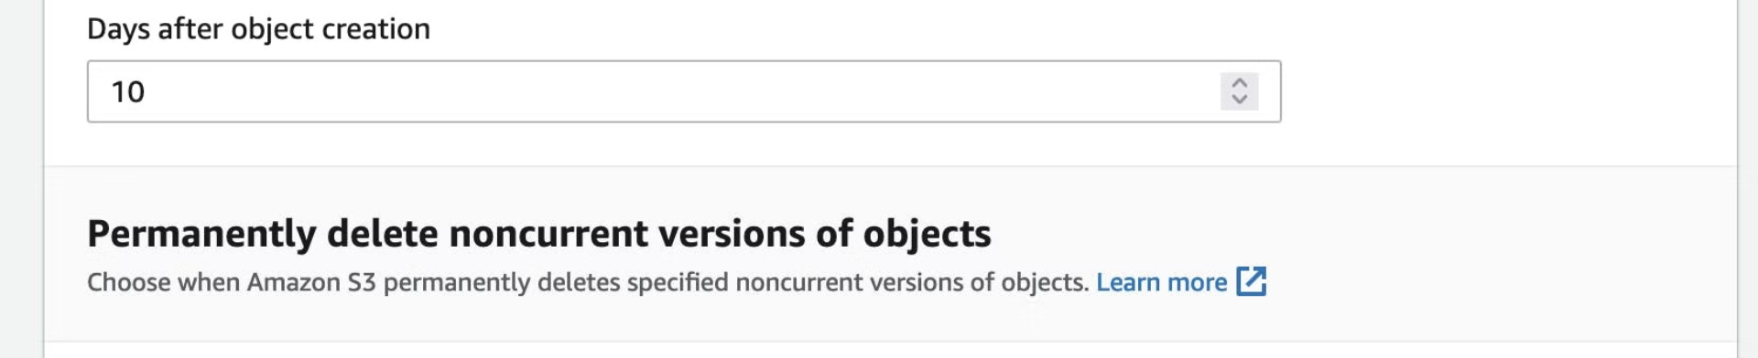



Expiration actions in S3 Lifecycle Rules
Object Expiration
Transition to Glacier
Reporting
Automatically delete objects after a specified number of days or on a certain date. This helps remove outdated or unused data to reduce storage costs.
Move infrequently accessed objects to the lower-cost S3 Glacier storage class. This archives data while still making it accessible for retrieval when needed.
Monitor expiration activity with detailed logs and metrics. This helps you analyze the impact of your lifecycle rules and optimize your storage usage.

Slide 7

Configuring S3 Lifecycle Rules
Define rules
Expire objects
Create custom S3 Lifecycle Rules to automate object management based on age, storage class, and other criteria.
Automatically delete objects that have reached the end of their lifecycle to reclaim storage and reduce costs.
1
2
3
Transition objects
Automatically move objects to more cost-effective storage classes like Glacier or Glacier Deep Archive as they age.

Slide 8
Creating a new S3 Lifecycle Rule
Define Rule
1
Name and describe the rule
Select Bucket
2
Choose the S3 bucket to apply the rule to
Configure Actions
3
Set the transition and expiration actions
Review and Save
4
Confirm the rule details and save
Creating a new S3 Lifecycle Rule involves several steps. First, you'll need to define the rule by giving it a name and describing its purpose. Next, select the S3 bucket where you want the rule to apply. Then, configure the desired transition and expiration actions. Finally, review the full rule details and save it to start automating your S3 storage management.

Slide 9
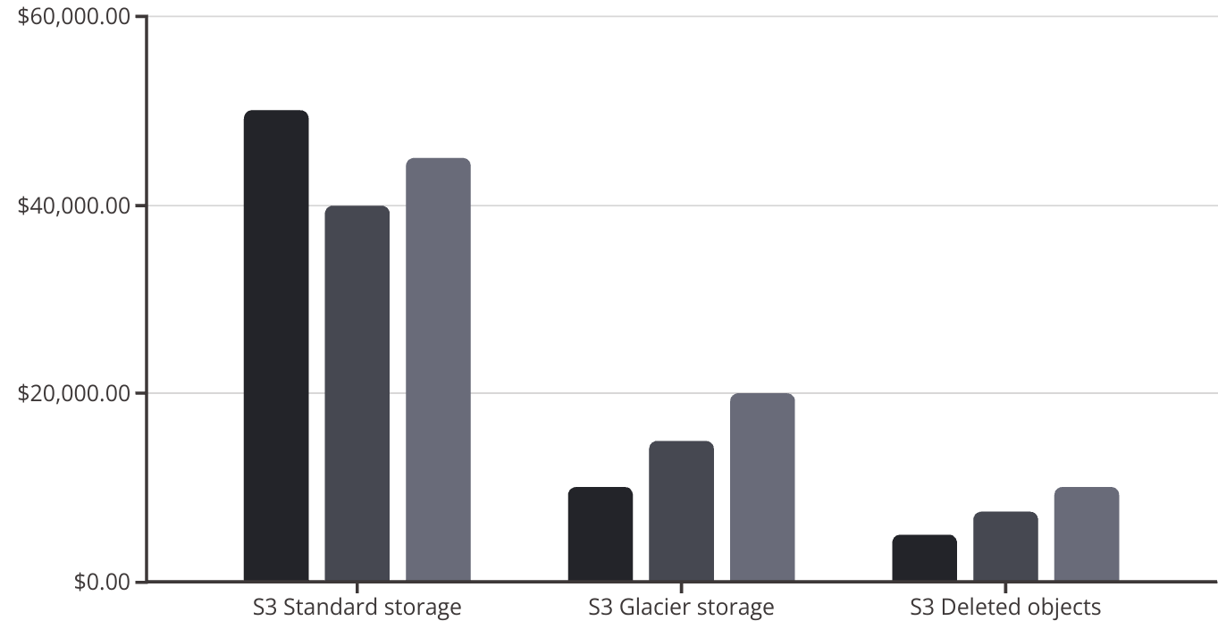
Monitoring S3 Lifecycle Rule activity
Monitoring the activity of your S3 Lifecycle Rules is crucial to ensure they are functioning as expected and optimizing your storage costs. AWS provides several tools to help you track and analyze the impact of your Lifecycle Rules.
The AWS CloudTrail service logs all actions taken on your S3 buckets, including Lifecycle Rule transitions and object deletions. You can review these logs to see when Lifecycle Rules are being applied and which objects are affected.
Additionally, the AWS Cost Explorer service allows you to analyze your historical S3 storage costs and identify savings from your Lifecycle Rules. You can view the storage class transitions and object expirations to understand the impact on your monthly bill.
Q1
Q2
Q3
The chart shows the impact of the S3 Lifecycle Rules, with a decrease in Standard storage and an increase in Glacier storage and deleted objects over the quarters.

Slide 10
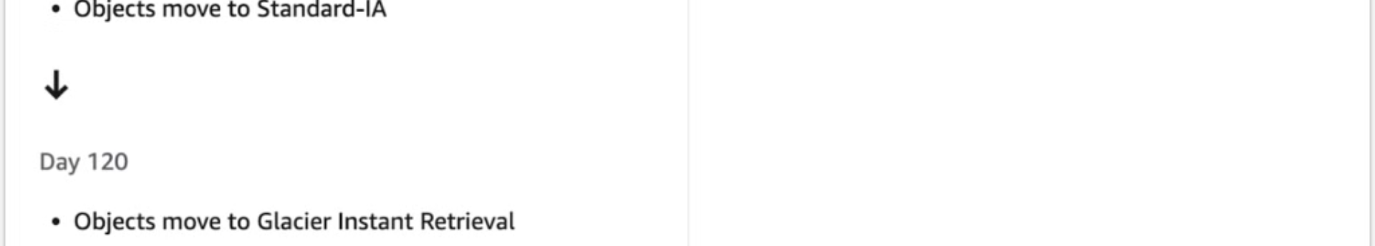
Cost savings with S3 Lifecycle Rules
Implementing S3 Lifecycle Rules can lead to significant cost savings on your AWS bill. By automatically transitioning infrequently accessed data to more affordable storage classes, such as Glacier or Glacier Deep Archive, you can reduce your overall storage costs. Additionally, setting expiration rules to delete objects that are no longer needed helps reclaim storage space and avoid unnecessary charges.
Storage class transition
Reduced storage costs
Automatic object deletion
Reclaimed storage space
By implementing well-configured S3 Lifecycle Rules, you can optimize your S3 storage strategy
and keep your AWS costs under control.

Slide 11

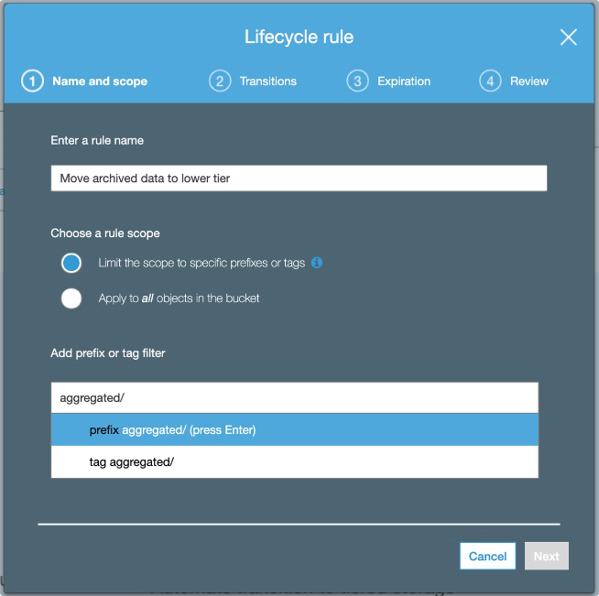
Archiving Infrequently Accessed Data with S3 Lifecycle Rules
1
Transition to Glacier Storage
2
Expire Unused Objects
Lifecycle Rules can also automatically delete objects that have not been accessed for a specified time period, freeing up storage and further cutting costs.
S3 Lifecycle Rules enable you to automatically transition infrequently accessed data to the more cost-effective Glacier storage class, reducing your storage costs.
3
Optimize Storage Tiers
By implementing a tiered storage strategy with Lifecycle Rules, you can store your most active data in the fastest and most expensive S3 storage classes, while archiving less frequently accessed data to Glacier.

Slide 12

Deleting Expired Objects with S3 Lifecycle Rules
Automated Object Removal
Expiration Configuration
Retention Policies
S3 Lifecycle Rules can automatically delete objects that have reached the end of their defined lifecycle, freeing up storage space and reducing costs.
You can configure Lifecycle Rules to permanently delete objects after a specified number of days, weeks, or months since their creation or last modification.
Lifecycle Rules allow you to implement data retention policies, ensuring that objects are automatically deleted when they're no longer needed, preventing storage bloat.

Slide 13

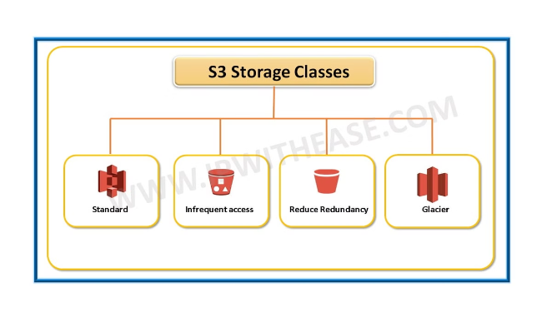
Optimizing S3 Storage Classes with Lifecycle Rules
1
Automate Transitions
2
Expire Unused Data
Lifecycle rules can automatically transition objects between different S3 storage classes, like moving data from S3 Standard to the lower-cost S3 Glacier or S3 Glacier Deep Archive.
Lifecycle rules can delete objects that have not been accessed in a long time, reclaiming storage space and reducing costs.
3
Optimize for Access Patterns
4
Reduce Manual Effort
By understanding your data's access patterns, you can use lifecycle rules to place it in the most cost-effective storage class.
Lifecycle rules automate the management of your S3 data, saving time and effort compared to manual object transitions and deletions.

Slide 14





Integrating S3 Lifecycle Rules with other AWS Services
AWS Lambda
Trigger AWS Lambda functions to execute custom actions when lifecycle events occur, like archiving objects or deleting expired data.
Amazon DynamoDB
Use DynamoDB to store metadata about S3 objects and
enable advanced lifecycle management policies.
Amazon Athena
Analyze S3 object metadata and lifecycle activity using Athena to gain insights and optimize your storage strategies.

Slide 15
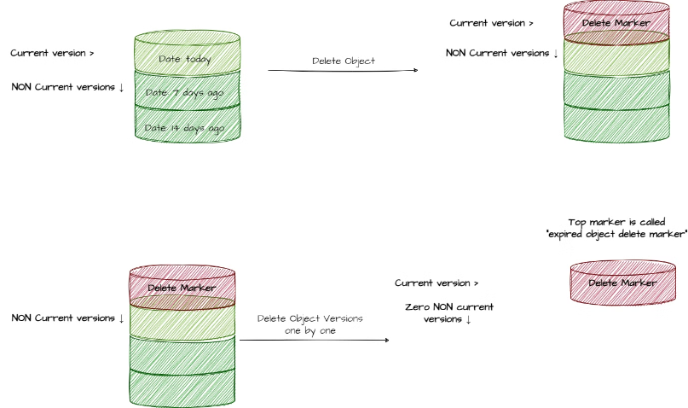
Real-world examples of S3 Lifecycle Rule usage
S3 Lifecycle Rules have a wide range of real-world applications. One common use case is automatically archiving older files to the lower-cost Glacier storage class. This helps companies manage costs by moving rarely accessed data to more affordable storage tiers.
Another example is setting up rules to delete objects after a certain retention period, such as removing temporary files or log data that is no longer needed. This keeps S3 buckets lean and efficient, reducing overall storage costs.

Slide 16

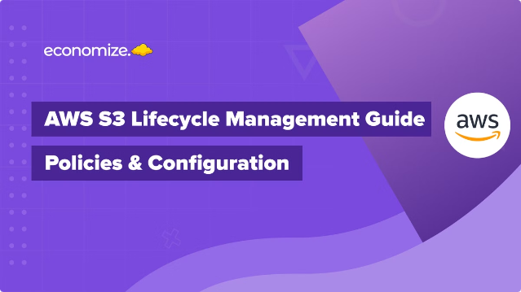
Conclusion and Key Takeaways
In conclusion, AWS S3 Lifecycle Rules offer a powerful way to automate data management and optimize storage costs. By understanding how to configure and apply these rules, you can save money on your S3 bill and ensure your data is stored in the most cost-effective way.

