Slide 1
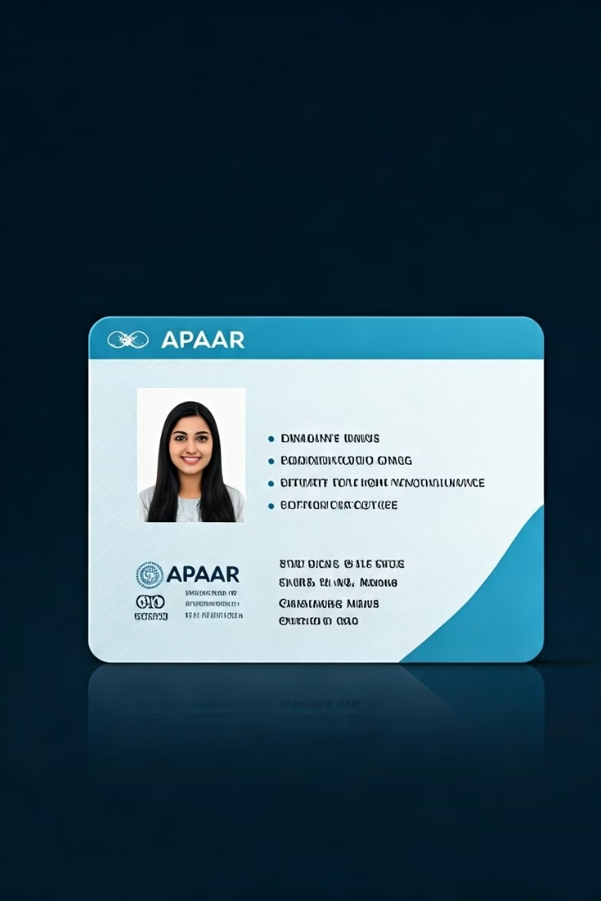

What is an APAAR ID Card?
The APAAR ID Card (Automated Permanent Academic Account Registry) is a unique identification system for students in India. It is designed to simplify and streamline the process of managing academic records and educational data for students throughout their lives. Think of it as a lifetime student ID that keeps track of all your educational achievements and activities.
by Ram N Java

Slide 2
Why is APAAR ID Important?
1
One ID for Everything
2
Track Academic Records
3
Easy Access
The APAAR ID acts as a single identity for students across all schools, colleges, and educational institutions in India.
It stores all your academic details, like exam results, certificates, and achievements, in one place.
Students, parents, and teachers can easily access academic records anytime, anywhere.
Example: Your school marks, college degrees, and even extracurricular activities can be linked to your APAAR ID.
Example: You can download your report card or transfer certificates without visiting the school.
No need to create multiple IDs for different stages of education.
4
Reduce Paperwork
5
Lifetime Use
The APAAR ID eliminates the need for physical documents and reduces paperwork during admissions or job applications.
The APAAR ID is permanent and stays with you throughout your life, even if you change schools or move to a different city.

Slide 3

How Does APAAR ID Work?
Registration
Students register for an APAAR ID through their school or educational institution.
The ID is linked to their Aadhaar card (a unique identification number for Indian citizens).
Data Storage
All academic records, such as exam results, attendance, and certificates, are stored digitally under the APAAR ID.
Access and Sharing
Students and authorized users (like parents or teachers) can access the data online.
The ID can be shared with colleges, universities, or employers when needed.

Slide 4
Benefits of APAAR ID
Convenience
Transparency
Ease of Transfer
No need to carry physical documents like mark sheets or transfer certificates.
Parents and students can track academic progress in real-time.
Moving to a new school or college becomes easier because all records are already linked to the APAAR ID.
All records are available digitally with just one ID.
Reduced Fraud
Lifetime Record
Since the ID is linked to Aadhaar, it reduces the risk of fake certificates or fraudulent records.
Your academic achievements are stored forever, making it easier to apply for jobs or higher education.

Slide 5




How to Get an APAAR ID
Visit Your School
Your school or educational institution will guide you through the registration process.
Link with Aadhaar
Provide your Aadhaar number to create the APAAR ID.
Access Your Data
Once registered, you can access your academic records online using your APAAR ID.

Slide 6




Summary
Unique ID
Record Management
1
A unique and permanent ID for students in India
Helps store and manage all academic records in one place
2
Benefits
4
Easy Access
Reduce paperwork, track progress, and maintain lifetime records
3
Makes it easier to access and share academic information
The APAAR ID Card is a simple and effective way to make education more organized and transparent!

