Slide 1
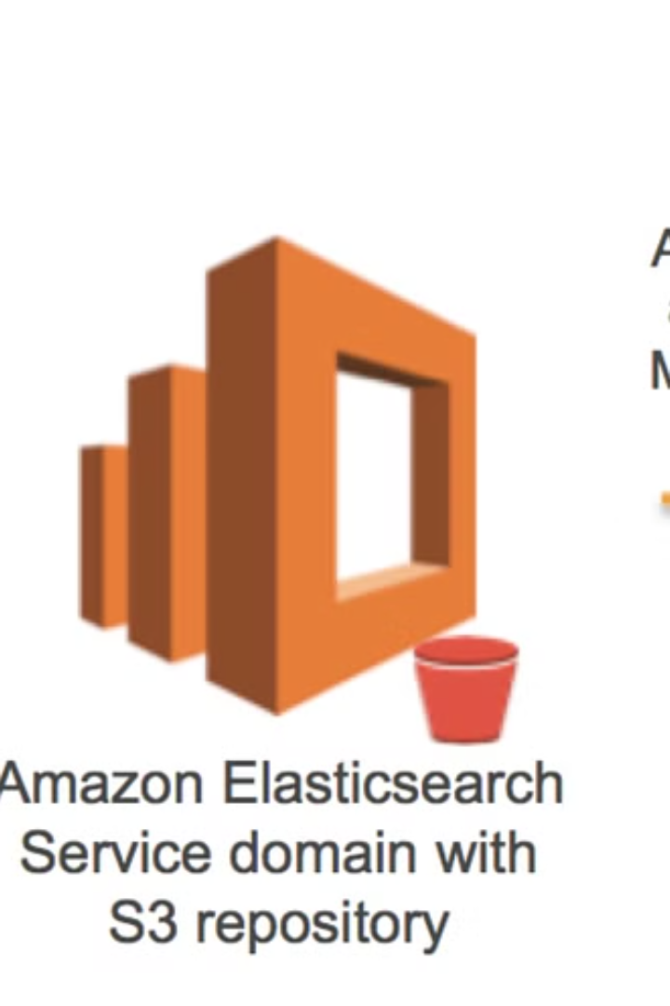

AWS S3 Pre-Signed URLs - Explained for Beginners
AWS S3 Pre-Signed URLs allow you to share files securely from your S3 bucket for a limited time without making the bucket public.
Imagine you have a private file in S3 that you want to share with someone. Instead of making the entire bucket public, you can generate a special link (Pre-Signed URL) that lets them access the file for a specific time.
by Ram N Java

Slide 2
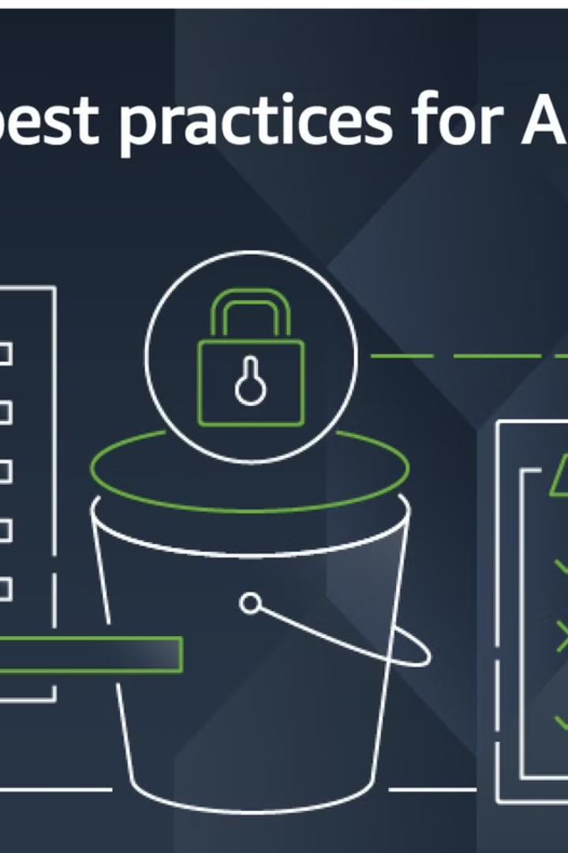
Why Use S3 Pre-Signed URLs?
Secure File Sharing
Only people with the URL can access the file.
Temporary Access
You control how long the link is valid.
No Need to Make Bucket Public
Keeps your data private.
Supports File Upload & Download
You can allow users to upload or download files.

Slide 3
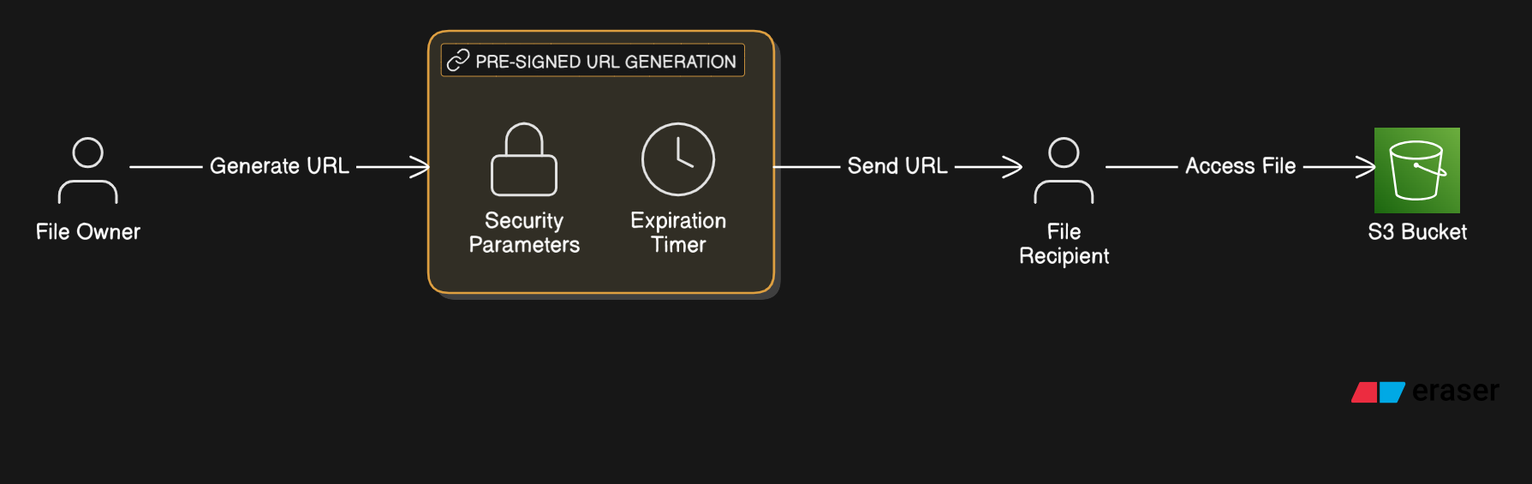

Slide 4
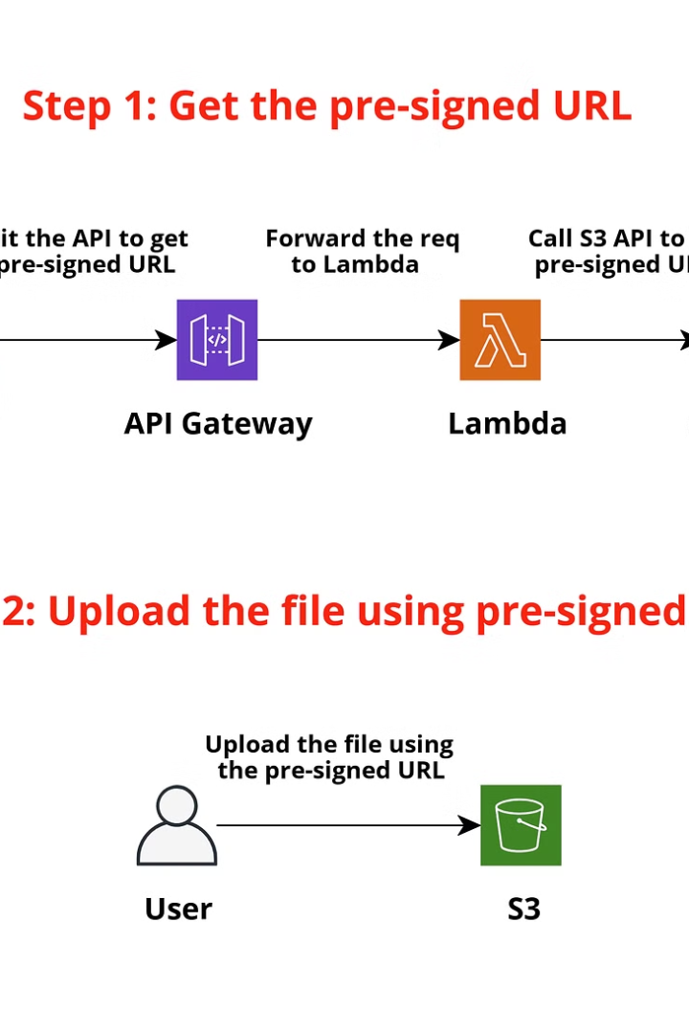
How Do S3 Pre-Signed URLs Work?
Step 1
You (the owner) generate a Pre-Signed URL using
AWS SDK or CLI.
Step 2
You send the URL to the person who needs access.
Step 3
The user clicks the link and can download or upload the file (before the URL expires).

Slide 5
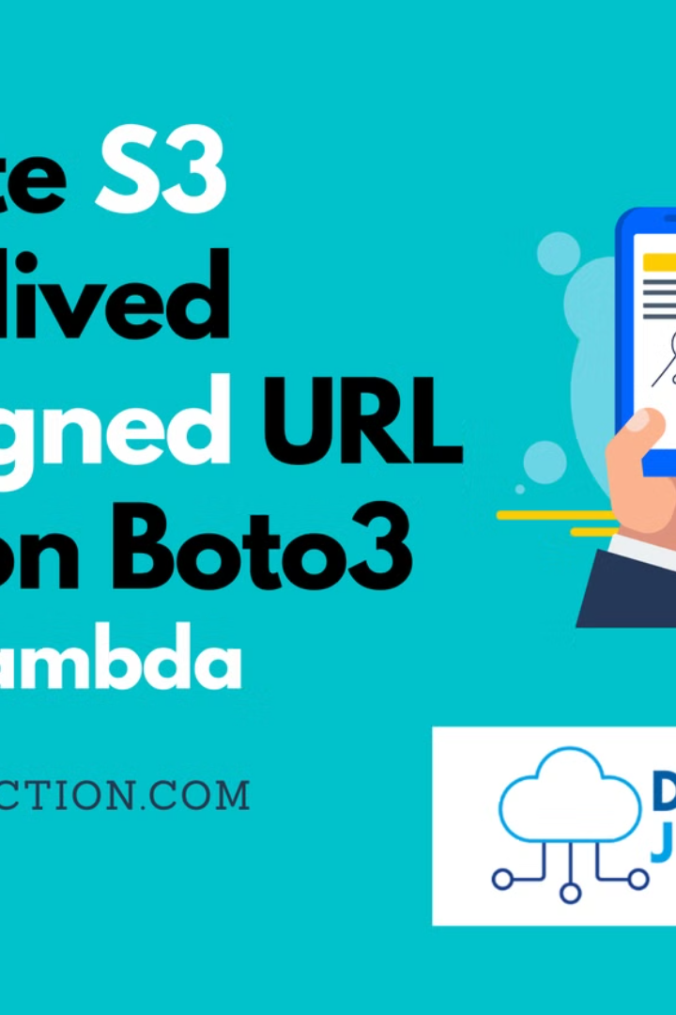

How to Create a
Pre-Signed URL?
Using AWS CLI:
aws s3 presign s3://my-bucket/myfile.txt --expires-in 3600
➡ This creates a URL valid for 1 hour (3600 seconds).

Slide 6
Example of a Pre-Signed URL
A generated Pre-Signed URL looks like this:
https://mybucket.s3.amazonaws.com/myfile.txt?AWSAccessKeyId=EXAMPLE&Expires=1712345678&Signature=abcdefg12345
The URL contains special security parameters that expire after the set time.

Slide 7





Things to Keep in Mind
Expiration Time
Only Grants Limited Access
Requires IAM Permissions
After expiry, the URL won't work anymore.
Users can't see other files in your bucket.
You need the right
IAM permissions to generate URLs.
Can Be Used for Uploading
You can also allow users to upload files securely.

Slide 8

Final Thoughts
AWS S3 Pre-Signed URLs are a secure and temporary way to share files without making your S3 bucket public. They help control access, reduce security risks, and simplify file sharing in applications. 🚀

