Slide 1
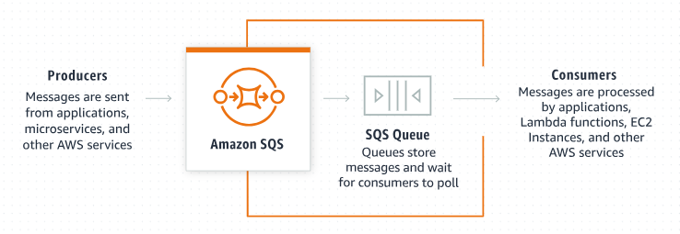
Creating an Amazon SQS Standard Queue: Step-by-Step Guide
What is Amazon SQS?
Amazon Simple Queue Service (SQS) is a fully managed message queuing service that allows you to decouple and scale microservices, distributed systems, and serverless applications. SQS enables you to send, store, and receive messages between software components at any volume, without losing messages or requiring other services to be available.
Creating an Amazon SQS (Simple Queue Service) Standard Queue is a straightforward process that allows you to manage messages between different parts of your application asynchronously.

Slide 2
Creating an Amazon SQS Standard Queue: Step-by-Step Guide
Types of SQS Queues:
There are two types of queues in Amazon SQS:
Standard Queues: Provide maximum throughput, best-effort ordering, and at-least-once delivery.
FIFO Queues: Ensure that messages are processed exactly once, in the exact order they are sent.

Slide 3
Creating an Amazon SQS Standard Queue: Step-by-Step Guide
What is a Standard Queue?
A Standard Queue in Amazon SQS offers high throughput, best-effort ordering, and at-least-once delivery. This means:
High Throughput: Supports a nearly unlimited number of transactions per second.
At-Least-Once Delivery: Ensures that each message is delivered at least once, but occasionally more than once.
Best-Effort Ordering: Guarantees that messages are generally delivered in the same order they were sent, but not always.

Slide 4
Creating an Amazon SQS Standard Queue: Step-by-Step Guide
Why Use a Standard Queue?
Standard Queues are ideal for applications where the order of message processing isn't crucial but the ability to handle a high volume of messages quickly is important. Common use cases include:
Processing user requests.
Managing background tasks.
Offloading tasks from your main application to improve performance.

Slide 5
Creating an Amazon SQS Standard Queue: Step-by-Step Guide
Step-by-Step Guide to Creating an Amazon SQS Standard Queue
Step 1: Sign in to the AWS Management Console
Go to the AWS Management Console.
Sign in with your AWS account credentials.
Step 2: Navigate to Amazon SQS
In the AWS Management Console, type "SQS" in the search bar and select Amazon SQS from the drop-down menu.
Step 3: Create a New Queue
On the Amazon SQS dashboard, click the Create queue button.
Step 4: Configure Queue Details
Queue Name: Enter a unique name for your queue.
Queue Type: Select Standard Queue.

Slide 6
Creating an Amazon SQS Standard Queue: Step-by-Step Guide
Step-by-Step Guide to Creating an Amazon SQS Standard Queue
Step 5: Configure Queue Settings (Optional)
Amazon SQS offers several configuration options for your queue. Here are some key settings you can configure:
Visibility Timeout: The duration (in seconds) that the message will be invisible to other consumers after being read. The default is 30 seconds.
Message Retention Period: The length of time that Amazon SQS retains a message. The default is 4 days, but you can set it from 1 minute to 14 days.
Maximum Message Size: The limit on the size of the messages that can be sent to the queue. The default is 256 KB.
Delivery Delay: The amount of time to delay the delivery of all messages added to the queue. The default is 0 seconds.
Receive Message Wait Time: The amount of time that a ReceiveMessage call will wait for a message to arrive if the queue is empty. The default is 0 seconds.
Step 6: Set Up Access Permissions (Optional)
Queue Access Policy: You can set up policies to control who can send messages to and receive messages from your queue. You can either create a custom policy or use a basic predefined policy.
Step 7: Configure Dead-Letter Queue (Optional)
Dead-Letter Queue (DLQ): Optionally, you can configure a DLQ to handle messages that can’t be processed successfully. This is useful for troubleshooting and ensuring that failed messages are not lost.

Slide 7
Creating an Amazon SQS Standard Queue: Step-by-Step Guide
Step-by-Step Guide to Creating an Amazon SQS Standard Queue
Step 8: Create Tags(Optional)
Add tags to your queue for better resource management and cost allocation.
Step 9: Review and Create
Review your queue settings.
Click Create queue.
Step 10: Send and Receive Messages
Now that your queue is created, you can start sending and receiving messages.
Sending a Message
On the queue's details page, click the Send and receive messages button.
Enter the message body in the Message body field.
Click Send message.
Receiving a Message
On the queue's details page, click the Send and receive messages button.
Click the Poll for messages button to retrieve messages from the queue.
The messages will appear in the Messages section.

Slide 8
Creating an Amazon SQS Standard Queue: Step-by-Step Guide
Example Use Case:
Imagine you have an e-commerce application. When a user places an order, the order details are sent to an SQS Standard Queue. Various services like payment processing, inventory management, and order fulfillment can then independently process the messages from the queue. This ensures that the system remains decoupled and scalable.

Slide 9
Creating an Amazon SQS Standard Queue: Step-by-Step Guide
Best Practices:
Monitor the Queue: Use Amazon CloudWatch to monitor the performance and health of your queues.
Handle Duplicate Messages: Since Standard Queues guarantee at-least-once delivery, ensure your application can handle duplicate messages.
Implement Error Handling: Use dead-letter queues to manage messages that can't be processed successfully.
By following these steps and best practices, you can effectively create and use Amazon SQS Standard Queues to build robust and scalable applications.

