Slide 1
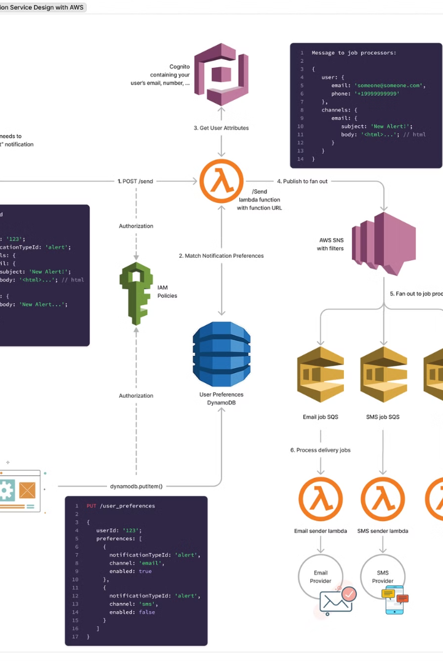

AWS SNS Subscription Filter Policy – Simple Explanation
AWS SNS (Simple Notification Service) allows you to send messages to multiple subscribers, like email, SMS, mobile apps, or other AWS services. But sometimes, not all subscribers need to receive every message. Subscription Filter Policy helps you control which messages a subscriber will receive.
What is a Subscription Filter Policy?
A Subscription Filter Policy lets SNS subscribers decide which messages they want to receive based on message attributes. Instead of sending all messages to all subscribers, AWS SNS only delivers relevant messages to each subscriber.
by Ram N Java

Slide 2
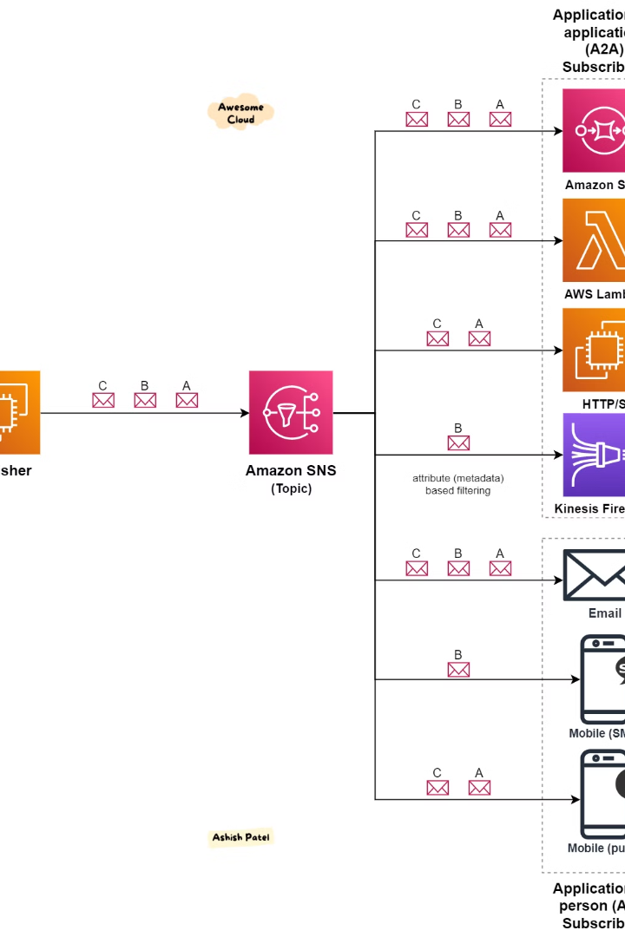
How Does It Work?
1
A publisher sends a message to an SNS topic (a central channel where messages are sent).
2
The message contains attributes (extra details about the message).
3
SNS checks each subscriber's filter policy to see if the message matches.
4
Only subscribers whose filter policy matches the message attributes will receive the message.

Slide 3
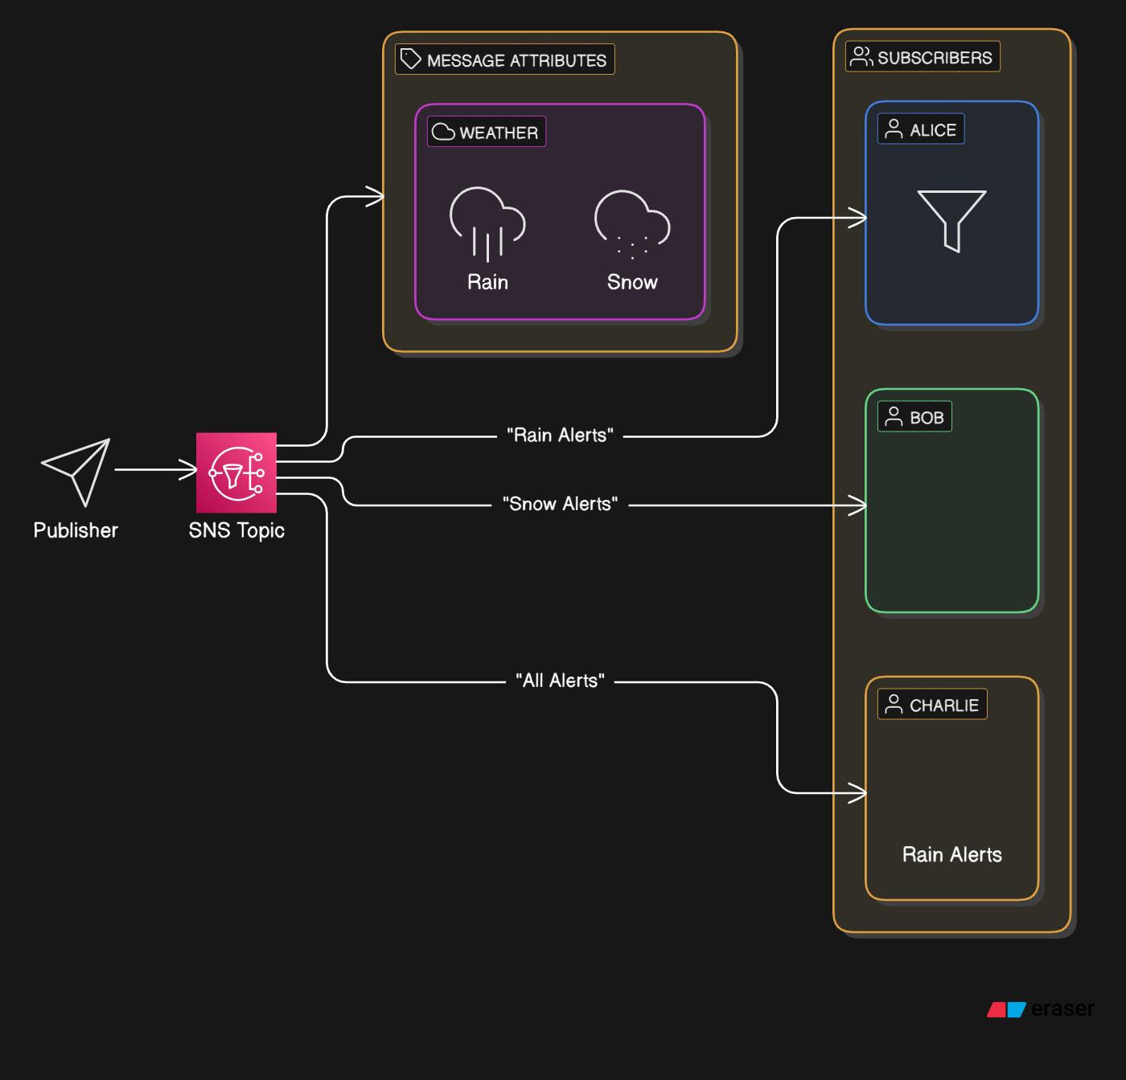
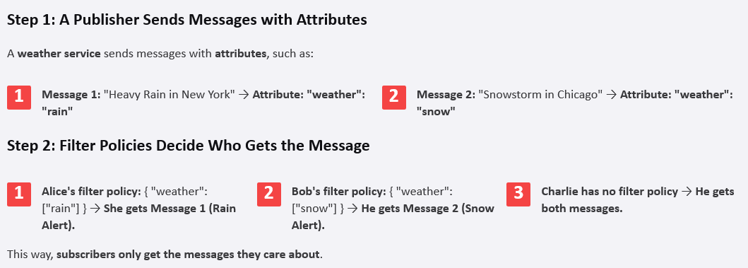

Slide 4
Example Scenario
Imagine you have an SNS topic for weather alerts. There are three subscribers:
1
Alice wants only "rain" alerts.
2
Bob wants only "snow" alerts.
3
Charlie wants all alerts.
Step 1: A Publisher Sends Messages with Attributes
A weather service sends messages with attributes, such as:
1
Message 1: "Heavy Rain in New York" → Attribute: "weather": "rain"
2
Message 2: "Snowstorm in Chicago" → Attribute: "weather": "snow"
Step 2: Filter Policies Decide Who Gets the Message
1
Alice's filter policy: { "weather": ["rain"] } → She gets Message 1 (Rain Alert).
2
Bob's filter policy: { "weather": ["snow"] } → He gets Message 2 (Snow Alert).
3
Charlie has no filter policy → He gets both messages.
This way, subscribers only get the messages they care about.

Slide 5





Why Use a Subscription Filter Policy?
Reduces unnecessary messages
Saves costs
Improves efficiency
Avoids unnecessary message processing.
Helps applications process only relevant data.
Subscribers get only what they need.
Simplifies message handling
No need for subscribers to filter messages themselves.

Slide 6





How to Set a Subscription Filter Policy?
Go to AWS SNS Console.
Select a topic.
Choose a subscription.
Edit the subscription and add a filter policy.
Save the settings.
You can also do this using the AWS CLI or AWS SDK.

Slide 7
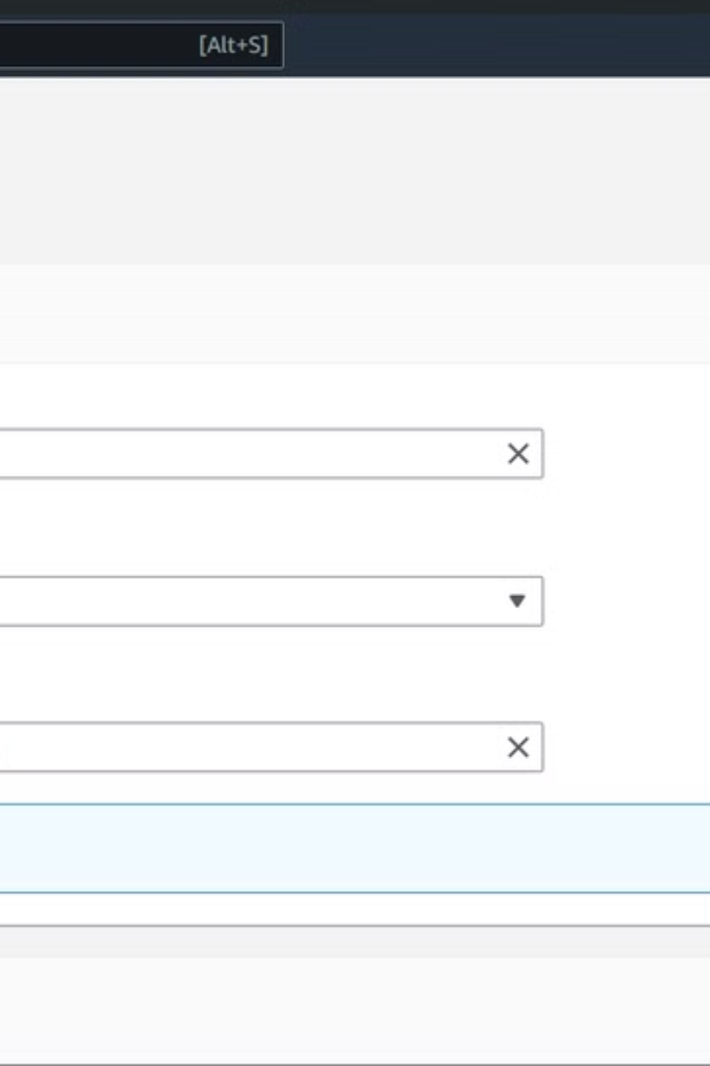
Summary
1
AWS SNS Subscription Filter Policy controls which messages a subscriber will receive.
2
It works by matching message attributes with a subscriber's filter policy.
3
Only relevant messages are delivered to each subscriber.
4
Saves costs, improves efficiency, and simplifies message handling.
This feature is useful when different subscribers need different types of messages from the same SNS topic.

