Slide 1
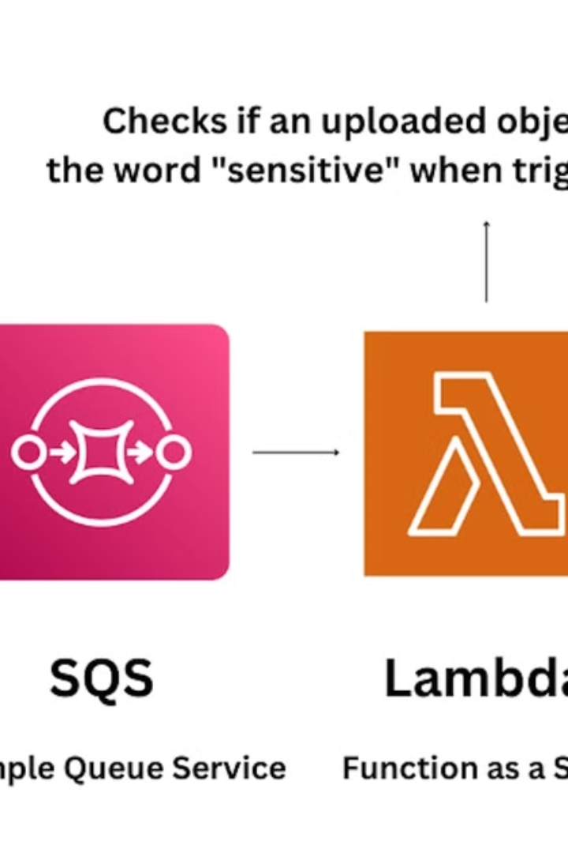

AWS S3 Event Notifications Explained for Beginners
AWS S3 Event Notifications allow you to get notified whenever something happens in your S3 bucket. It's like setting an alarm for specific events, so you can take action automatically.
by Ram N Java

Slide 2
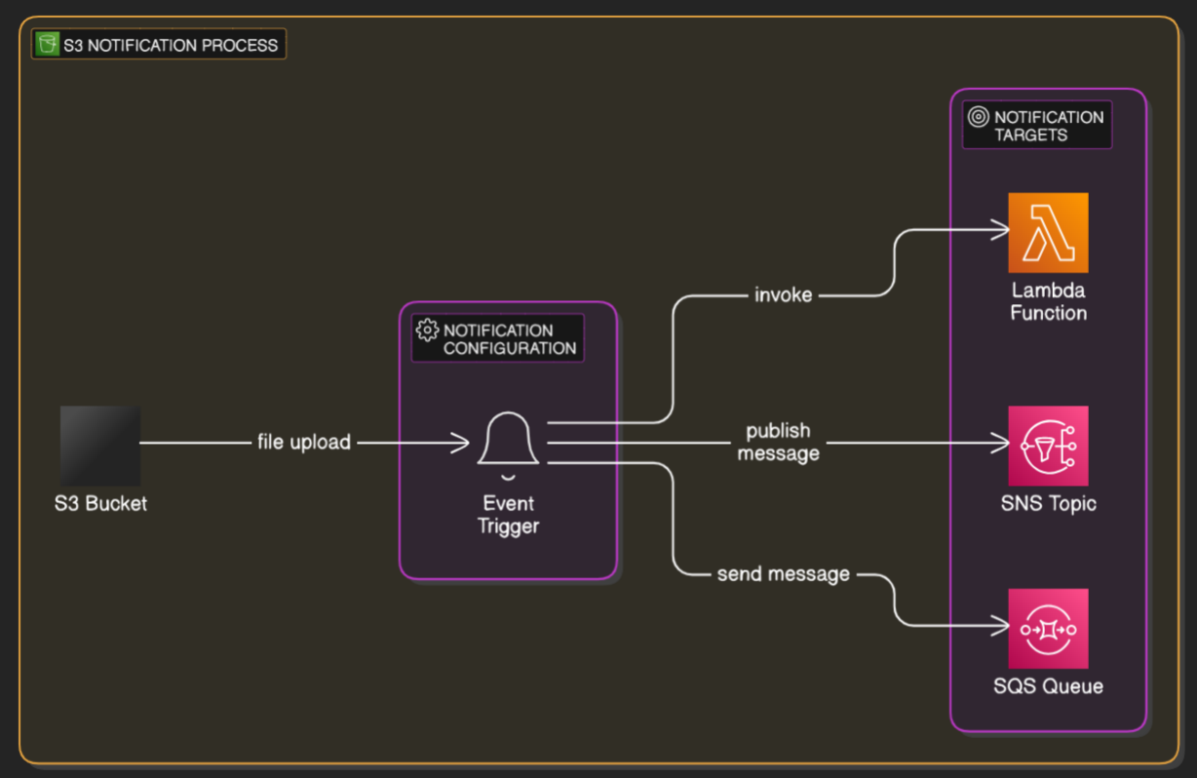

Slide 3

What Are S3 Event Notifications?
Event Notifications are messages
Trigger other AWS services
Event Notifications are messages sent when certain actions (like uploading, deleting, or updating files) occur in your S3 bucket.
These messages can trigger other AWS services, such as AWS Lambda, Amazon SQS (Simple Queue Service), or Amazon SNS (Simple Notification Service).

Slide 4
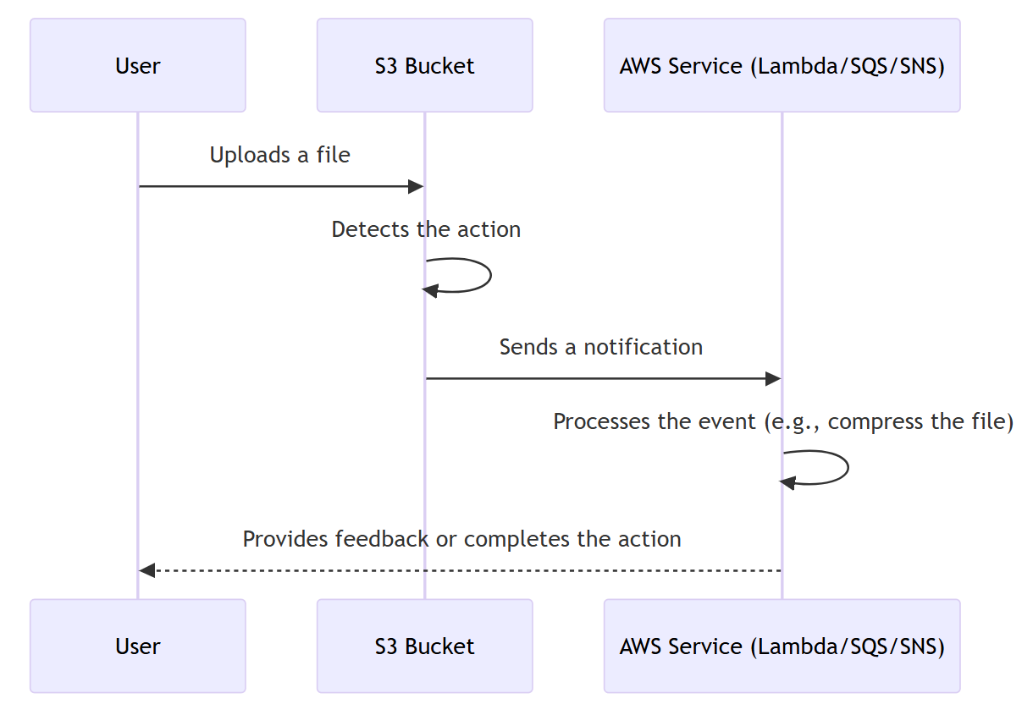
How Do S3 Event Notifications Work?

Slide 5
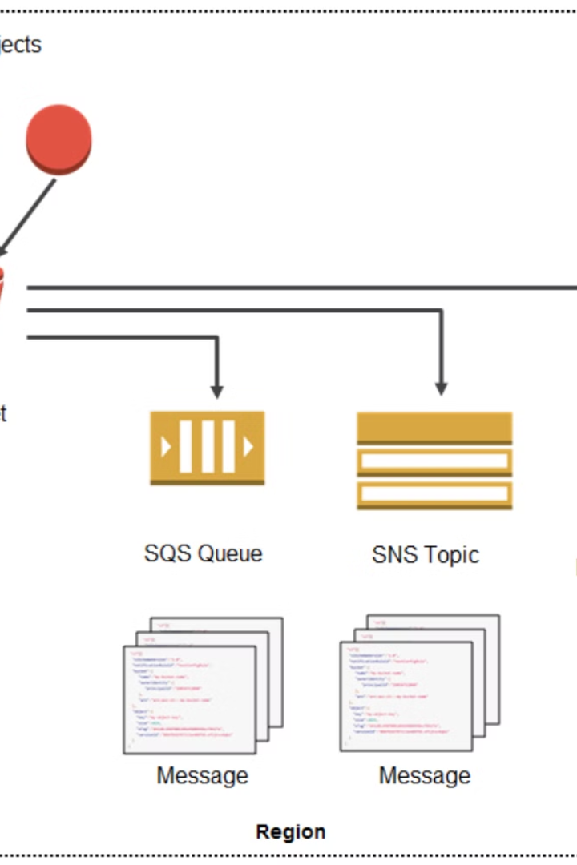




How Do S3 Event Notifications Work?
Action Happens
For example, someone uploads a file to your S3 bucket.
Trigger Event
The bucket detects the action and triggers a notification for it.
Send Notification
The event is sent to the service you've chosen (e.g., Lambda, SQS, or SNS).
Perform Action
The receiving service processes the event (e.g., your Lambda function compresses the file).

Slide 6




Why Use Event Notifications?
Event notifications are helpful when you want to:
Automatically process files
Keep track of changes
Automatically process files uploaded to S3 (e.g., resizing images or processing logs).
Keep track of changes in your bucket.
Notify systems
Notify someone or another system when something happens in your bucket.

Slide 7
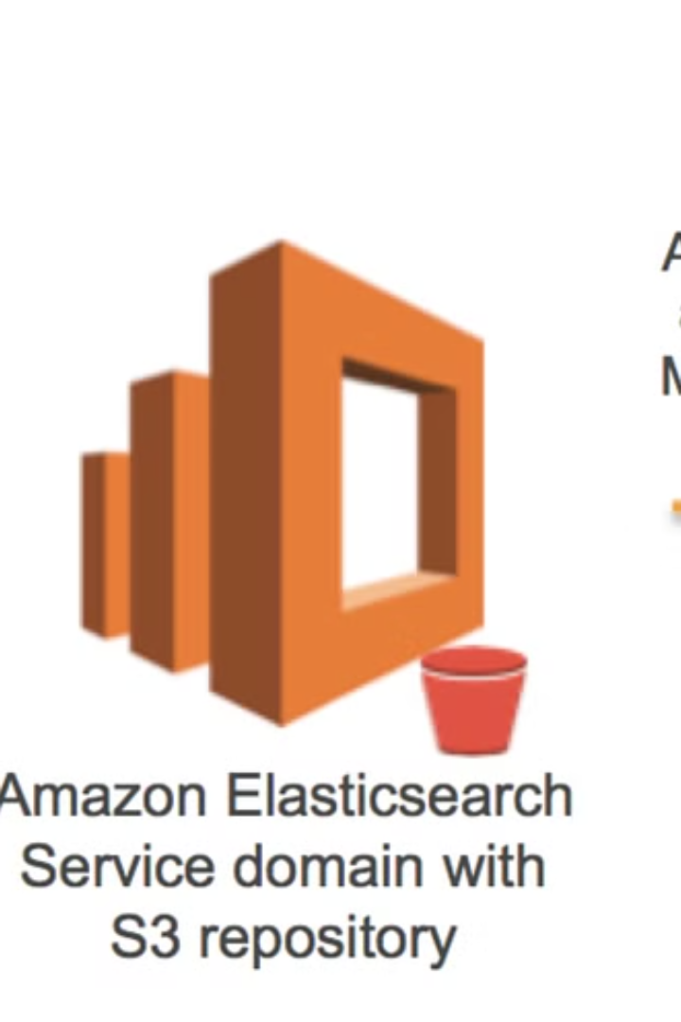
What Events Can You Track?
You can configure notifications for actions like:
File Uploads
File Deletions
When a file is added to your bucket.
When a file is deleted.
File Modifications
When an existing file is updated.

Slide 8
Example Use Case
Imagine you upload a new photo to your S3 bucket. Using event notifications:
1
S3 detects the upload
2
The event triggers an AWS Lambda function
3
Lambda resizes the image and stores it in another S3 bucket

Slide 9
Steps to Set Up S3 Event Notifications:
1
Go to the AWS S3 Console
2
Select your bucket
3
Click on Properties and find Event Notifications
4
Add a new notification
5
Choose the event type (e.g., file upload)
6
Select a destination (e.g., Lambda, SNS, or SQS)
7
Save your settings

