Slide 1
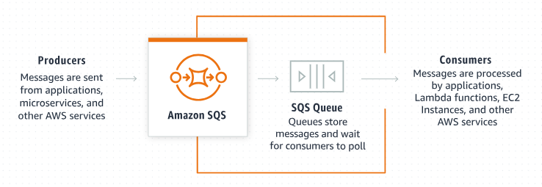
How to Create an Amazon SQS FIFO Queue: A Beginner's Guide
What is Amazon SQS?
Amazon Simple Queue Service (SQS) is a fully managed message queuing service by AWS. It enables you to decouple and scale microservices, distributed systems, and serverless applications.
Creating an Amazon SQS FIFO (First-In-First-Out) Queue ensures that the messages are processed in the exact order they are sent and are delivered only once. This is crucial for applications where the order of operations and message deduplication are important.

Slide 2
How to Create an Amazon SQS FIFO Queue: A Beginner's Guide
Steps to Create an Amazon SQS FIFO Queue
1.Log in to AWS Management Console:
Open your web browser and go to the AWS Management Console.
Sign in with your AWS account credentials.
2. Navigate to SQS:
In the AWS Management Console, type "SQS" in the search bar and select "Simple Queue Service" from the dropdown.
3. Create a New Queue:
Click on the "Create queue" button.
4. Configure Queue Settings:
Queue Name: Enter a unique name for your queue. The name must end with the suffix .fifo.
Queue Type: Select "FIFO Queue."

Slide 3
How to Create an Amazon SQS FIFO Queue: A Beginner's Guide
Steps to Create an Amazon SQS FIFO Queue
5. Configure Additional Settings:
Default Visibility Timeout: The duration (in seconds) that the received messages are hidden from subsequent retrieve requests after being retrieved by a ReceiveMessage request.
Message Retention Period: The duration (in seconds) that Amazon SQS retains a message. The default is 4 days.
Maximum Message Size: The size (in bytes) that you want to allow for the maximum size of a message. The default is 256 KB.
Delivery Delay: The amount of time (in seconds) to delay the first delivery of all messages added to the queue. The default is 0 seconds.
Receive Message Wait Time: The duration (in seconds) for which a ReceiveMessage call waits for a message to arrive in the queue before returning. The default is 0 seconds (short polling).

Slide 4
How to Create an Amazon SQS FIFO Queue: A Beginner's Guide
Steps to Create an Amazon SQS FIFO Queue
6. Set Queue Attributes:
Content-Based Deduplication: If enabled, Amazon SQS uses a SHA-256 hash to generate the MessageDeduplicationId using the body of the message and deduplicate messages with the same content automatically. If disabled, you must provide a MessageDeduplicationId explicitly..
Deduplication Scope: Specify whether the deduplication applies to the entire queue or to a specified message group.
Fifo Throughput Limit: Choose whether you need high throughput for messages in the queue.
Message Group ID: If you want messages to be grouped and processed in parallel within the group, specify a MessageGroupId for each message. This is especially useful for parallel processing of multiple ordered message groups.

Slide 5
How to Create an Amazon SQS FIFO Queue: A Beginner's Guide
Steps to Create an Amazon SQS FIFO Queue
7. Configure Dead-letter Queue (Optional):
A dead-letter queue is used to handle messages that can’t be processed (consumed) successfully. If you want to configure a dead-letter queue, click on "Enable" and select the dead-letter queue details.
8. Access Policy (Optional):
You can specify who can send messages to and receive messages from the queue. You can use the default policy or customize it based on your requirements.
9. Tagging (Optional):
You can add tags (key-value pairs) to your queue for easier management and billing.
10. Review and Create:
Review all the settings you have configured. If everything looks good, click on the "Create Queue" button.

Slide 6
How to Create an Amazon SQS FIFO Queue: A Beginner's Guide
Send and Receive Messages
Now that your queue is created, you can start sending and receiving messages.
Sending a Message
On the queue's details page, click the Send and receive messages button.
Enter the message body in the Message body field.
Click Send message.
Receiving a Message
On the queue's details page, click the Send and receive messages button.
Click the Poll for messages button to retrieve messages from the queue.
The messages will appear in the Messages section.

Slide 7
How to Create an Amazon SQS FIFO Queue: A Beginner's Guide
Summary
Creating an Amazon SQS FIFO Queue is a simple process that involves configuring various settings to suit your application's needs. By following the steps above, you can easily set up a FIFO queue, send and receive messages in the correct order, and manage your messaging system efficiently. This enables you to build robust and reliable applications that require ordered message processing and exactly-once delivery.

