Slide 1

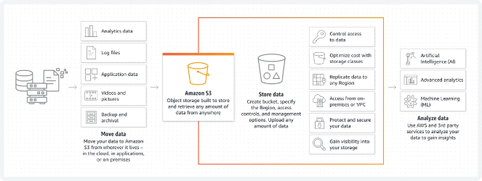

Amazon Simple Storage Service (S3): Your Gateway to Scalable Cloud Storage
Amazon Simple Storage Service (Amazon S3) is a widely-used object storage service offered by Amazon Web Services (AWS). It allows you to store and retrieve any amount of data from anywhere on the web. This powerful and flexible storage solution is designed to handle a wide range of use cases, from simple file storage to complex data management scenarios. In this presentation, we'll explore the key concepts, basic operations, and essential features of AWS S3, providing you with a comprehensive understanding of this versatile cloud storage service.
by Ram N Java

Slide 2
Key Concepts of AWS S3
Object Storage
Scalability
Durability and Availability
Objects: Data in S3 is stored as objects. Each object consists of the data itself, metadata (information about the data), and a unique identifier (key).
S3 automatically scales to handle large amounts of data and a high number of requests without requiring any configuration or management from the user.
S3 is designed for 99.999999999% (11 nines) of durability, meaning that your data is highly unlikely to be lost.
It offers high availability, ensuring that your data is accessible whenever you need it.
Buckets: Objects are stored in containers called buckets. A bucket is like a folder or directory where you can organize your data.

Slide 3

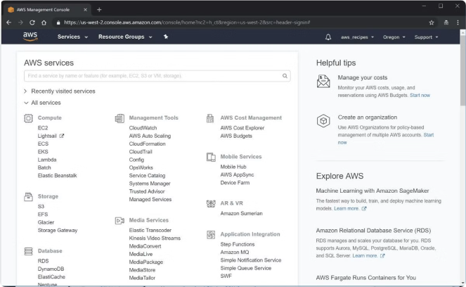
Basic Operations in S3
1
Creating a Bucket
You can create a bucket using the AWS Management Console, AWS CLI, or AWS SDKs. Each bucket must have a unique name and is created in a specific AWS region.
2
Uploading Objects
Objects can be uploaded to S3 using the console, CLI, or SDKs. You can upload single file, multiple files, or entire directories.
3
Retrieving Objects
You can download objects from S3 using the same methods. S3 provides URL endpoints for objects, making them accessible over the web if the appropriate permissions are set.
4
Managing Access Permissions
S3 provides various ways to manage access to your data, including bucket policies, access control lists (ACLs), and AWS Identity and Access Management (IAM) policies.

Slide 4
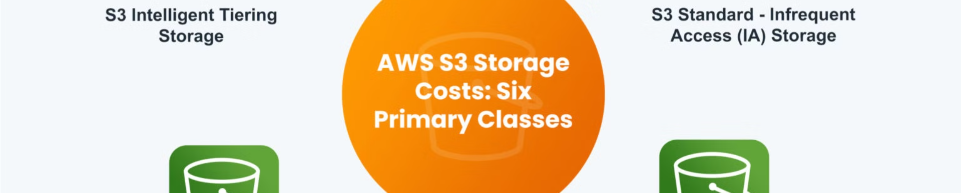
S3 Storage Classes: Standard and Intelligent-Tiering
Standard
Intelligent-Tiering
High durability, availability, and performance for frequently accessed data.
Automatically moves data between two access tiers (frequent and infrequent) based on changing access patterns.

Slide 5

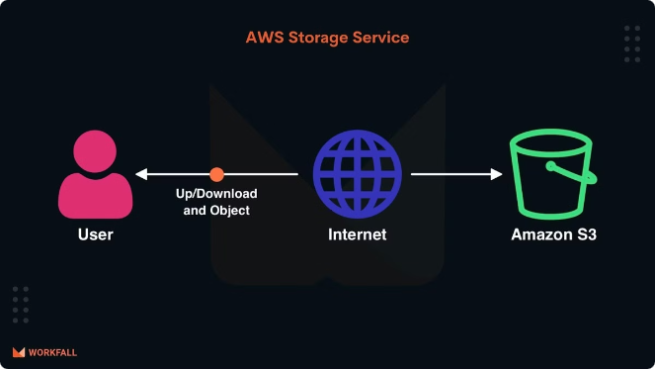
S3 Storage Classes:
Infrequent Access and Glacier
Standard-IA (Infrequent Access)
Lower-cost storage for data that is accessed less frequently but requires rapid access when needed.
One Zone-IA
Lower-cost option for infrequently accessed data stored in
a single availability zone.
Glacier
Low-cost storage for data archiving with retrieval times
ranging from minutes to hours.
Glacier Deep Archive
Lowest-cost storage option for long-term data archiving with retrieval times of up to 12 hours.

Slide 6
Key Features of AWS S3: Versioning and Lifecycle Policies
Versioning
Lifecycle Policies
You can enable versioning on a bucket to keep multiple versions of an object. This helps protect against accidental deletion or overwriting of data.
S3 allows you to define lifecycle policies to automatically transition objects to different storage classes or delete them after a specified period.

Slide 7
Key Features of AWS S3:
Encryption and Data Transfer
Encryption
Data Transfer Acceleration
S3 supports data encryption both
In-transit and at-rest. You can use
server-side encryption with
AWS-managed keys (SSE-S3), AWS Key Management Service (SSE-KMS), or client-side encryption.
S3 Transfer Acceleration uses Amazon CloudFront's globally distributed edge locations to accelerate data transfers to and from S3.

Slide 8

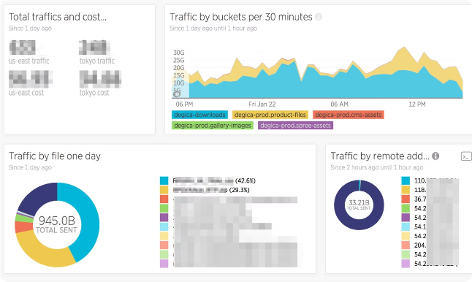
Logging and Monitoring in AWS S3
1
Server Access Logging
S3 provides server access logging to track requests for access to your bucket.
2
AWS CloudTrail
Use CloudTrail to log, continuously monitor, and retain account activity related to actions across your AWS infrastructure.
3
AWS CloudWatch
Monitor S3 resources and applications in real-time using CloudWatch metrics and alarms.

Slide 9






Getting Started with AWS S3
Sign Up for AWS
Create an AWS account if you don't already have one.
Access the S3 Console
Log in to the AWS Management Console and navigate to the S3 service.
Create a Bucket
Follow the prompts to create a new bucket, specifying the bucket name and region.
Upload Objects
Use the console or other tools to upload files to your bucket.
Set Permissions
Configure access permissions to control who can view or modify your data.
Explore More Features
Experiment with different storage classes, lifecycle policies, versioning, and other features to understand how they can benefit your use case.

Slide 10

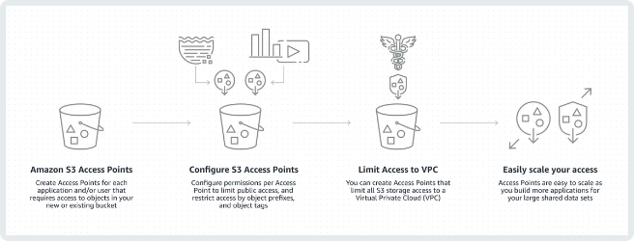
Conclusion: Harnessing the Power of AWS S3
Versatile Storage Solution
AWS S3 is a powerful and flexible storage service that can handle a wide range of use cases, from simple file storage to complex data management scenarios.
Comprehensive Features
By understanding the basic concepts, operations, and features of S3, you can effectively leverage this service to meet your storage needs.
Scalable and Reliable
With its scalability, durability, and high availability, S3 provides a robust foundation for your data storage requirements in the cloud.

