Slide 1


How to Use
Printers & Scanners
Printers and scanners are useful devices that help you print documents and digitize paper files.
by Ram N Java

Slide 2
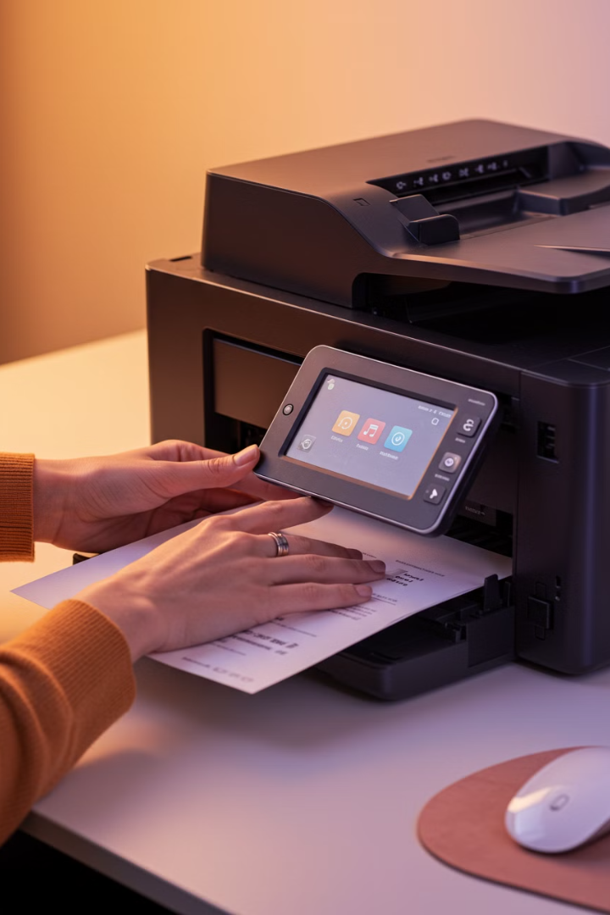
How to Use a Printer
What is a Printer?
A printer is a device that prints text or images from your computer onto paper.

Slide 3
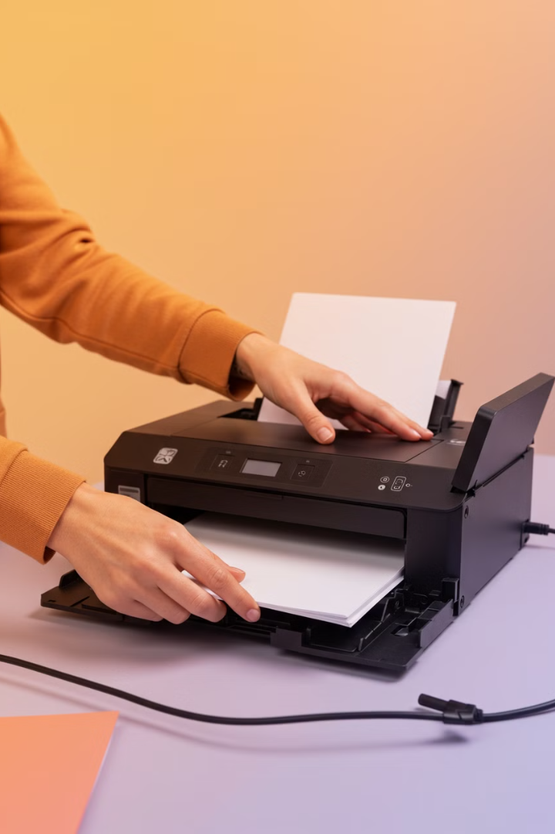



Steps to Print a Document
Connect the Printer
Make sure the printer is connected to your computer. It can be connected via USB cable, Wi-Fi, or Bluetooth.
Example: Plug the USB cable into your computer and printer.
Install Printer Software
Install the printer driver (software) from the CD that comes with the printer or download it from the manufacturer's website.
Example: Go to the printer brand's website (like HP or Canon) and download the driver.
Load Paper
Open the paper tray and load it with the correct type and size of paper.
Example: Place A4 paper in the tray and adjust the guides to fit the paper.

Slide 4
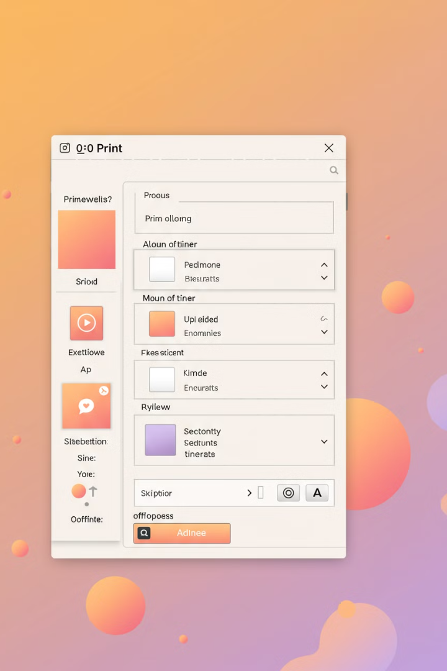



Steps to Print a Document
Open the Document
Open the file you want to print on your computer (like a Word document or PDF).
Print the Document
Click File > Print (or press Ctrl + P on the keyboard).
Select your printer and choose the number of copies, page range, and other settings.
Click Print.
Example: Print 2 copies of a 5-page document.
Collect Your Printout
Wait for the printer to finish printing, then collect your document from the output tray.

Slide 5
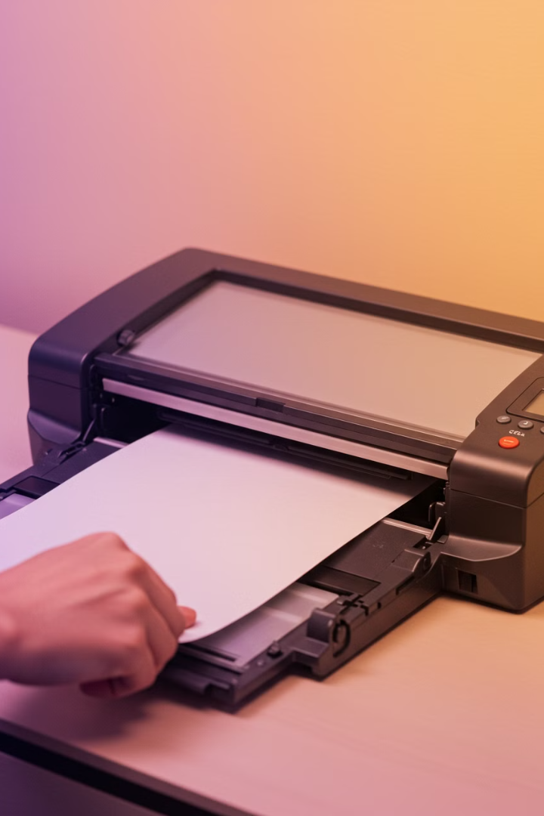
How to Use a Scanner
What is a Scanner?
A scanner is a device that converts a physical document or photo into a digital file on your computer.

Slide 6
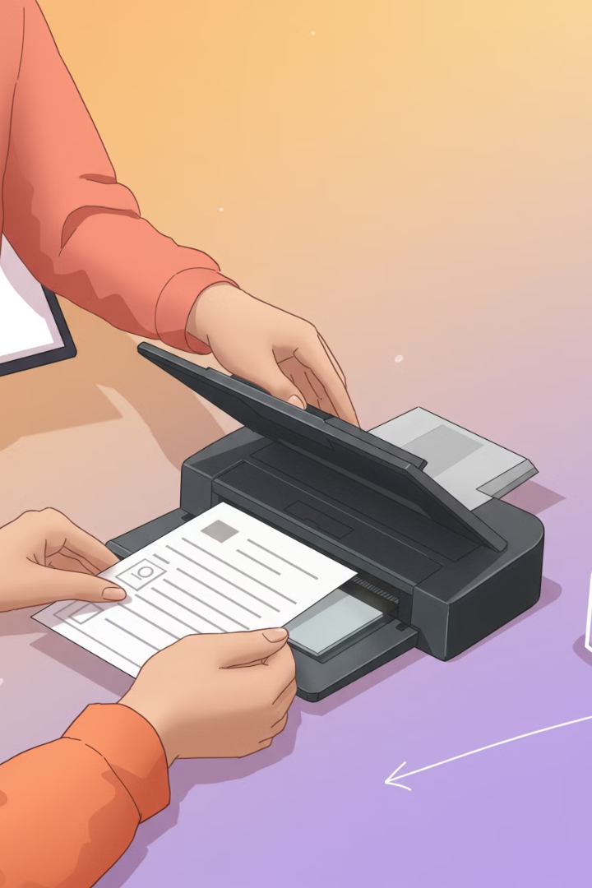



Steps to Scan a Document
Connect the Scanner
Connect the scanner to your computer using a USB cable or Wi-Fi.
Example: Plug the USB cable into your computer and scanner.
Install Scanner Software
Install the scanner driver (software) from the CD that comes with the scanner or download it from the manufacturer's website.
Example: Go to the scanner brand's website (like Epson or Canon) and download the driver.
Place the Document
Lift the scanner lid and place the document or photo face down on the glass.
Align it with the edges marked on the scanner.
Example: Place a photo face down in the top-right corner.

Slide 7




Steps to Scan a Document
Open Scanning Software
Open the scanning software on your computer. This could be the software that came with the scanner or a built-in program like Windows Scan or Apple Image Capture.
Adjust Settings
Choose the file type (like PDF or JPEG), resolution (quality), and color mode (color or black-and-white).
Example: Scan a photo as a JPEG in high resolution.
Scan the Document
Click Scan or Start in the software.
Wait for the scanner to complete the process.
Save the File
After scanning, save the file to your computer. Choose a location and name for the file.
Example: Save the scanned document as "Receipt.pdf" in the "Documents" folder.

Slide 8





Tips for Using Printers and Scanners
Keep Devices Clean
Use the Right Paper
Check Ink or Toner Levels
Dust and dirt can affect performance. Clean the printer rollers and scanner glass regularly.
Use the correct type and size of paper for your printer or scanner.
For printers, make sure there's enough ink or toner. Replace cartridges when needed.
Example: Use photo paper for printing photos.
Update Software
Troubleshoot Issues
Keep your printer and scanner drivers up to date for better performance.
If the printer or scanner doesn't work, check the connections, restart the device, or reinstall the software.

Slide 9
Summary
Printers
Scanners
Use them to print documents or photos. Connect the printer, load paper, and click Print from your computer.
Use them to digitize documents or photos. Place the document on the scanner, adjust settings, and click Scan.
With these steps, you'll be able to print and scan like a pro!

