Slide 1

Understanding CORS:
Cross-Origin Resource Sharing
Imagine you're at home (this is your website) and you want to borrow a book from your friend's house (this is another website). Normally, you can only get books from your own house, not from someone else's. This rule is called the Same-Origin Policy – your website can only get resources from the same place it was loaded from.
But what if you need to borrow that book from your friend's house? This is where CORS (Cross-Origin Resource Sharing) comes in. CORS is like asking your friend for permission to borrow that book. If your friend agrees and says, "Sure, you can borrow it," they send a note that says, "It's okay for them to take the book." The note is like a special message that the browser understands, telling it that borrowing is allowed.
by Ram N Java

Slide 2
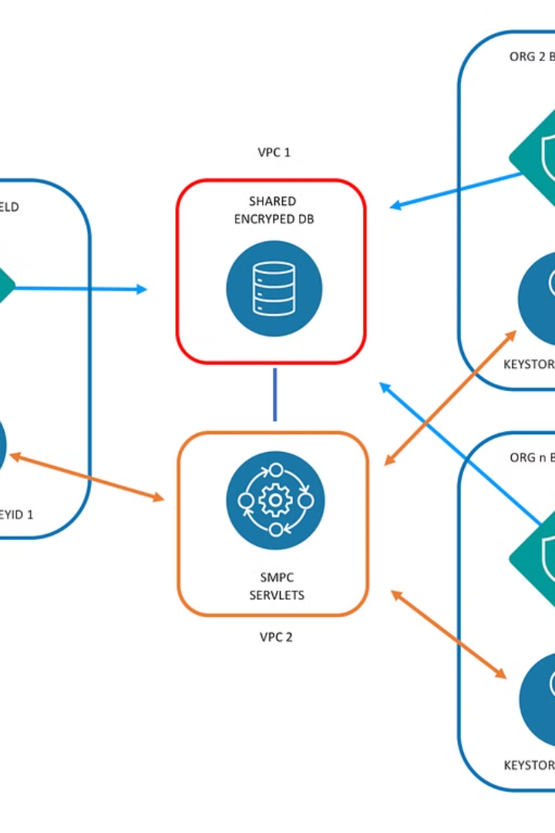



How CORS Works
Step 1: Request
Your Website asks for something from another website (like an image, file, or data).
Step 2: Check and Respond
The Other Website checks if it's okay to share that resource and sends back a message (called a
CORS header) that says, "Yes, it's fine to share this."
Step 3: Access
If the message says it's okay, Your Website can use the resource.
Without CORS, the browser would not allow your website to use anything from the other website because it would be too risky. But with CORS, it's a safe way to share resources between websites.

Slide 3
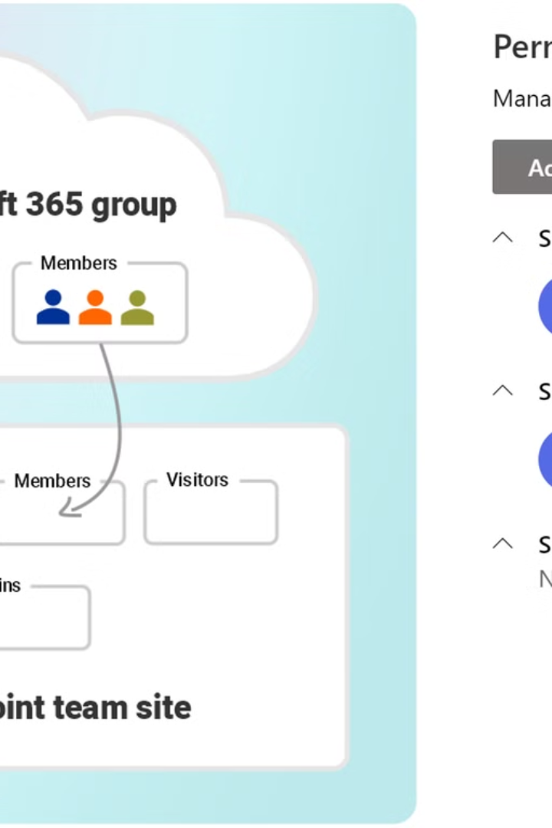
CORS in Action:
A Simple Example
1
Your Website
www.example.com wants to get data from
another Website (api.example2.com )
2
Another Website
api.example2.com says, "It's okay for www.example.com to get this data"
(CORS allows it).
3
Result
Now, Your Website can use that data!

Slide 4
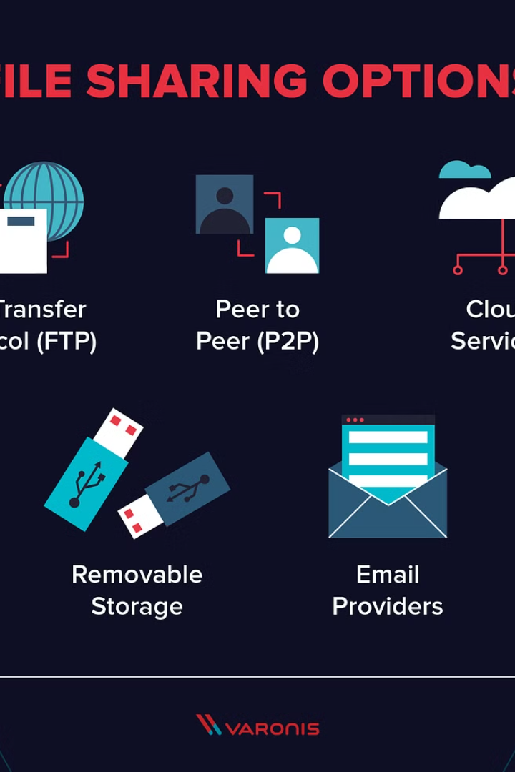
Why CORS is Important
Safety First
Permission-Based Sharing
CORS helps make sure that websites only share resources when it's safe, so malicious websites can't steal your data.
It's like asking for permission before taking something from someone else's house.

