Slide 1
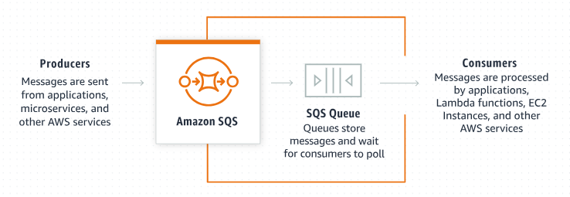
Explaining Amazon SQS: Understanding the Maximum Message Size for Beginners
What is Amazon SQS?
Amazon Simple Queue Service (SQS) is a fully managed message queuing service by AWS. It allows you to send, store, and receive messages between software components at any volume without losing messages.

Slide 2
Explaining Amazon SQS: Understanding the Maximum Message Size for Beginners
What is the Maximum Message Size in Amazon SQS?
When using Amazon SQS, there's a limit on how large a single message can be. This is called the maximum message size.

Slide 3
Explaining Amazon SQS: Understanding the Maximum Message Size for Beginners
Key Points:
Maximum Size Limit:
256 KB: Each individual message in Amazon SQS can be up to 256 kilobytes (KB) in size.This includes both the body of the message and any additional metadata.
Why is there a Limit?:
The size limit ensures that messages can be processed efficiently and helps maintain the performance and reliability of the SQS service.
It also helps manage costs, as larger messages would require more resources to store and process.

Slide 4
Explaining Amazon SQS: Understanding the Maximum Message Size for Beginners
Key Points:
3. What Happens if a Message Exceeds the Limit?:
If you try to send a message that exceeds 256 KB, Amazon SQS will not accept it. You'll need to split the data into smaller chunks that fit within the size limit and send them as multiple messages.
4. Working with Larger Data:
Chunking: Break your large data into smaller parts, each within the 256 KB limit, and send them as separate messages.
External Storage: Store the large data in an external service like Amazon S3 (Simple Storage Service) and send a reference (such as an S3 object URL) in the SQS message. This way, the SQS message stays within the size limit, but the actual data can be much larger.

Slide 5
Explaining Amazon SQS: Understanding the Maximum Message Size for Beginners
Amazon SQS Extended Client Library for Java:
To send messages larger than 256 KB, we can use the Amazon SQS Extended Client Library for Java (https://github.com/awslabs/amazon-sqs-java-extended-client-lib).
This library allows you to send an Amazon SQS message that contains a reference to a message payload in Amazon S3. The maximum payload size is 2 GB.

Slide 6
Explaining Amazon SQS: Understanding the Maximum Message Size for Beginners
Example Scenario:
Imagine you have a web application that processes user-generated content, like photos. A photo file might be larger than 256 KB. Instead of sending the entire photo in an SQS message, you can:
Store the photo in Amazon S3.
Send a message to SQS containing the URL of the S3 object.
The application receiving the SQS message can then retrieve the photo from S3 using the URL.

Slide 7
Explaining Amazon SQS: Understanding the Maximum Message Size for Beginners
Summary:
The maximum message size in Amazon SQS is 256 KB. This limit helps maintain performance and cost-efficiency.
For larger data, you can split the data into smaller messages or use external storage solutions like Amazon S3 and include references in your SQS messages.

