Slide 1
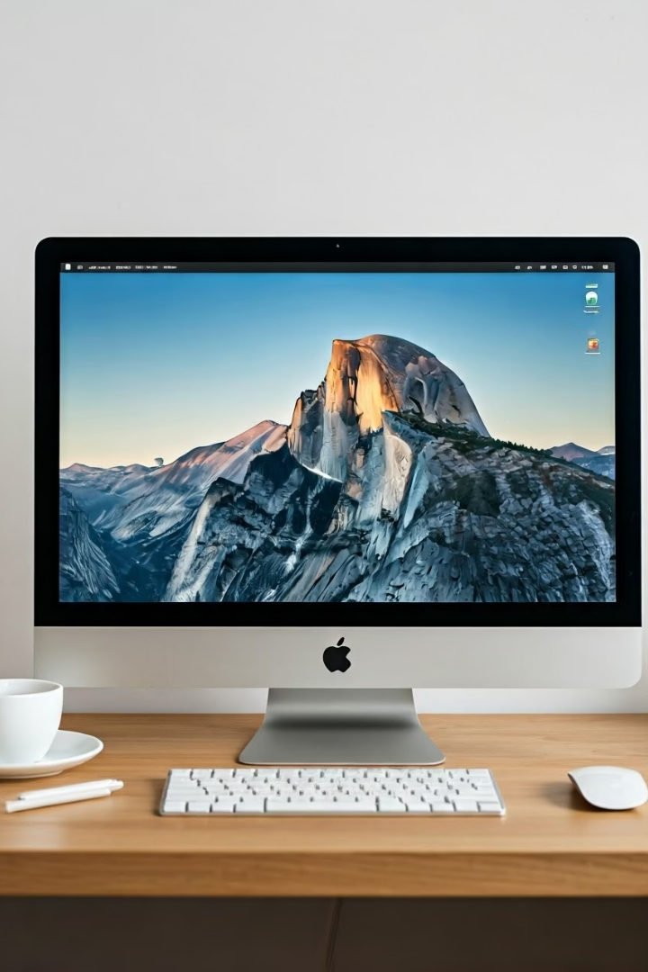

macOS Basics:
How to Use a Mac Efficiently
What is macOS?
macOS is the operating system used in Apple Mac computers like the MacBook Air, MacBook Pro, iMac, and Mac mini. It controls how your computer works and how you interact with it.
by Ram N Java

Slide 2

Desktop and Dock
Desktop
The Desktop is your main screen where you can see files, folders, and open windows.
Dock
The Dock is the row of icons at the bottom of the screen.
It gives you quick access to your favorite apps, open apps, and the Trash.

Slide 3
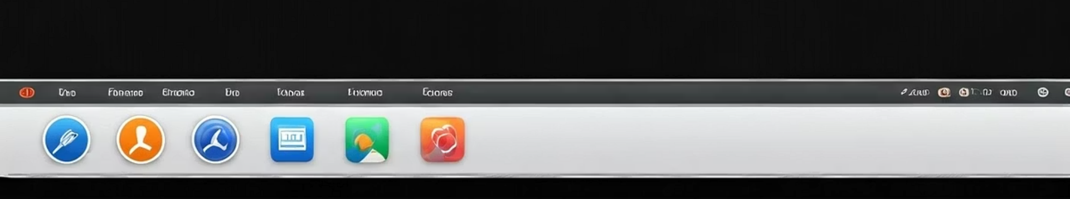



Menu Bar
Left Side
Center
Right Side
On the left, you'll see the
Apple logo, which gives you access to system settings,
shut down, restart, and log out.
The Menu Bar is at the top of the screen. It changes based on the app you are using.
On the right side, you'll see Wi-Fi, battery status, volume, date/time, and Spotlight Search.

Slide 4
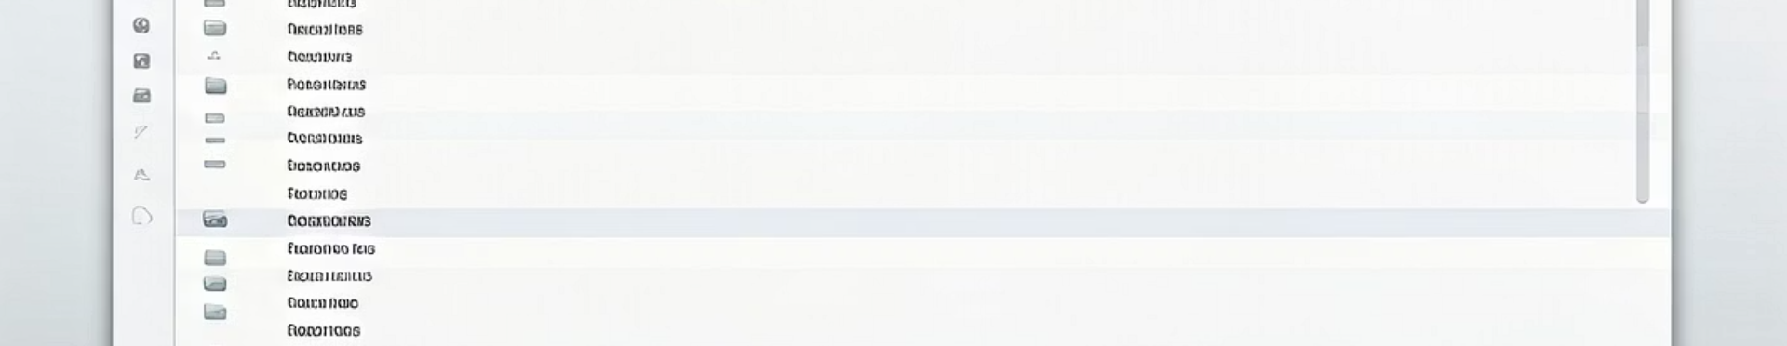



Finder
File Manager
Browse Files
Access Finder
Finder is the file manager of macOS.
It helps you browse files, open folders, and organize documents.
You can open Finder by clicking the smiley face icon on the Dock.

Slide 5
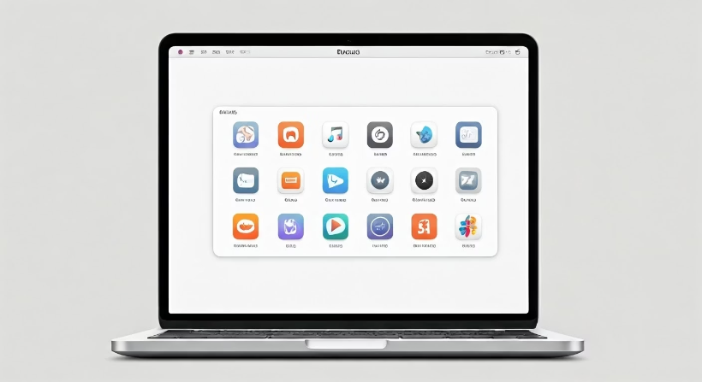
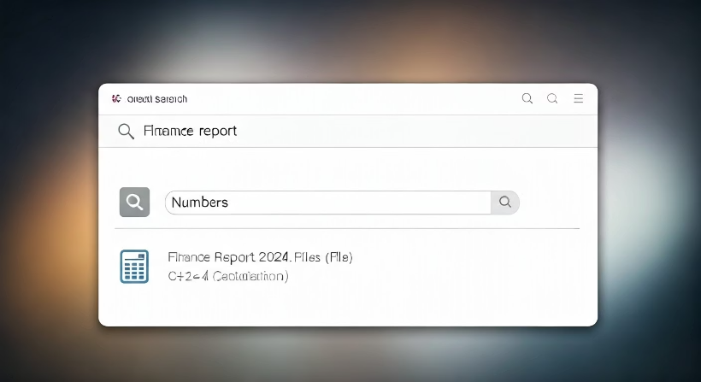
Launchpad and Spotlight
Launchpad
Spotlight Search
Launchpad shows all your installed apps. You can open it from the Dock or pinch with four fingers on the trackpad.
Spotlight Search lets you quickly find files, apps, emails, or even do calculations. Press
Command + Spacebar to open Spotlight.

Slide 6
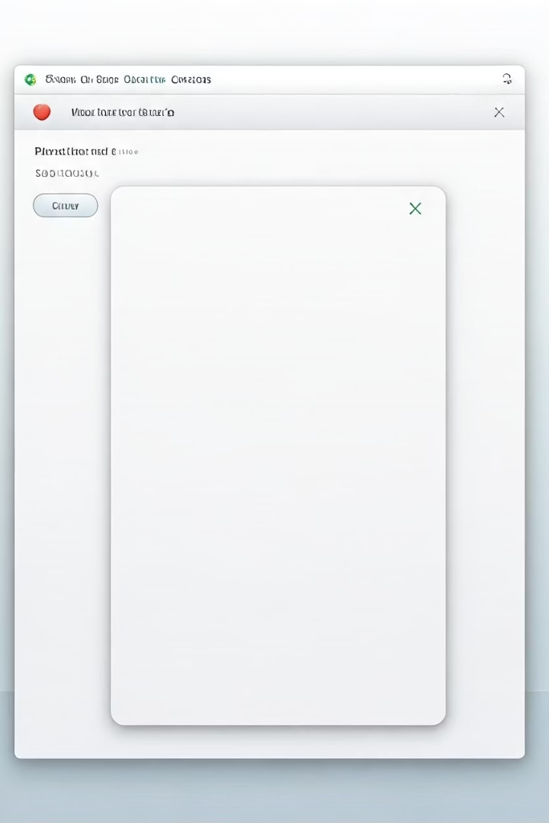
Using Applications
Opening Apps
Click an app's icon in the Dock or Finder to open it.
Window Controls
To close a window, click the red button on the top-left. To minimize, click yellow, and to maximize, click green.
Quitting Apps
Use Command + Q to fully quit an app.

Slide 7








System Settings
Network
Appearance
Configure Wi-Fi and network connections
Change wallpaper and display settings
Privacy
Users
Set privacy settings and security options
Add users and manage accounts
Go to the Apple menu > System Settings to change things like Wi-Fi, wallpaper, sound, or keyboard.
You can also add users, set privacy settings, and update your Mac here.

Slide 8





Gestures and Shortcuts
Trackpad Gestures
Keyboard Shortcuts
Copy & Paste
Command + C to copy
Use the trackpad for gestures like swiping between apps or zooming.
Learn shortcuts to improve efficiency
Command + V to paste
App Switching
Command + Tab to switch between apps

Slide 9






Saving and Organizing Files
iCloud
Use iCloud to store files online
Tags
Use Tags to categorize files
Folders
Save files in Documents, Desktop, or custom folders
Save files in Documents, Desktop, or custom folders.
Use Tags and folders in Finder to stay organized.
Use iCloud to store files online and access them from any Apple device.

Slide 10



Updating macOS
Open System Settings
Navigate to settings panel
Check for Updates
Go to General > Software Update
Install Updates
Download and install latest version
Go to System Settings > General > Software Update to check for the latest updates.
Keeping your Mac updated helps improve performance, security, and features.

Slide 11
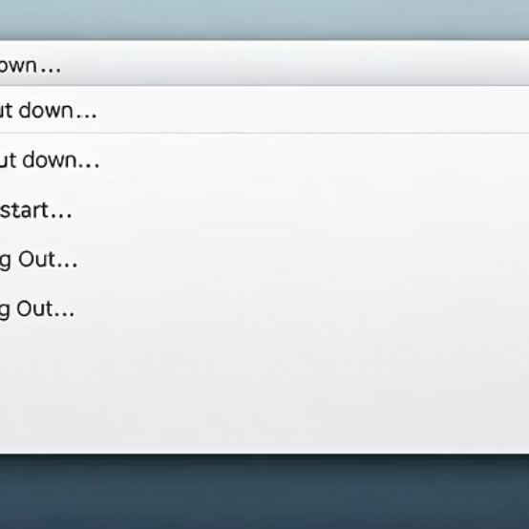
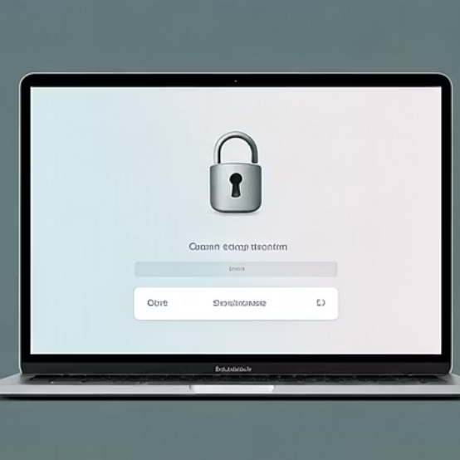

Shutting Down or Restarting
Click the Apple logo on the top left, then choose Shut Down, Restart, or Sleep.
You can also lock your screen from here.

