Slide 1
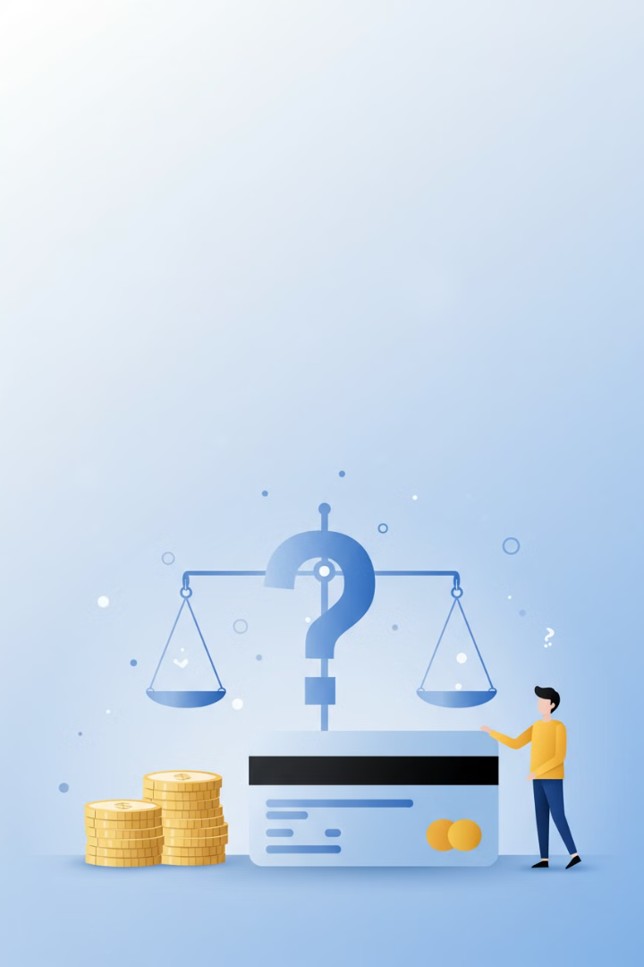

Credit Cards: Good or Bad?
Credit cards are a type of payment tool that allows you to borrow money from a bank or financial institution to make purchases. They can be very useful if used responsibly, but they can also lead to financial problems if misused. Let’s break down the advantages and disadvantages of credit cards to help you decide if they are good or bad for you.
by Ram N Java

Slide 2
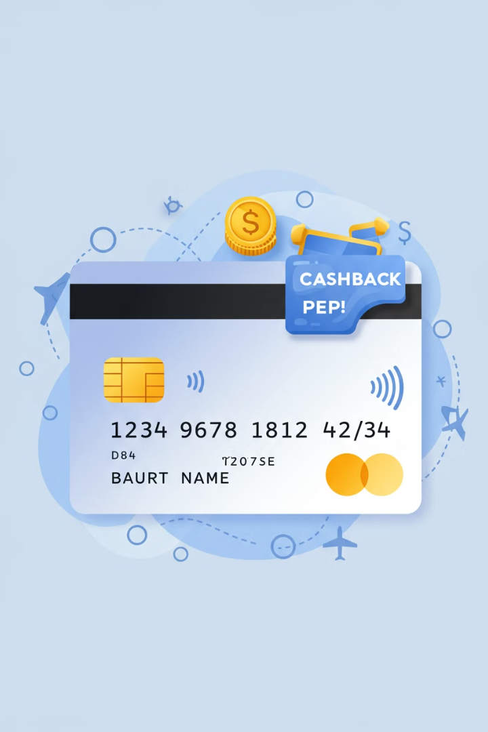
Advantages of Credit Cards
1
Convenience
2
Build Credit History
Credit cards are easy to carry and widely accepted for payments in stores, online, and even abroad.
Using a credit card responsibly helps you build a good credit score, which is important for getting loans, mortgages, or better interest rates in the future.
You don't need to carry cash everywhere.
3
Rewards and Benefits
Many credit cards offer cashback, reward points, or discounts on purchases.
Some cards also provide travel perks like free airport lounge access or travel insurance.

Slide 3
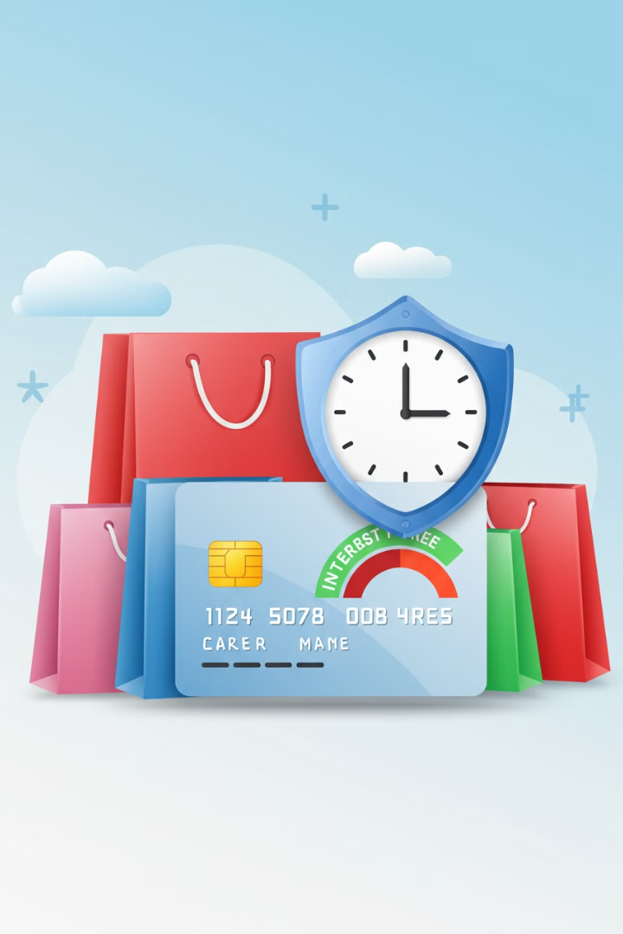



More Advantages of Credit Cards
Emergency Funds
Purchase Protection
Interest-Free Period
Credit cards can be a lifesaver in emergencies when you need money quickly.
Credit cards often come with fraud protection and warranty extensions on purchases, keeping you safe from scams or faulty products.
Most credit cards offer an interest-free period (usually 20-50 days) to pay back what you owe without extra charges.
Example: Paying for car repairs or medical bills.
If your card is stolen or misused, you can report it, and you won't be held responsible for unauthorized charges.

Slide 4




Disadvantages of Credit Cards
High-Interest Rates
If you don't pay your full balance on time, credit cards charge high interest rates, which can quickly increase your debt.
Debt Trap
It's easy to overspend with a credit card, leading to unmanageable debt if you're not careful.
Fees and Charges
Credit cards come with annual fees, late payment fees, and foreign transaction fees, which can add up over time.

Slide 5



More Disadvantages of Credit Cards
Temptation to Spend
Having a credit card can make it tempting to buy things you don't need, leading to unnecessary expenses.
2
Negative Impact on Credit Score
1
Missing payments or maxing out your credit limit can hurt your credit score, making it harder to get loans in the future.
Complex
Terms and Conditions
Credit card agreements can be hard to understand, with hidden fees or conditions that may catch you off guard.
3

Slide 6

When Are Credit Cards Good or Bad?
When Are Credit Cards Good?
When Are Credit Cards Bad?
Credit cards are good if:
Credit cards are bad if:
You pay your balance in full every month to avoid interest.
You overspend and can't pay back the money.
You use them to earn rewards or build credit.
You only make minimum payments, leading to high interest and debt.
You need them for emergencies or online purchases.
You use them for impulse purchases or things you can't afford.

Slide 7





Tips for Using Credit Cards Responsibly
Pay on Time
Always pay your full balance before the due date to avoid interest and fees.
Track Spending
Keep an eye on your spending to avoid overspending.
Set a Budget
Only use your credit card for purchases you can afford.
Avoid Cash Advances
Cash withdrawals on credit cards often come with high fees and interest rates.
Read the Fine Print
Understand the terms and conditions of your credit card to avoid surprises.

Slide 8
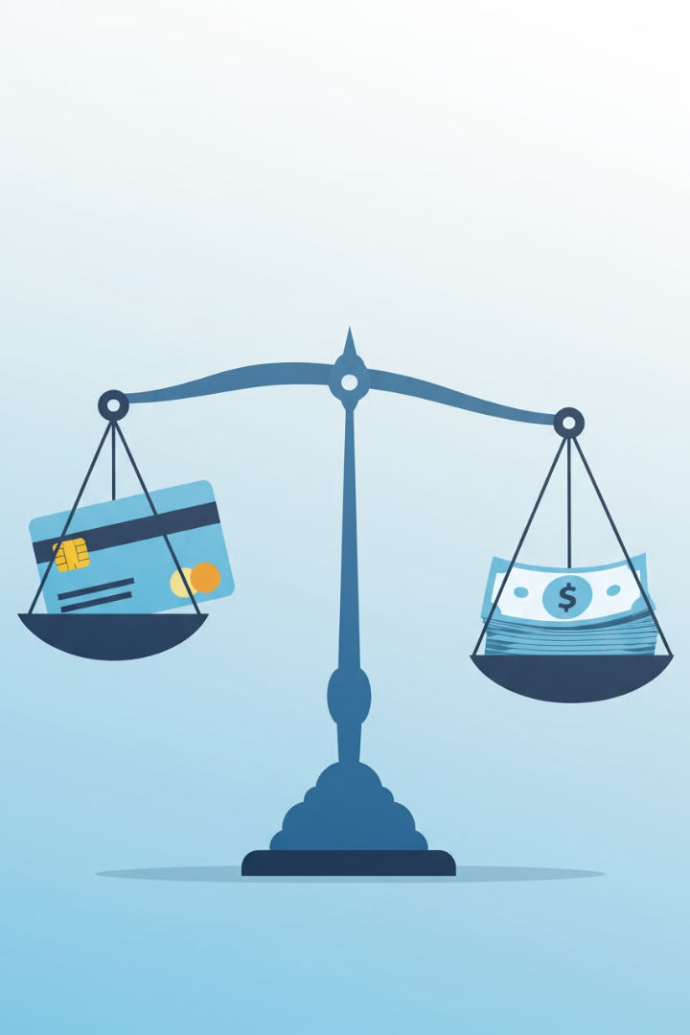
Summary
Good Use of Credit Cards
Bad Use of Credit Cards
However, they can also be bad if misused, leading to debt and financial stress.
Credit cards can be good if used responsibly, offering convenience, rewards, and financial flexibility.
Key to Responsible Use
The key is to spend wisely, pay on time, and avoid unnecessary purchases.

